Slide 1
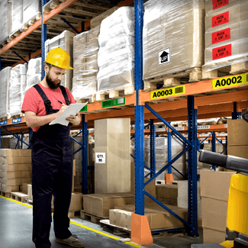
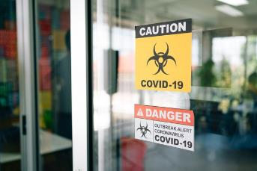
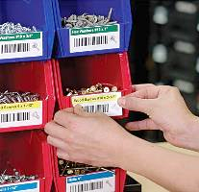
ColorWorks
Value Proposition and Applications
APR
2021
Product managers:
Andy Scherz
Andrew Moore
Bonny Rindahl

Slide 2


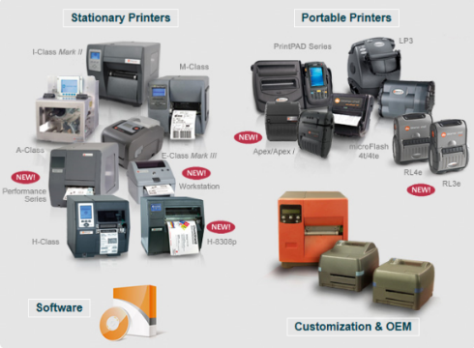



Market Well Served By Great Products
Wide – Narrow
Fast – Slow
Portable – Stationary
Heavy duty – Light duty
High cost – Low cost
But All Can Only Print Black and White

Slide 3
Limitations of Black Only Printing
Only two ways to drive attention:
  Text Size
  Font Style

Slide 4
Color Adds New Communicating Power
  Make key info pop
  Warn & Highlight

Slide 5
Value Proposition
Gap in the Market
Epson’s Value Proposition
Pre-printed labels are expensive, time-consuming to order, and there’s a lead time
Lead time not in own control
Ever-changing label, safety, and regulatory requirements → need to change labels and signs on the fly
Reduce labeling costs vs. purchasing pre-printed labels
Customize to the size, content, and color you want
No lead time
Improve operational efficiency and flexibility
Reduce errors
Notes:
This moment is propitious for labels. Why especially now? Labels before and labels after COVID but even more now and after since we’ve gone through a shake-up of monumental proportions in supply chains everywhere. Without a label a product isn’t finished and doesn’t ship. A prescription is not filled, etc. Preprinted labels are great (expensive inventory and all that) until your label converter is jammed with work doing toilet paper packaging cause that’s where the demand spiked, and his lead times are now stretched. But you can’t wait. So why not cut out a step in the chain and do your labels where you need them, when you need them?

Slide 6
In-Store:
Shelf Tags
Shelf Talkers

Slide 7
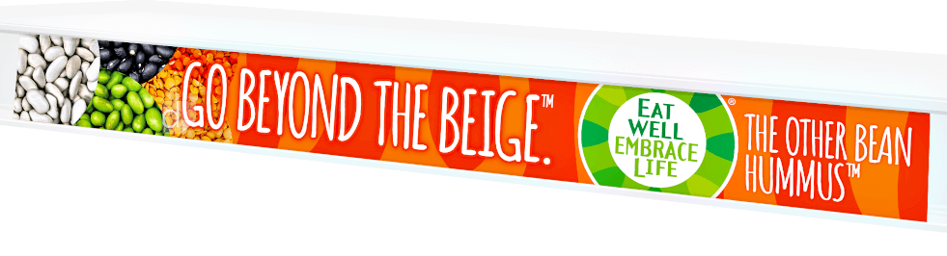
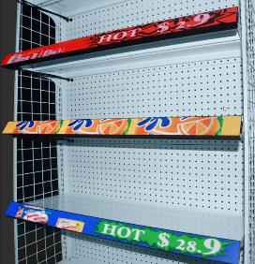

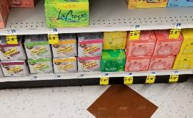

Shelf Tags Shelf Talkers
Long thin strips to label shelves in-store
Identifies product sections
Details specific product prices
Small tags highlight promotions in-store
Details specific discounts, coupons
Draws attention to focused products
Vivid Colors Draw Attention and Boost Store Image

Slide 8
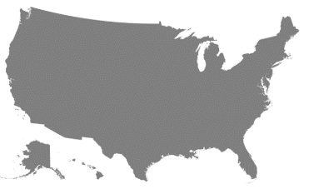


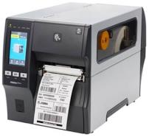
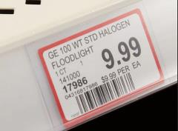

Process Today
TYPICAL THERMAL TRANSFER PRINTER
Previous technology mostly monochrome
Only way to enhance was to use pre-color media
HQ prints & distributes to stores
Problems:
  Central planning
  Distribution logistics
  Stores can’t change prices
  Stores can’t create special promotions
Problems:
Not visually appealing
Doesn’t draw attention to specific items
Poor brand image

Slide 9
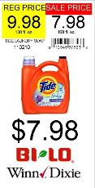

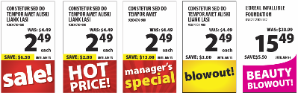

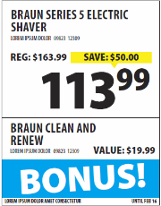
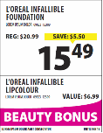
ColorWorks Solution
Easy in-store color printing
Create powerful color branding & promotion
In-store flexibility to change prices, promote items, reallocate shelf space
BLAND
IMPACTFUL

Slide 10













Images Help Customers Find Product
Helps Retailers Sell More
How easy can you find red shoe on right? Left?
Images required by virtually all large DYI stores
Shoes rapidly migrating to images on label

Slide 11
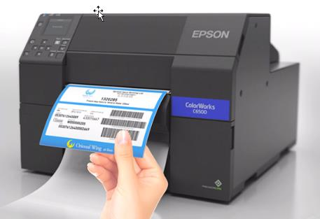
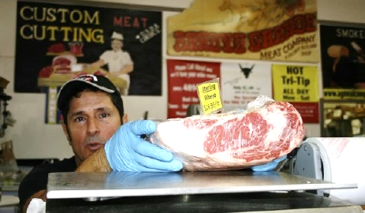
Epson 1st to Market Solution
Automatic Color Label Peeler
First color inkjet printer with peel and present feature
Faster production flow
Apply labels with gloves on

Slide 12
Healthcare
Retail Pharmacy
Mail Order Pharmacy
Institutional Hospital

Slide 13
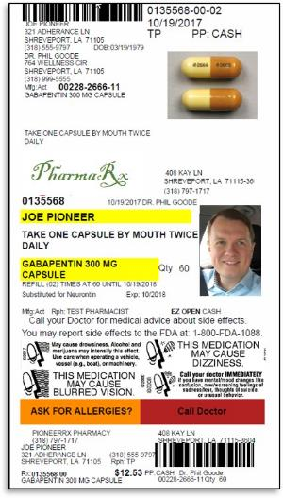
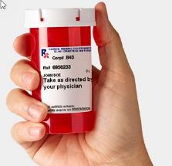
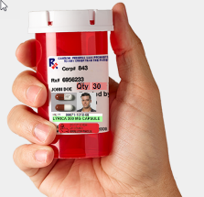
Retail - Pharmacy
Driver is improved patient safety
  Pictures identify medication and patient
  Automatic color coded warnings
Product looks customized and personal

Slide 14
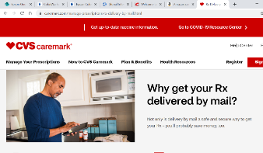
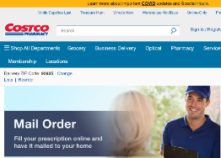
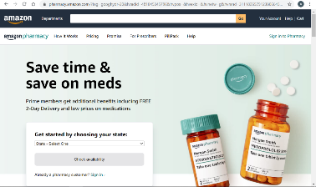
Mail Order & Internet Pharmacy
Global Internet Pharmacies expected to reach $191 billion by 2027*
Need label printers for batch operations
Millions of labels/ month
* Source: https://www.ihealthcareanalyst.com/global-internet-pharmacies-market/

Slide 15



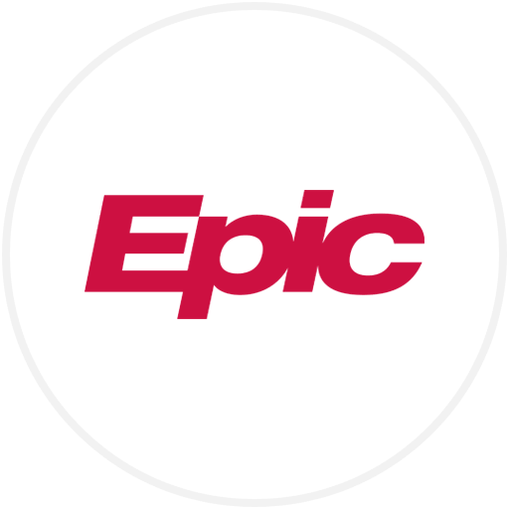



Institutional Hospital EHR Providers
EHR providers certify devices for institutional use, (i.e., scanners):
  Admitting
  In-Patient Pharmacy
  Lab

Slide 16
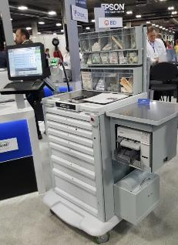
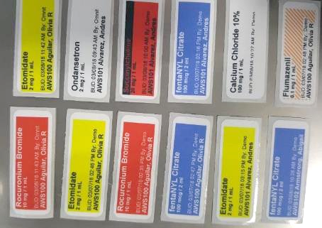
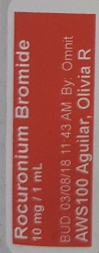

Hospital
Medical carts
Printer embedded on cart to print custom drug labels
Current major customers / prospects
  Aesynt – 514
  Omnicell – 509 (expect 5,000)
  BD CareFusion
Syringe labels
Color helps prevent errors
Print on demand as exact patient information entered
Each syringe labeled as prepared at cart
MEDICATION
COLOR CODE
EXACT DOSE
DR. ID
PREP TIME
PATIENT ID

Slide 17
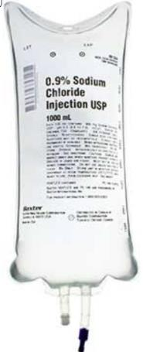
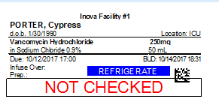
Hospital
Custom drug label
IV bag labels
Each mixture customized to specific patient
Color coding required for safety
Hospitals label thousands of IV Bags and syringes every week
Patient wristbands
Photo ID
Color highlights safety risks (e.g., allergies)
Hundreds shipped to VA

Slide 18
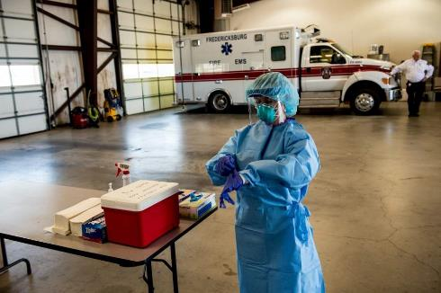
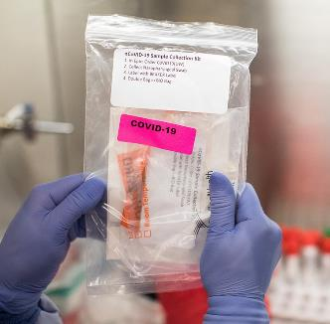
Test Kits
CDW sold 204 x C3500 printers for mobile COVID 19 testing sites in TX

Slide 19
Retail Store / Restaurants

Slide 20
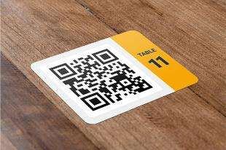
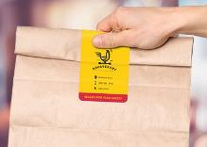
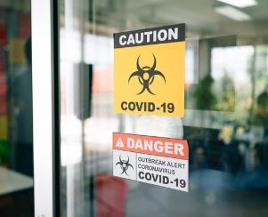
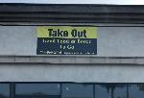
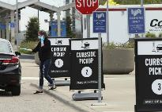
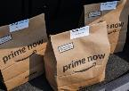

Retail Storefront & Restaurants
DURABLE QR CODES ON TABLES
CURBSIDE PICKUP LABELS
Identify recipient
Add branding, visual interest
Color codes for curbside, delivery, in-store
DURABLE COVID-RELATED SIGNS

Slide 21
Manufacturing / Warehouse / Logistics

Slide 22
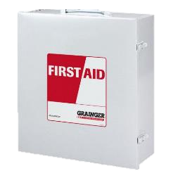
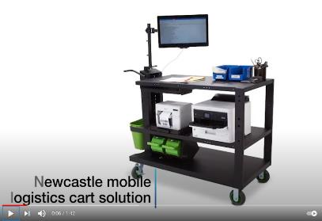


Manufacturing / Warehouse
Mobile cart
Mobile workstations: create paperwork and labels anywhere in warehouse
  Reduce cycle time
  Reduce labeling errors
  Improve productivity
Facility Signs/ Labels
Safety signs and labels
Warehouse rack labels
Carton labels
Contains: PC, monitor, C3500 label printer, BIJ printer, barcode scanner
Play video
Notes:
Mobile workstations are a great way to increase efficiency in manufacturing or warehouses. One example is the Newcastle mobile cart, which was pioneered by our BIJ team. These carts include a PC, monitor, C3500, BIJ printer, and barcode scanner. In warehouses, one of the major forms of inefficiency is walking back and forth to get what you need. Plus, when you do that, it also introduces risk of mistakes. Now, they have everything they need right where they need it, improving quality and productivity. We can play this short video.
Another application in manufacturing or warehouses is safety signs and labels. If you look for them, you would be able to spot hundreds of signs and labels around the facility – reminding operators to put on safety glasses, or showing caution, or labeling first aid kits. There are hundreds of different labels, in color, in different sizes, with different messages. Today, most of these companies order pre-printed signs and labels from an industrial supply catalog. They pay $3-10/label. But ColorWorks gives a better solution – printing whatever they need, at a lower cost per label, and getting it immediately. Besides safety signs and labels, ColorWorks can also be used for warehouse rack labels or carton labels.

Slide 23
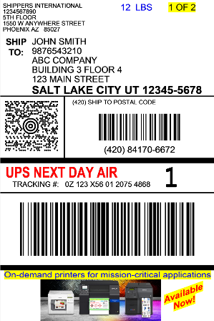


Manufacturing / Warehouse
Lean / Bus Process Improvement
Warehouse putaway labels
Reduce picking/ shipping errors
Bin labels
Find needed part faster → Improve efficiency
Shipping Labels
Shipping label with color ad
Colorized elements to draw attention
60% of surveyed consumers would likely make a repeat purchase after a personalized experience.*
Play video
* Source: https://segment.com/blog/announcing-the-state-of-personalization-2021/
Notes:
In order to survive in the market, pretty much every manufacturing company or warehouse has implemented a process improvement program, such as Lean. ColorWorks printers come in really handy here. One example is with bin labels. They can print color coded labels with pictures of the part on the label, and then it makes it much easier and faster for an operator to find what they’re looking for.
Another example is colorizing warehouse putaway labels. Imagine if you had these labels in black and white only. You have a pallet of part number 675141 but somehow, part number 675147 got mixed in and this pallet of materials is going out to a construction site. But no one notices, because with black and white, everything looks the same. You ship it out, the mistake is discovered at the site, and there’s not enough of the right material to finish the job. Imagine all of the wasted time and expediting costs that is incurred when this happens.
Now, what if you had ColorWorks? Part number 675141 is always coded in red and 675147 is coded in blue. If you had a pallet, you would immediately notice that something is wrong, and all of those problems would be avoided.
Now let’s move to shipping labels. Imagine at the bottom of a shipping label, you were able to put a color ad. Everyone checks the shipping label when they receive a package. This is prime real estate for an ad. The box is coming from a company that the customer just bought from, and it shows another product they may be interested in or a coupon for their next order. This is cross-selling in all its glory. And with just a few new sales from that color ad, you’ve earned your return on investment with your ColorWorks printer. Plus, according to an Infogroup survey of 1,500 consumers, 44 percent said they would switch to a brand that better personalizes its marketing message. Plus, 44 percent of consumers surveyed said they would likely make a repeat purchase after a personalized experience.
Even without an ad, a shipping label really benefits from color elements to highlight degree of priority.
Now let’s play a short video that showcases our flagship product, the C6000 series, in industrial applications.

Slide 24
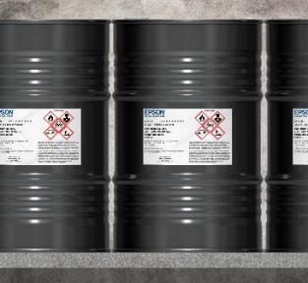
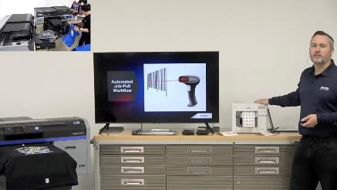
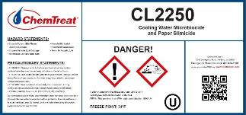
Manufacturing / Warehouse
Chemical drum labels
Chemical drum labels must comply with GHS requirements for color pictograms and durability
Garment printing
High volume T-shirt printing using barcode workflow automation
Unique heat tolerant feature of ColorWorks
Thermal labels unusable after going through hot oven
Notes:
If you notice a company has chemical drums, that’s another place ColorWorks can be deployed. Our printers can create labels that meet GHS requirements. GHS requirements is a safety standard, requiring color and durability on drum labels.
Lastly, Tim Check last week created a video showcasing high volume T-shirt printing with his SureColor F3070 and a C3500 printer creating the barcodes. Note that thermal printers cannot be used here; they die after going through a hot oven. But our inkjet labels withstand heat and other elements very well.

Slide 25
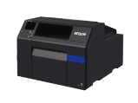



Product Lineup
Attribute | C6000 A/P | C6500 A/P | C7500G | C7500 | C4000
MSRP | $2,580-3,050 | $3,500-3,980 | $8,819 | $8,819 | $1,919
Print speed (inches per second) | 4.7 (4” wide) | 3.4 (8” wide) | 11.8 | 11.8 | 3.9
Print width maximum | 4.25” | 8.34” | 4.25” | 4.25” | 4.25”
Max Resolution | 1200 x 1200 | 1200 x 1200 | 1200 x 600 | 1200 x 600 | 1200 x 1200
BS5609 | Yes | Yes | Yes | Yes | Yes
Internal media support | 8” roll | 6” roll | 8” roll | 8” roll | 4” roll
Peeler | Yes | Yes | No | No | No
ESC/Label Command | Yes | Yes | Yes | Yes | Yes
Remote Mgmt | Yes | Yes | No | No | Yes
Print speeds are based on the print engine speed only. Total throughput time for any label depends on factors including label size, file size, print resolution, speed of data transmission and other factors.
MSRP prices effective 10/20/2019

Slide 26

Spotlight on C6000 Series Printers
Video:
Epson C6000 Series – Take the Tour
New video coming soon!

Slide 27
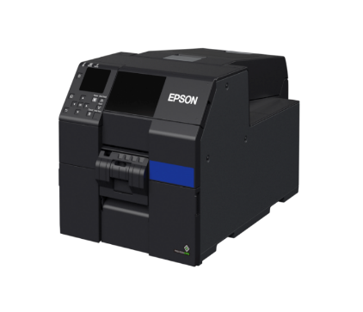
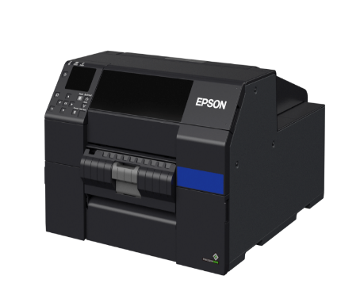
C6000/ C6500 Feature Overview
Reliable performance – Epson engineered for demanding mission critical applications
First printer specifically designed as a color upgrade to thermal transfer
Fast time to first label – Fast throughput up to 5 in/sec
Astounding image quality – up to 1200 DPI with variable droplet sizes
Seamless integration – ZPL-II, Major Middleware, SAP®, Windows®, Mac®, Linux
Remote Printer Management – ideal for managing large fleets over network
Notes:
For the 1st time in the market, there is an industrial color label printer – the C6000 series, which have the reliability and features needed for industrial use.
The C6000 series was specifically engineered and designed to handle the tough, mission critical warehouse or manufacturing environment that is dominated by thermal printers.
Print speeds are comparable to thermal printers, at up to 5” per second.
The C6000 series is not limited to printing standard warehouse labels. It can still do the beautiful boutique labels at 1200 dpi resolution.
These printers integrate easily into any operating system or label application, including BarTender, Codesoft, NiceLabel, etc.
We also have remote printer management for companies that need to manage a large fleet of printers over a network.
The C6000 series printers can do all the things those thermal printers can do, and it can do it with color.

Slide 28
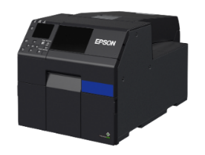
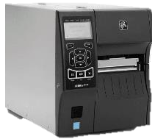


First color inkjet printer designed to replace thermal transfer
Designed to plug into the traditional thermal transfer market providing the features, compatibility, and performance users need while delivering stunning "product label" image quality at a comparable price.
Zebra ZT410
$1,600
Epson C6000
$2,580
Notes:
This compares one common thermal transfer printer with our C6000A model. Prices are within the same ballpark, but the C6000A has the added capability of colorizing any label.

Slide 29
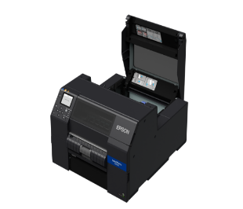
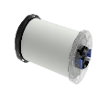



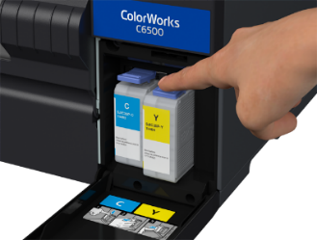

Easy to Setup and Use
Versatile media loading from all sides
Fast easy consumable changes
Full graphic control panel
Blue user touch points
Notes:
We’ve used thermal printers before, and the Epson C6000 series is so much easier to operate. To load the media, you simply drop the spindle in and feed the leading edge in. To change out the ink cartridge, you simply press the blue lever, pull it out, and push the new one in until it clicks into place. To change a thermal ribbon, you have to wind the ribbon through all of these tiny rollers without crinkling the ribbon. It takes a lot of operator skill.
And, the printer has a full graphic control panel in the front that will show you ink levels, media level, and let you perform many different functions.

Slide 30



C6000 Print Quality Comparison
Zebra ZT410 at 14 ips
Zebra ZT410 at 2 ips
EPSON C6500A at 4.7 ips
Notes:
The difference in print quality between thermal printers and the C6000 series is remarkable.
On the left is a label printed from a common thermal printer, the Zebra ZT410, running at 14 ips. The print quality is terrible and those barcodes come out so badly that they are not scannable.
We had to slow the printer way down in order to improve print quality to get the barcode to scan. The middle shows how that label comes out at 2ips.
On the right is the C6500A at the max speed setting. This is the highest speed, lowest print quality setting, and it comes out way better than anything the thermal printer can do.

Slide 31



C6000 Bar Code Quality Comparison
High quality bar codes in either ladder or picket fence modes for mission critical jobs
Zebra ZT410
14 IPS
Zebra ZT410
2 IPS
EPSON C6500A
4.7 IPS
Printed on matte thermal transfer media at best settings using iimak FH wax ribbon
Printed on plain non-inkjet paper in lowest quality mode
Notes:
Here’s a closeup of what the barcode looks like under those same conditions– 14 ips, then 2 ips, then Epson C6500 on plain paper (no fancy inkjet coating) with lowest quality mode.
For mission critical jobs, barcodes must be scannable. So print quality is important.

Slide 32



C6000 Text Quality Comparison
Huge improvement in readability for small text and details
Zebra ZT410
14 IPS
Zebra ZT410
2 IPS
EPSON C6500A
4.7 IPS
Printed on matte thermal transfer media at best settings using iimak FH wax ribbon
Printed on plain non-inkjet paper in lowest quality mode
Notes:
Here’s a look at how text prints out, under those same 3 conditions.
3 point font is very, very small, but the Epson printhead technology maintains the readability of the text even at such a tiny font size. Again, this was done at max speed, lowest quality mode, on plain paper.

Slide 33

Competitive operating costs
Ink cost is comparable to thermal transfer.
For similar durability, ColorWorks costs less. Only bottom end of durability costs less for thermal.
Thermal transfer ribbon prices based on published prices in Zebra ZipShip Ribbons price list May 1, 2019
ColorWorks pricing based on printing the ISO standard color test suite in Plain and Matte modes. 2X ISO is cost to double the density of the ISO patterns. 2X ISO equals to a typical GHS label
Notes:
Now you might be wondering – there must be a catch somewhere. The ink cost must be higher. But that’s not the case.
This graph compares the printing cost of various thermal transfer ribbons to Epson’s inkjet printing costs.
Wax ribbons are at the lowest price point, but even Zebra says on their website that these wax ribbons won’t stand up to chemicals or abrasion.
If you need moderate durability, you need a wax/ resin ribbon, which ranges from 1 to 1.5 cents per label for the ribbon cost.
Epson ColorWorks is on the right, and we’ve given a few options here. If you’re printing on a synthetic label with a normal ink density, the ink printing cost is only 0.65 cents per label. This label has excellent durability, has color, and is actually cheaper than a thermal label with moderate durability and only black.
Let’s say you are printing a boutique or GHS label and need double the ink density. Even then, the ink printing cost is about the same as thermal.
The 2 bars on the far right of the chart show the ink printing cost on matte paper, which lays down more ink.
Overall, the printing costs with color inkjet are comparable to thermal transfer ribbons, but inkjet provides much better durability.

Slide 34
Thank you
epson.com

