Slide 1
Color label printing opportunities within hEalthcare
Andy Scherz
MAY 2020

Slide 2


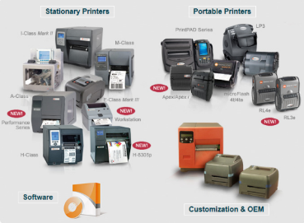



Market Well Served By Great Products
Wide – Narrow
Fast – Slow
Portable – Stationary
Heavy duty – Light duty
High cost – Low cost
But All Can Only Print Black and White

Slide 3


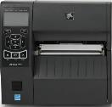
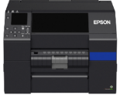


Epson Introduces Color Solution Ready to Drop Straight Into Action
Add a few data mods to colorize
Plug-n-Play direct ZPL II printing
ZPL II capability standard
Customer can start monochrome and migrate to color as needed
Makes customer trials easy as they don’t have to modify programming to test

Slide 4
Color Adds New Communicating Power
  Make key info pop
  Warn & Highlight

Slide 5
Color can boost safety
  GOOD
  BETTER
  BEST
The Allergens Pop

Slide 6
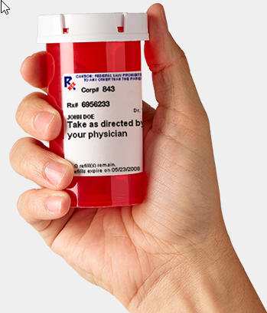

Safety & Value Add
Patient safety is important
Medication errors significant cause of injury
Can the label be improved to help reduce errors?

Slide 7


Safety & Value Add
Color draws attention to important data
Photos make identification easier
Label is easier to understand
Computer system automatically draws all elements reducing human error
Product looks customized and personal

Slide 8
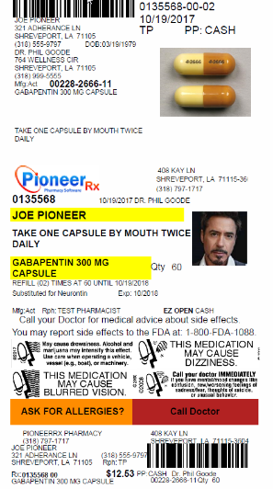
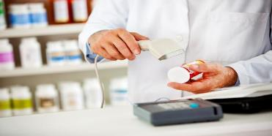
Retail - Pharmacy
Driver is improved patient safety
  Pictures to clearly identify medication and patient
    Helps eliminate errors among family members
  Automatic color coded warnings
Targeted at retail pharmacy

Slide 9
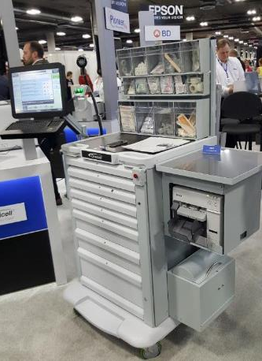
Medical Hospital – Custom drug label
Printer embedded on cart
Needs small footprint
Must print small labels
Medical grade power supply
Short print runs and low volume
Epson engages in direct sales

Slide 10
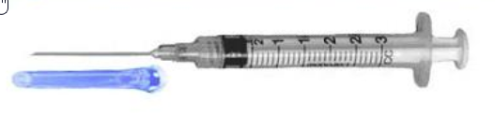
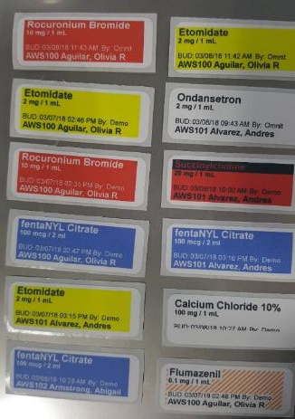
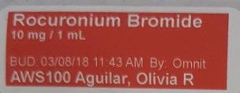
Prints Syringe Label Dynamically
Color helps prevent errors
Print on demand as exact patient information entered
Each syringe is carefully labeled as prepared at cart
MEDICTION
COLOR CODE
EXACT DOSE
DR. ID
PREP TIME
PATIENT ID

Slide 11
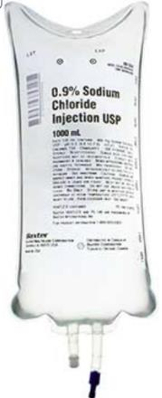
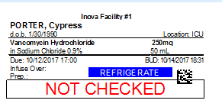
Medical Hospital – Custom Drug Label
IV bag labels
Each mixture is custom to specific patient
  Cannot be pre-printed
  Color coding required for safety
Requires strong tie to IT system for correct label contents

Slide 12
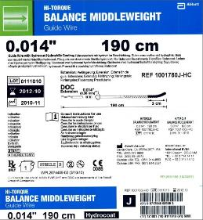
Medical Devices Demand Color
Epson ColorWorks printers:
Effortlessly handle variable color content, custom label designs, diverse sizes, and evolving requirements
High resolution images, barcodes, and text
Eliminate pre-printed labels
BS5609 certified labels last under extreme conditions
Connectivity with required enterprise software
Smooth integration into production workflow with its ZPL II, I/O port, and peeler features
Notes:
Customer Insight: [What is the customer dealing with? Painpoints?]
Customer Benefit: [What does the customer want to be able to do?]
Gap in the market: What’s the problem with current solutions? Why does status quo not work? What is the market need?
Epson’s Value Prop: Why does our solution fill the gap in the market?
What makes us special/different?

Slide 13
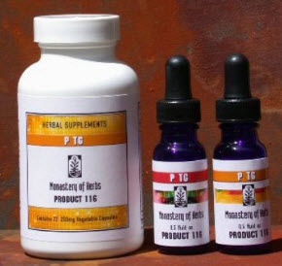
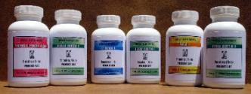
Nutraceutical and Supplement Labels
Trend from major to boutique brands
Increasing SKU count & smaller runs
Product requirements
  High print quality
    C3500 limited by print quality
    C7500 limited by size
  Color matching and image control
    C7500GE supports with Wasatch
    C3500 not available
  Full bleed
  No need for complex system integration or remote management – good fit for today’s products
End user prefers in house production
Cost per label very important

Slide 14
Wrist ID Bands
Photo ID
Color highlights of safety risks
  Allergies
  Falls
Hundreds shipped to VA

Slide 15
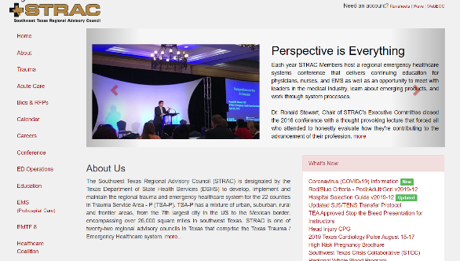
Color Enables Fast Reaction
CDW sold 125 C3500 printers to aid in special Covid-19 testing application

Slide 16
In-House Pharmacy Value Proposition
Industry Errors:
Journal American Pharmacists Association - 2009
  “Dispensing errors are common in hospitals and nursing homes
  as well as in community drugstores.”
US Pharmacist.com 2008
  "The typical retail pharmacist admitted to making an
  average of 2.5 errors during the previous two-month period,
  and 8% believed that they made more than six.”
J Am Pharm Assoc. 2003
American Pharmacists Association 2003
  “Dispensing errors are a problem on a national level, at a rate of about 4 errors per day in a pharmacy filling 250 prescriptions daily. An estimated 1.5 million errors occur during the filling of 3 billion prescriptions each year.”
Journal American Medical Association Jan 1997
  Average cost of Adverse Drug Event is $5,857
  In-House Pharmacies
Epson Confidential

Slide 17





Product Selector
Attribute | C6000 | C6500 | C7500G | C7500 | C3500 | C831
MSRP | $2,580-3,050 | $3,500-3,980 | $8,819 | $8,819 | $1,919 | $2,070
Print speed (inches per second) | 4.7 | 3.4 | 11.8 | 11.8 | 3.3 | 2.5
Print width maximum | 4.25” | 8.34” | 4.25” | 4.25” | 4.1” | 8.0”
Resolution | 1200 x 1200 | 1200 x 1200 | 1200 x 600 | 1200 x 600 | 720 x 360 | 720 x 720
BS5609 | Yes | Yes | No | Yes | Yes | Yes
Internal media support | 8” roll | 6” roll | 8” roll | 8” roll | 4” roll | None
Rear media feed support | Ext. Roll & fanfold | Ext. Roll & fanfold | Ext. Roll & fanfold | Ext. Roll & fanfold | Ext. Roll & fanfold | Tractor feed & Ext. Roll
Time to first print | Near instant | Near instant | 10-15 seconds | 10-15 seconds | Near instant | Near instant
High gloss media | Yes | Yes | Yes | No | Yes | Yes
Semi gloss media | Yes | Yes | Yes | No | Yes | Yes
Matte media | Yes – less black | Yes – less black | Yes – less black | Yes | Yes | Yes
Peeler | Yes | Yes | No | No | No | No
MSRP prices effective 10/20/2019

Slide 18
Current Sales Challenge
How do you convince a customer to replace all their old B&W printers with new B&W printers?
Will new printer do anything better? No
Will it save them time or money? No
Will it help improve their efficiency? No
Will it help grow revenue? No
Will it cost a lot? Yes
It’s a Tough Value Proposition to Develop

Slide 19
New Sales Opportunity with Epson
Offer to improve customer’s business with color:
Eliminate waste of pre-printed labels
Color code to reduce errors
Add pictures to reduce errors and help ID products
Improved branding to grow sales
Enable private brands and customization
Eliminate hassles of ribbons and thermal transfer
Epson Offers Reasons to Flip the Base

