Slide 1

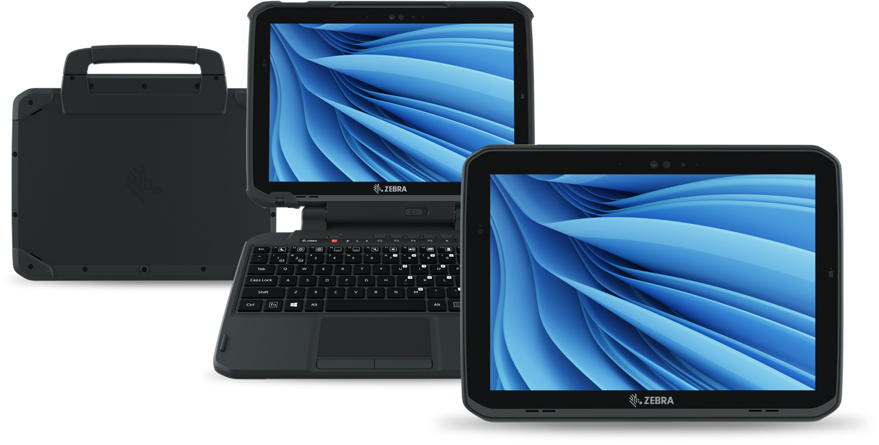
ET80/ET85
Rugged 2-in-1 Tablet
With You. For You. For Them.
May 12, 2025

Slide 2
Agenda
Why Zebra?
The Market Reality… and Changing the Game
Vertical Markets
Unique Benefits
Key Features
Security and Services

Slide 3
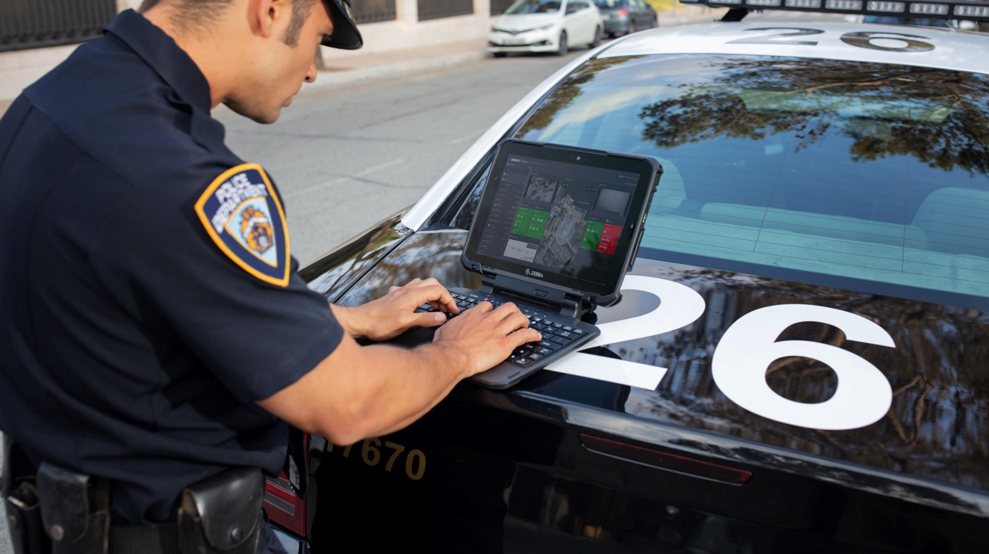
Why Zebra?

Slide 4










Why Zebra
Extensive Reach
Scalable to meet any
enterprise demands
Leader Status
Gartner Magic Quadrant for Indoor Location Services — Worldwide
Our People
Make the Difference
Channel
Accolades
$5.6B
Global Sales
#1
128+ offices
in 55 countries
Rugged
Mobile Computing
5,300+ US and INTL
patents issued and pending
Data Capture
9,800+
employees worldwide
Barcode Printing
10,000+ channel
partners in over 180 countries
Mobile RFID
$567M+ R&D
~10% of Sales
Sources: VDC Research and Zebra analysis (f#1 market share), Gartner, Inc., "Magic Quadrant Indoor Location Services, Global," Tim Zimmerman, Annette Zimmermann, 13 January 2020 (Leader Status Status)
4

Slide 5
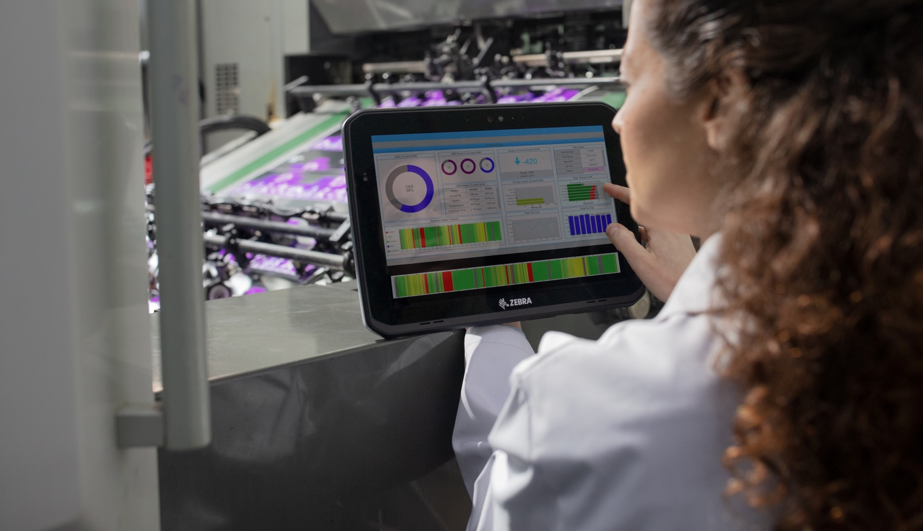
The Market Reality…
and Changing the Game

Slide 6
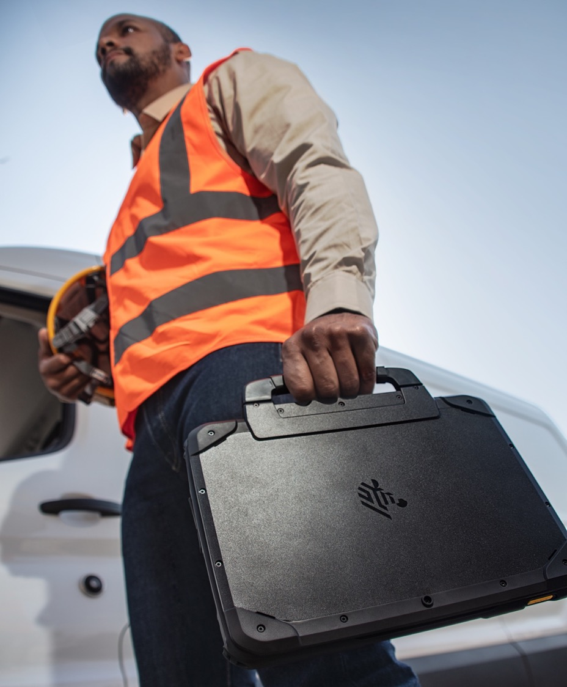

Your work is fundamental
to your community.
People depend on you.
  You’re always in motion, overcoming obstacles, handling urgencies and solving problems. Time is essential and trust is critical.
The stakes are high.
Though your determination remains unquestioned, sometimes your mobile technology isn’t up to the task.
ZEBRA TECHNOLOGIES

Slide 7



It’s time to empower your best work
with the versatile, rugged 2-in-1 tablet that’s built to perform at the highest level,
like you
Sleek, portable and built to help you do the most – on the plant floor, in a vehicle and in the field – for those who depend on you…
A rugged 2-in-1 tablet that’s flexible and powerful with advanced wireless connectivity to help you take on whatever your day holds …
Tailored to work the way you work best with a touchscreen, keyboard or both to capture information and input data anywhere …

Slide 8
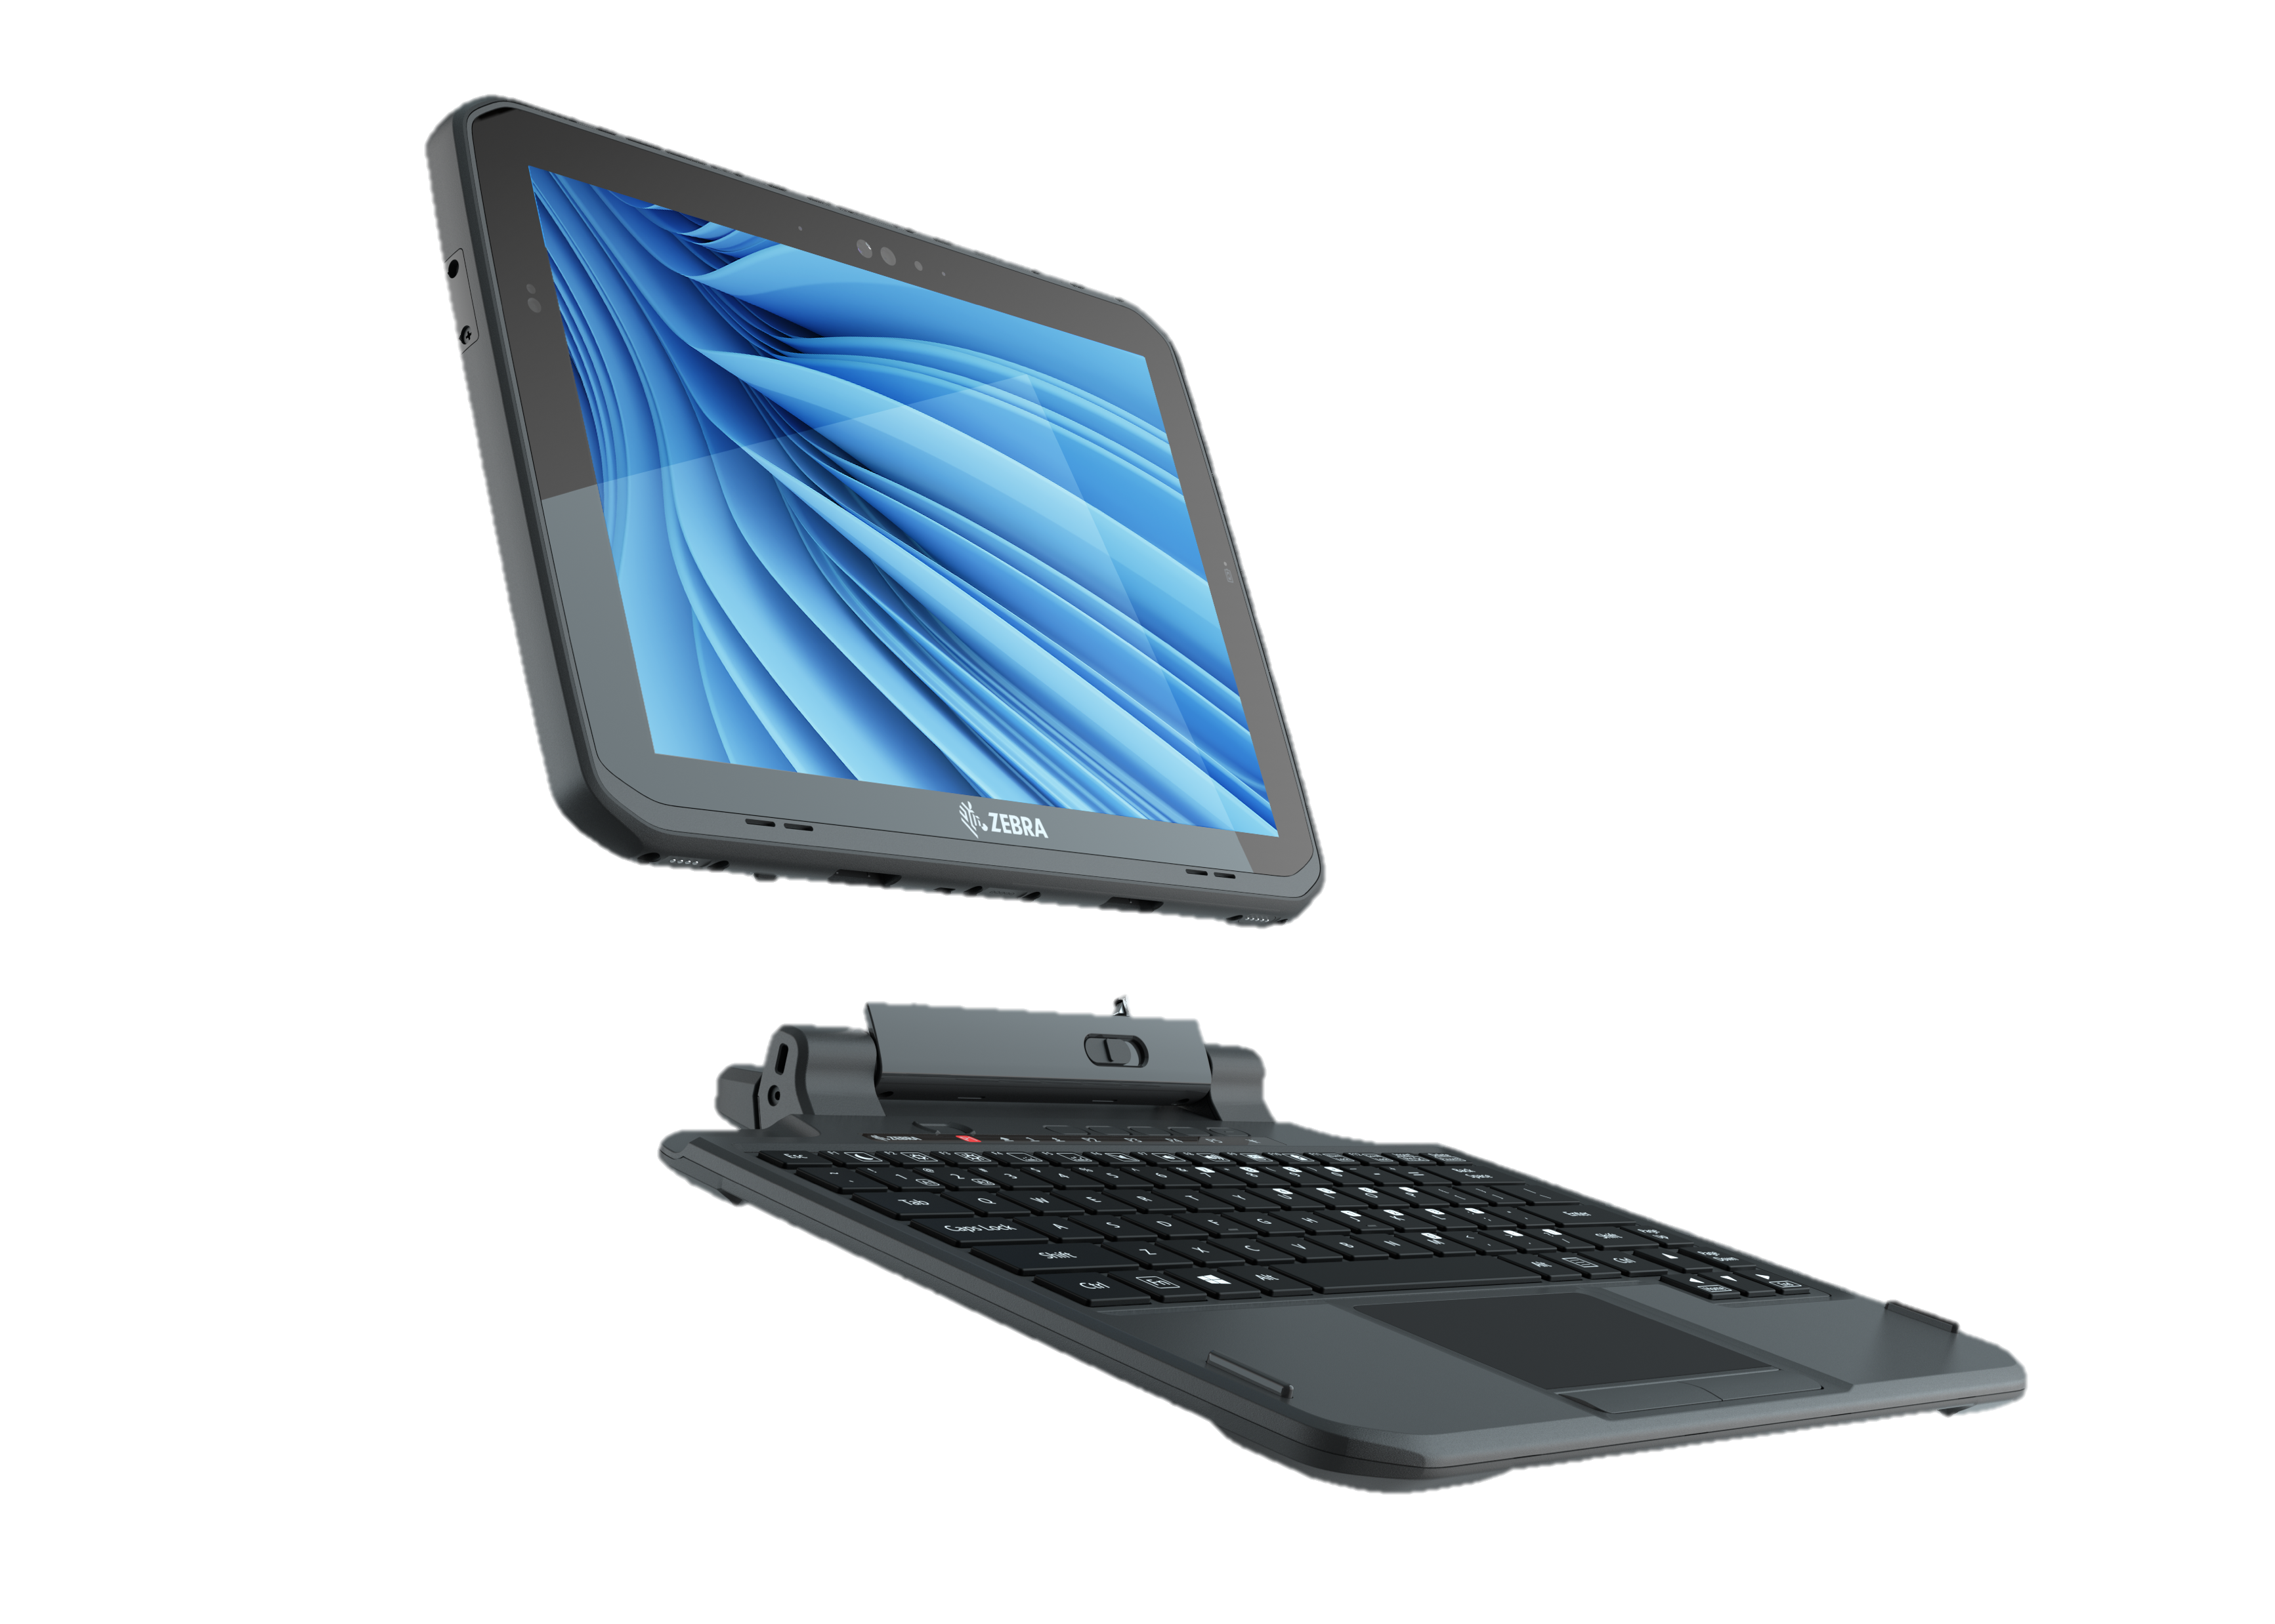
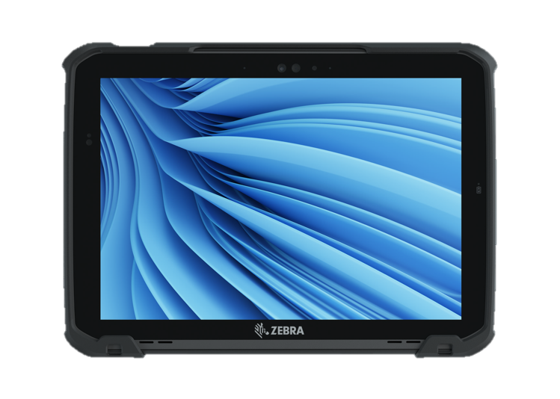
Introducing the
  ET80/ET85
    The device you can trust so you can serve the people who depend on you. Made for the difference you make.

Slide 9
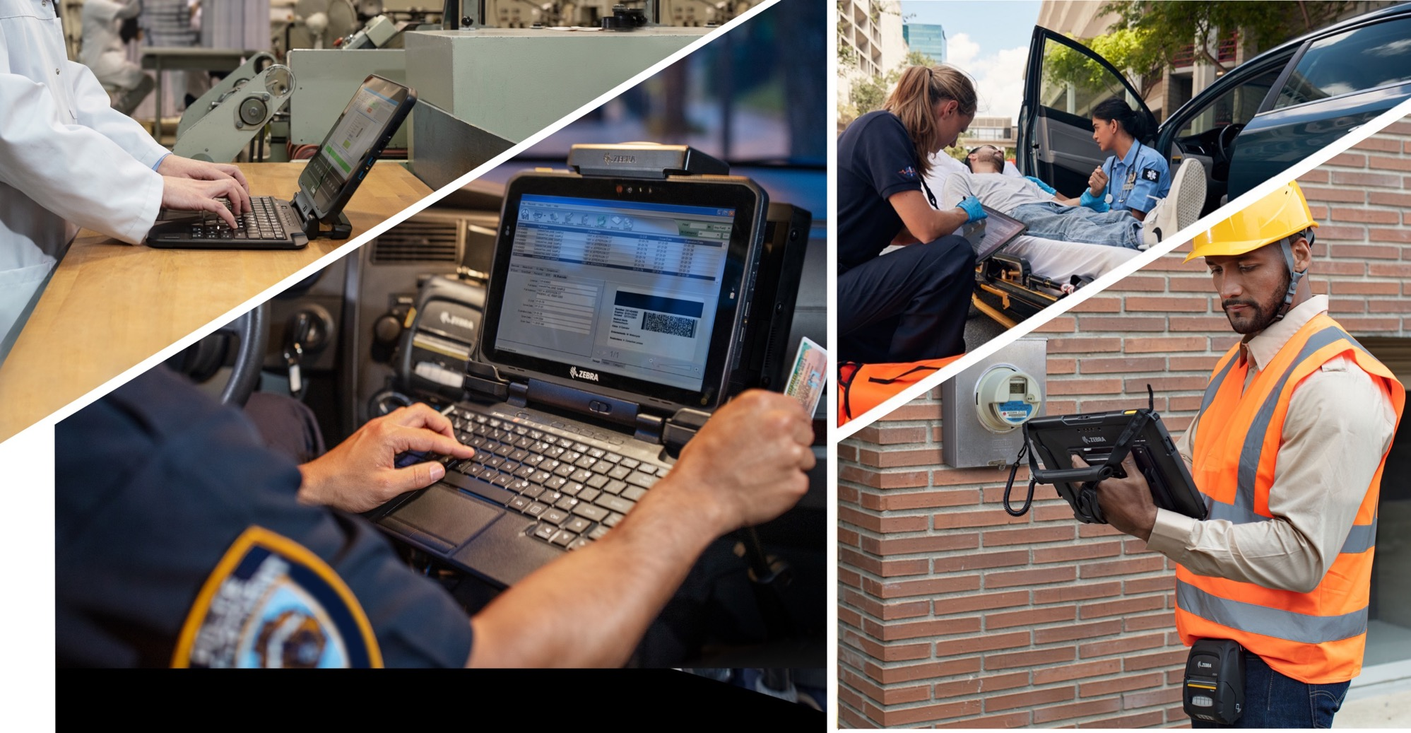
Vertical Markets

Slide 10

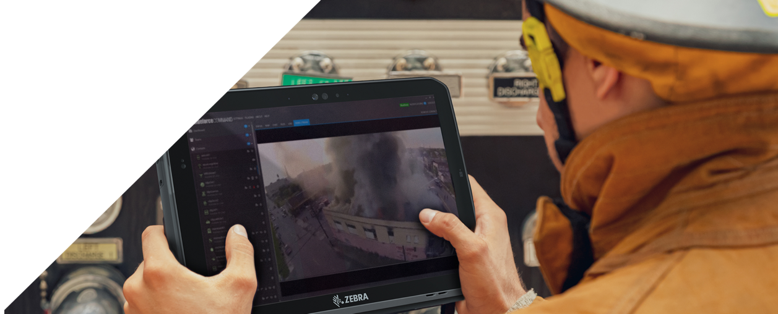
Applications
Verticals
State and Local Government/Public Safety
Applications:
Routing/dispatch communications
Personnel tracking
Incident reporting
E-Citation
Records management
Mobile incident command
Inventory management
Patient care reporting

Slide 11
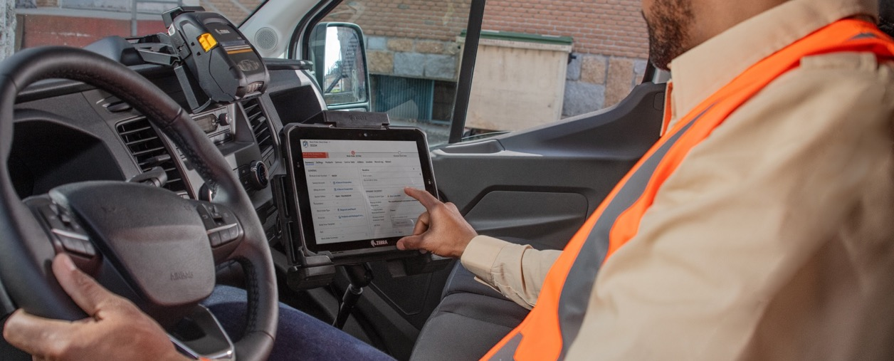

Applications
Verticals
Utilities/Critical Field Service
Applications:
Routing/dispatch communications
Personnel tracking
Emergency Repairs
Mobile work order management
Safety inspection and compliance
Meter reading
Remote assistance

Slide 12
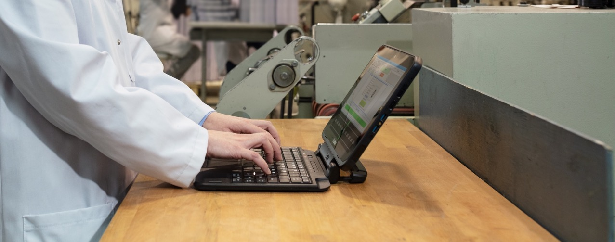

Verticals
Manufacturing
Applications:
Plant management
Mobile HMI
PLC programming
Communications
Maintenance repair and overhaul
Quality assurance
Forklift operations
Specialized (clean room, pharma, etc.)

Slide 13
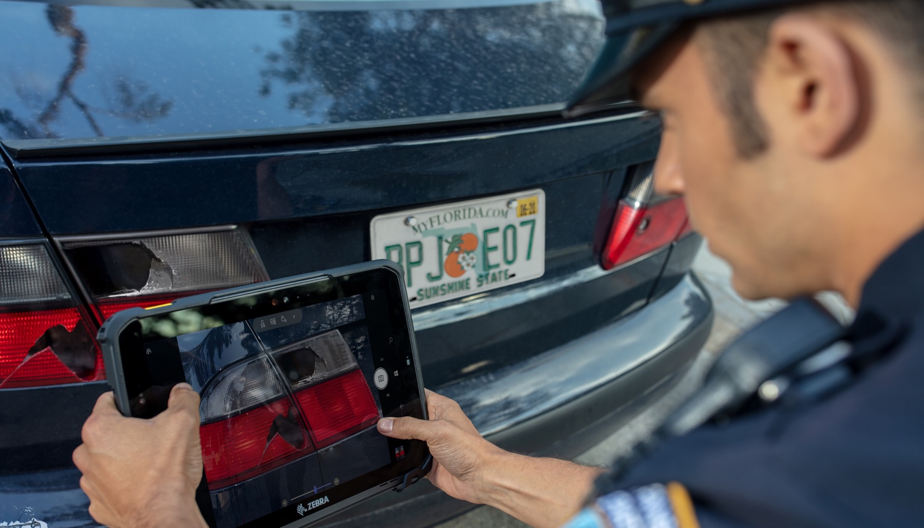
Unique Benefits

Slide 14
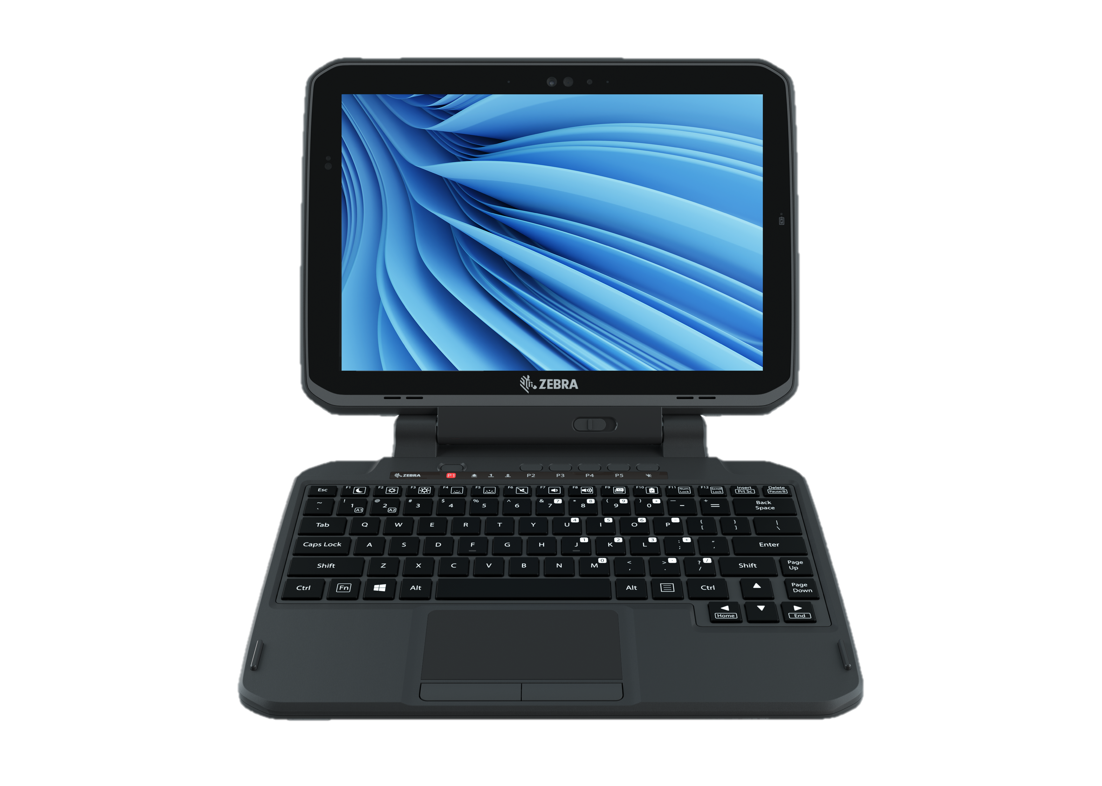
How does the ET80/ET85 stand out from the rest?

Slide 15
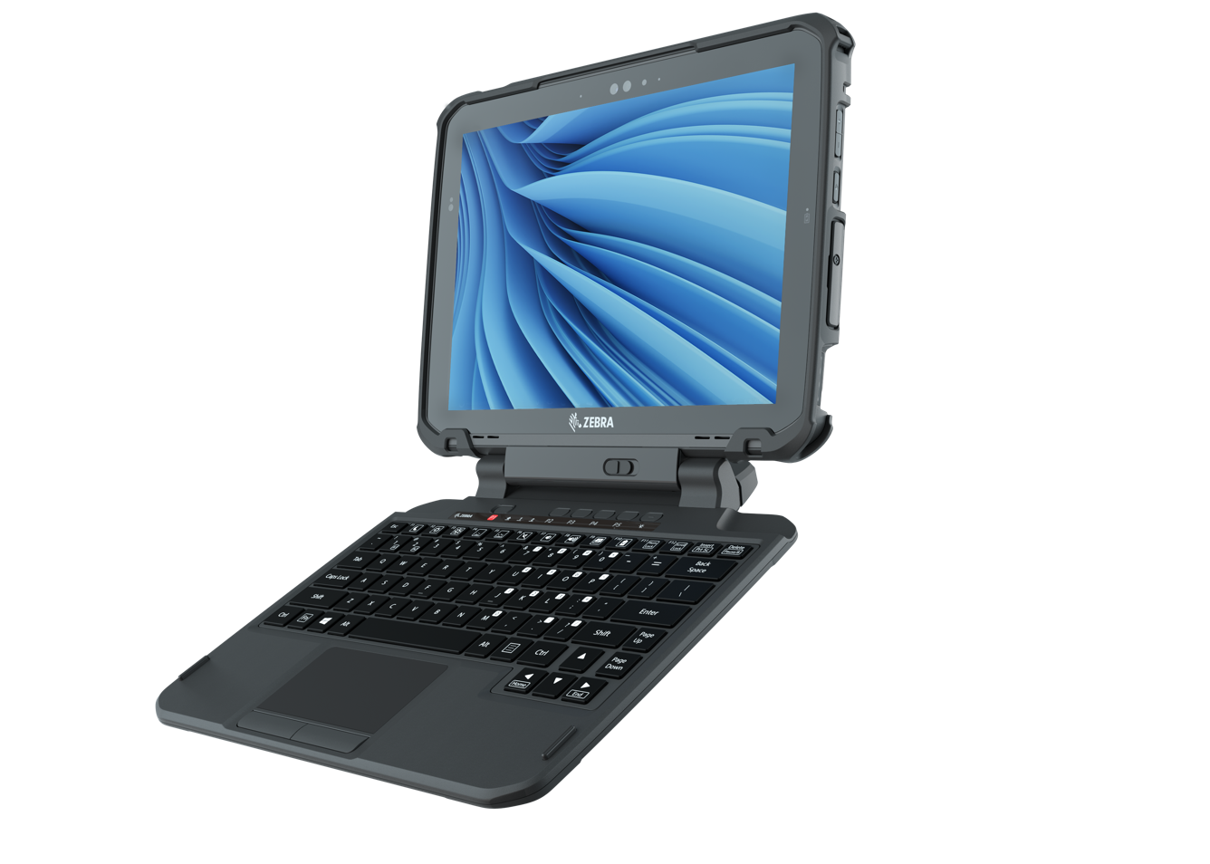


Ruggedness
for the Most Unforgiving Roles and Environments
Designed for flexibility
Thinner and lighter than major 2-in-1 competitors
E-Pen for signatures and handwritten note taking
Friction hinge keyboard with color backlighting for true laptop replacement
Built for mission-critical applications
Rugged tested at
MIL-STD-810H
Certified at IP65 with ports open
Fan-less design won’t spread contaminants

Slide 16

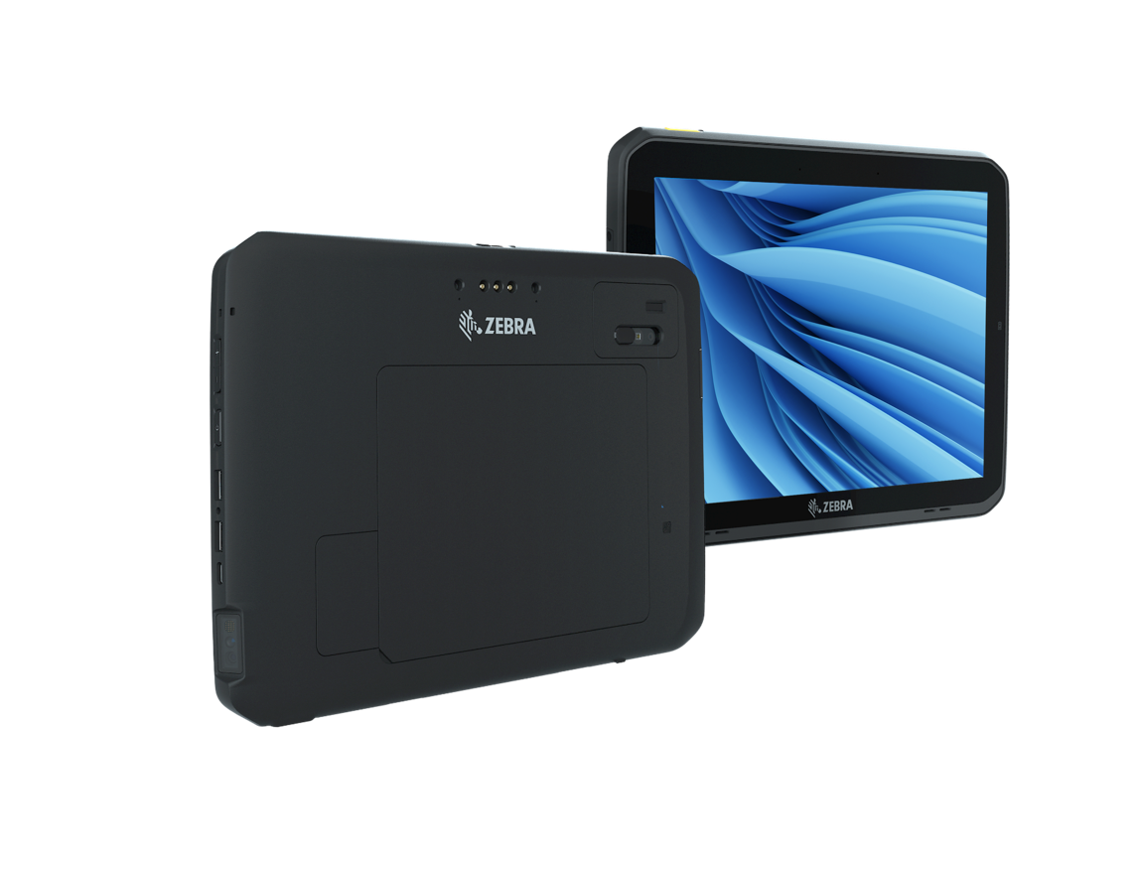
Connectivity
to work Anywhere and Perform at the Highest Levels
Advanced connectivity and performance
5G, 4G and CBRS*
Support for Wi-Fi™ 6E** for the fastest WLAN access
Intel’s 11th generation CPU for fast processing
Shipping on Windows® 11 Professional 64-bit
Integrated barcode reader for on-the-spot data capture
3 antenna passthroughs for strong GPS and wireless signals
Certified on public safety networks
3 USB ports on tablet with an expansion port for true serial
* Not available in all regions
**Windows 11 Pro required for Wi-Fi 6E (6 GHz band). Wi-Fi 6 available with Windows 10

Slide 17
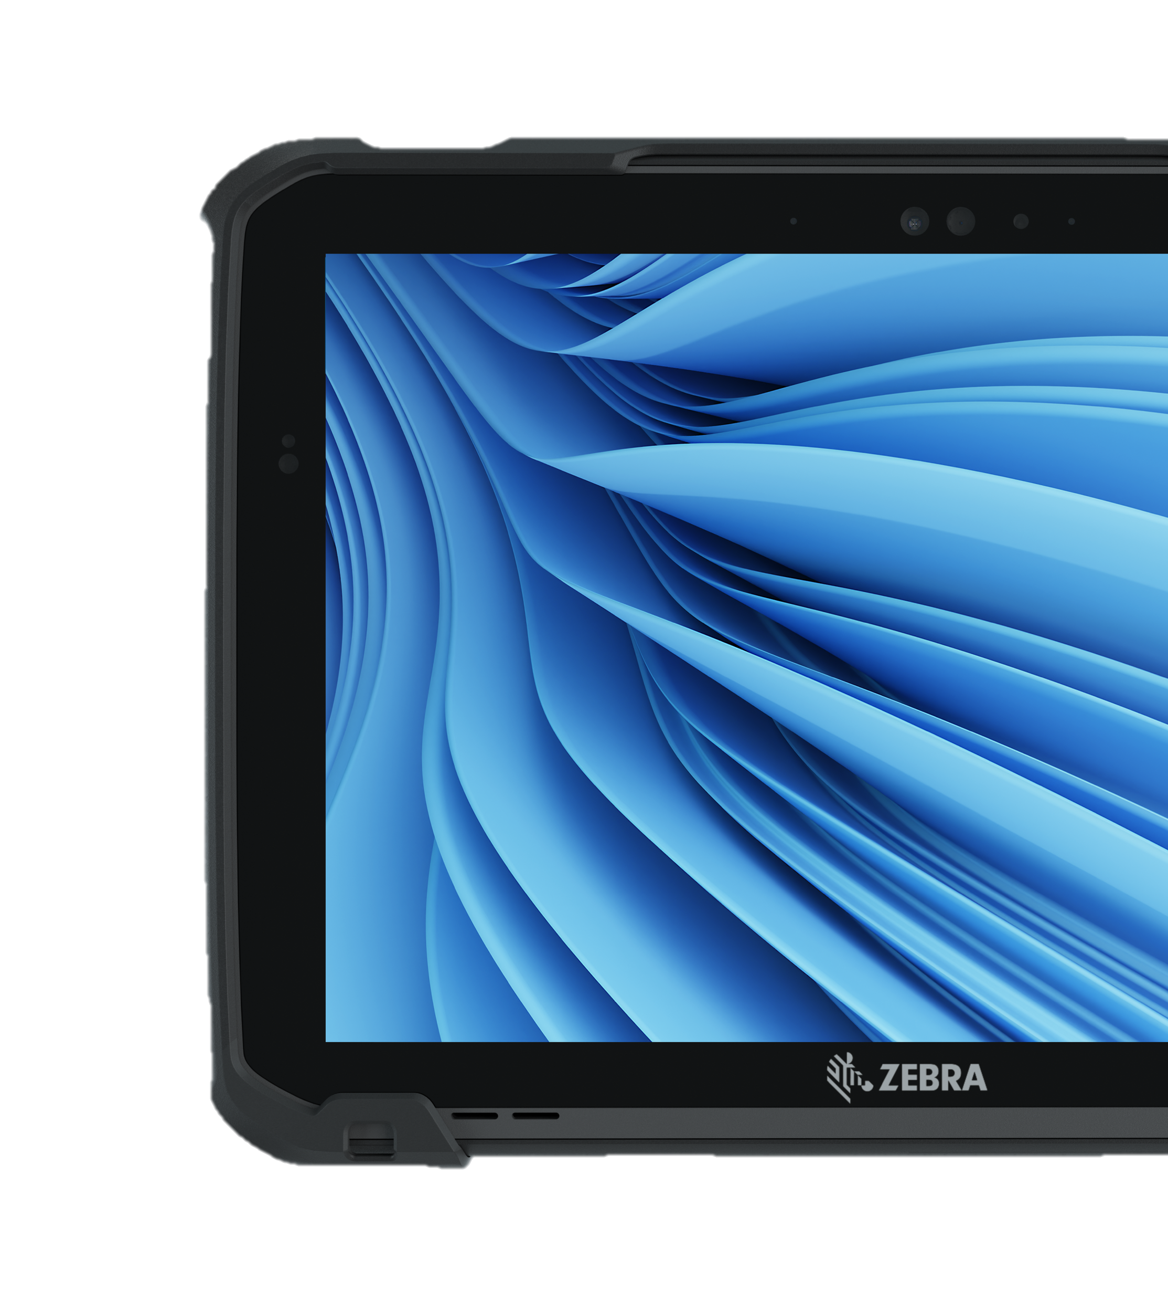


Capabilities
Built for Your Processes and Environments
New software features
Push-to-talk feature offered by
Workcloud Communication for
instant communication across
your workforce
PowerPrecision+ Batteries let you monitor status and health metrics to assure full-shift productivity
123Scan makes scanner configuration and deployment easy
Enhanced security
Windows® Hello front facing camera for facial recognition login
Fingerprint reader for secure login
Insertable CAC reader option validates credentials

Slide 18
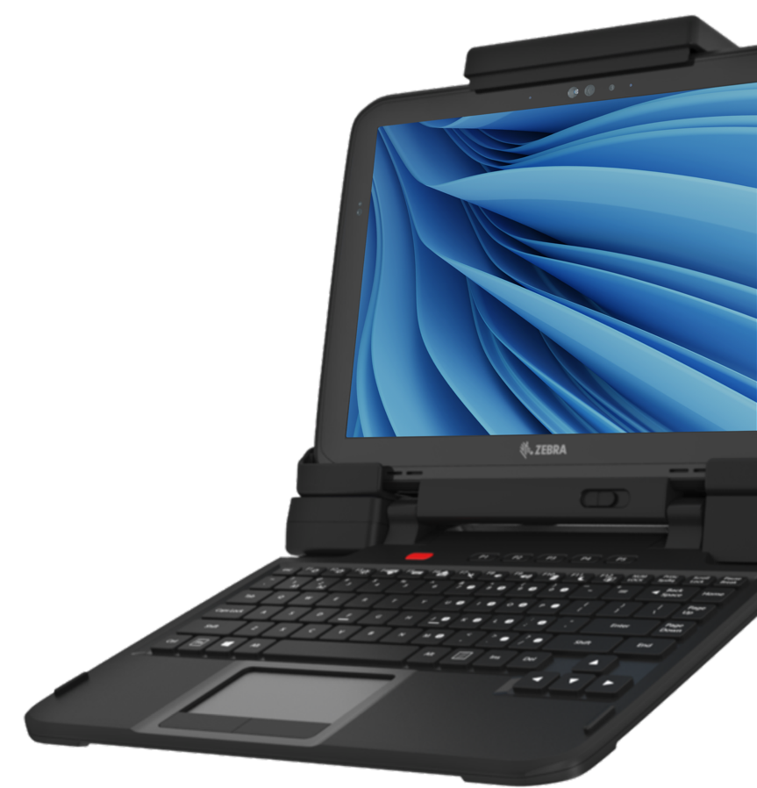


Versatility
in the Dock and On the Go
Flexible docking options
Universal docking solution that lets you dock and undock in seconds
Dock tablet with or without rugged case and expansion back
Dock offers up to 9 additional ports for more ways to connect
More portability
Carry your way with shoulder and hand strap accessories
Keyboard extendable hard handle for added security when carrying
Auxiliary battery with hot-swap capabilities for critical, ongoing use

Slide 19
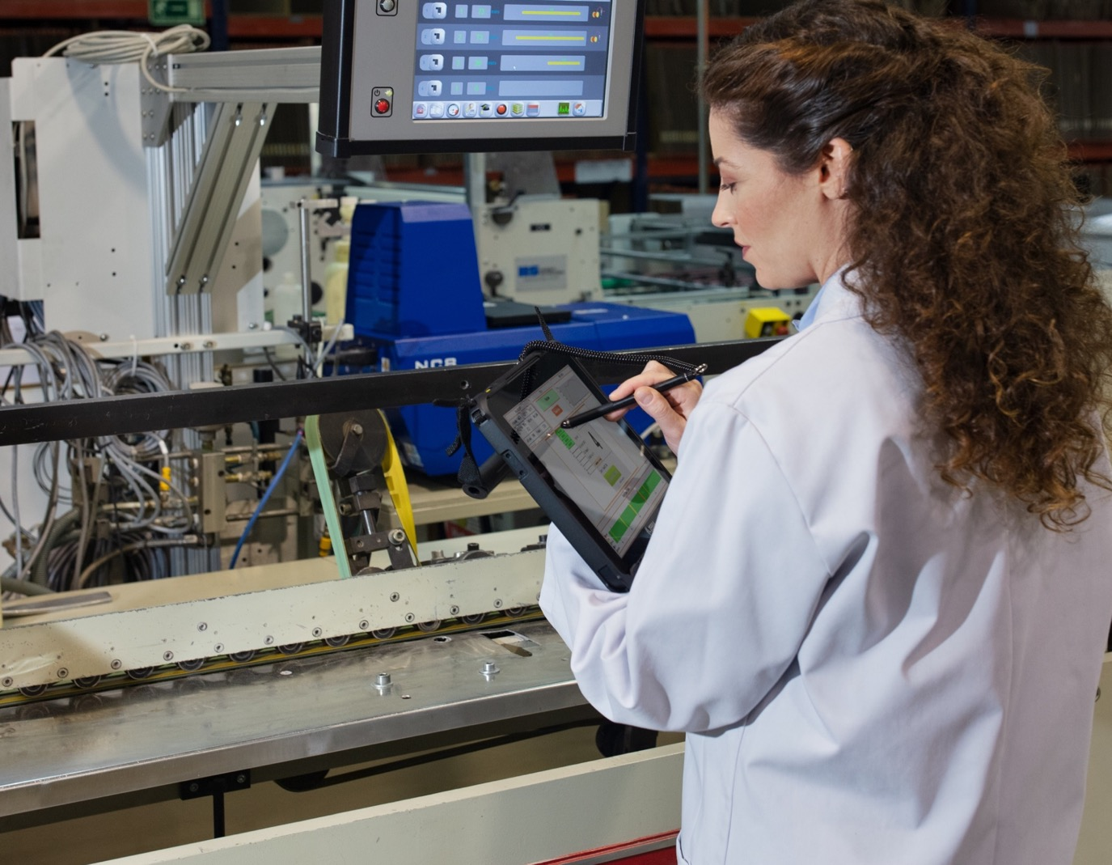
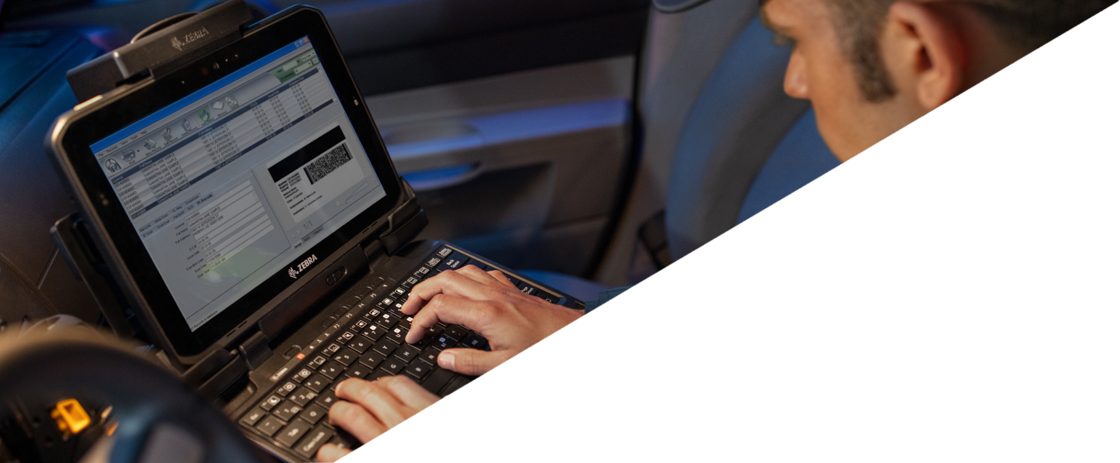
Key Features

Slide 20
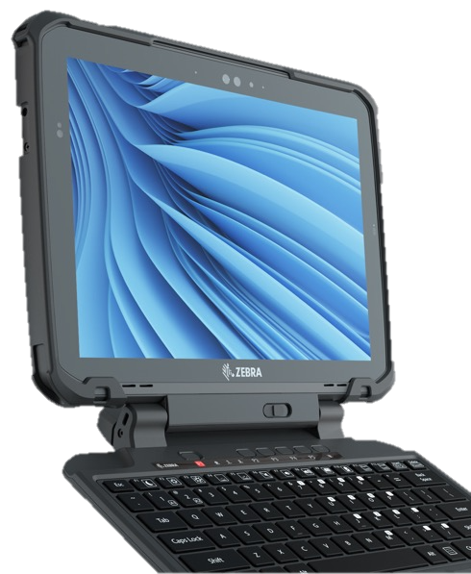
Spec Overview
ET80 / ET85
ET80 / ET85
Ergonomics and UI
Form Factor
2-in-1 rugged tablet with friction hinge rugged
keyboard option
Display
12 in. 3:2 QHD (2160 x 1440) — 800 nits
Sunlight readable
Corning Gorilla Glass
Anti-reflective (AR)/Anti-Smudge screen treatment
Night-vision mode
Touch Panel
Capacitive 10-point multi-touch; Glove and Wet
modes; MPP 2.0 active pen compatible
Dimensions
Tablet: 12.1 in. W x 8.9 in. L x 0.6 in. H
308 mm W x 225 mm L x 16 mm H
Tablet with keyboard: 12.1 in. W x 9.6 in. L x 1.1 in. H
308 mm W x 244 mm L x 29 mm H
Weight
Tablet (with standard battery): 2.8 lbs./1.3 kg
Keyboard: 1.85 lbs/0.84 kg
System
CPU
11th generation Intel® Core™ i7-1180G7 vPro(R)
processor
11th generation Intel® Core™ i5-1140G7 vPro(R)
processor
11th generation Intel® Core™ i5-1130G7 processor
Memory
8 GB or 16 GB LPDDR4x-4266
Storage
128 GB, 256 GB or 512 GB tool-less user
removable PCIe SSD
Software Platforming
Windows® 11 Professional 64-bit
Zebra-only Value Add Software Tools
Workcloud Communication PTT
PowerPrecision+ Batteries
123 Scan
Connectivity
Wi-Fi (WLAN)
Wi-Fi 6E*, 802.11ax R2 including the new 6 Ghz
band, 2x2 MIMO; 802.11a/b/g/n/ac R2/ax R2,
WPA, WPA2, WPA3, WPS, PMF, WMM, WMM-PS,
WFD, Wi-Fi Agile Multiband, Wi-Fi Optimized
Connectivity, Wi-Fi Location, Wi-Fi TimeSync
Cellular (WWAN)
ET85 configurations required: available 5G
(support for 3 GPP Rel 15 including Cat 22 LTE, CBRS
3G, and sub 6 GHz NR) data only or Global LTE
Category 12 data only
Bluetooth® (WPAN)
Bluetooth 5.2 + Audio LE, Class 1
GPS
ET85 configurations required: GPS, GLONASS,
BeiDou/Compass, Galileo. Dual band (L1 + L5)
with a GPS
NFC
Supports NFC peer to peer, card reader/writer
and card emulation modes
Durability
Drop Specifications
MIL-STD-810H drop to plywood over concrete
Standard: 4 ft./1.2 m
With optional rugged boot: 5 ft./1.5 m
With keyboard: 3 ft./0.9 m
Sealing
IP65 for tablet with ports open, keyboard and dock
Operating Temp.
-4º F to 140º F/-20º C to 60º C
Data Capture
Scanning
SE4107 2D scanner (available option)
Rear Camera
13 MP auto-focus camera with user controllable
LED flash; mechanical privacy shade
Front Camera
FHD Windows Hello auto-focus camera;
mechanical privacy shade
Battery
5180 mAhr, 7.7V rechargeable Li-Polymer; user
replaceable (39.8 Whr)
Charge time 0 to 90% in 2 hours
Optional hot swappable 3400mAh, 7.6V (25.8 Whr) secondary battery (expansion back required)
Operation: 11 hours (17 hours with auxiliary battery)4
45W USB-PD (type C) AC adapter sold separately
Audio
Stereo front facing speakers
2 front-facing microphones
2 rear-facing microphones
Audio headset supported in USB-C and USB-A ports
Sensor Technologies
Ambient Light Sensor
3-Axis e-compass
3-Axis Gyroscope
3-Axis Accelerometer
*Windows 11 Pro required for Wi-Fi 6E (6 GHz band). Wi-Fi 6 available with Windows 10
Notes:
Need spec sheet

Slide 21
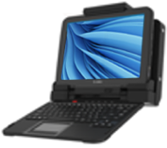
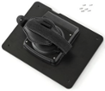




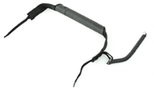
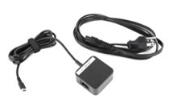
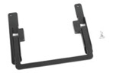

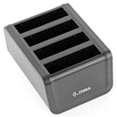

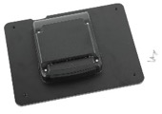
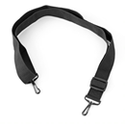

Accessories
Overview
Unmatched comprehensive suite of accessories
Workflow options
Carrying/Protective options
Charging/Power options
Common Dock
Vehicle
Office
Forklift
Expansion back
Rotating hand strap
Aux battery Slot
Friction Hinge
Rugged Keyboard
Handle with stylus holder
Rugged Boot
with Attach Points for Straps / Handles
Auxiliary Battery
(For use with expansion back)
Internal Battery
Ethernet/ Serial: Tool-less Thumb-Screw Attach Option
AC Adapter USB-C
AC cord sold separately
Expansion back Kickstand
Can be added to ET80 / ET85 expansion back
Stylus Tether
4-Slot Battery Charger
Ethernet: Tool-less Thumb-Screw Attach Option
Stylus MPP 2.0
Expansion Back - CAC
Aux battery slot
Optional Kickstand sold separately
Shoulder Strap
ZEBRA TECHNOLOGIES

Slide 22
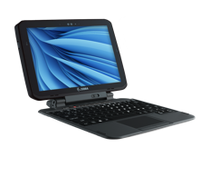



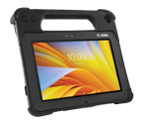

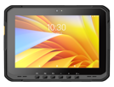







Tablet Portfolio
12"
ET8x
10"
ET4x-HC
L10/L10ax
ET6x
8"
ET4x
ET5x
Right-price rugged tablets that are built for the enterprise Thinnest and lightest Zebra tablets Integrated scanner: choice of three Zebra scan engines Z-Backs: additional power and payment modules Advanced wireless communications Rugged boot option increases durability | Built for healthcare from the inside out Purpose built for healthcare Disinfectant-ready housing Thinnest and lightest Zebra tablets Integrated scanner Emergency alert button Advanced wireless communications Healthcare handstrap improves portability | Surprisingly rugged, thin and lightweight for everyday business use Z-Backs add functionality; additional power, scanning and payment modules 8 in. integrated scanner option Rugged boot option increases durability | Seriously rugged to the core, incredibly versatile XSlate – Classic form factor XPad – Rugged integrated handle with scanner Optional keyboard accessory Advanced wireless communications and processor (L10ax Windows) Rugged specs that outperform in the harshest conditions | The most versatile rugged business tablet Rugged for the most demanding use cases – including the freezer Advanced wireless communications and processor Most advanced data capture options, including advanced range scanning Rugged vehicle dock for material handling vehicles True 2-in-1 tablet with detachable friction hinge keyboard | Uncompromised rugged mobility True 2-in-1 tablet with detachable friction hinge keyboard Rugged, yet surprisingly thin and lightweight for a 12 in. tablet Advanced wireless communications and processor Universal docking solution – desktop and vehicle
ZEBRA TECHNOLOGIES
22
Notes:
Need images for devices

Slide 23

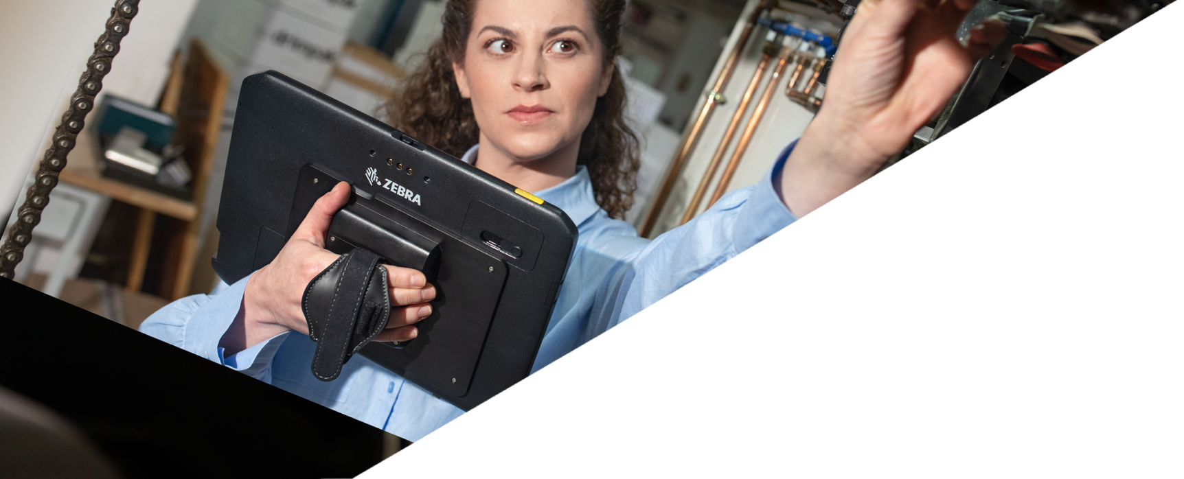
Security and Services

Slide 24

Protect your business from dangerous security threats
Shield your organization with multiple layers of defense
Not all security measures can measure up to your needs. When considering technology, consider these critical security attributes intrinsic to Zebra Technologies and peace of mind.
Built-in protection and performance
Highly effective security
protocols and features
Effortless integration
Prepared to anticipate and fulfill your integrations needs
Customizable for your needs
Security levels adjusted based on your company needs
Continuous vigilance and support
Pair years of OS security updates and firmware enhancements
Automated security capabilities
A secure connected environment
for you and your team
Simpler maintenance and service
Tested to perform with minimal maintenance, maximum uptime
Aligned with globally recognized standards
Best practices and guidelines set by the world’s security experts
A leader in secure enterprises technology
Productivity and security are at the core of everything Zebra does
ZEBRA TECHNOLOGIES
24

Slide 25



Standard Maintenance Plans
More than just repair, Zebra protects your technology from the
inside out — and the operational outcomes you expect from it.
Never One Size-Fits-All, choose the plan to best help you serve your strategic vision:
Comprehensive repair services*
3-day repair turnaround time
8x5 local time technical support
Software updates and patches
Device Diagnostics Tool¹
Insight into contracts, repair reports and more with cloud-based VisibilityIQ™ OneCare™²
All the features of Essential, PLUS
‘Like-new’ advance device replacement
24x7 technical support
Spare pools management
Standard Device Commissioning preloads devices with OS, software and applications
* Devices can be sent into the Service Center for repair with or without the hard drive
Available for Zebra mobile computers.
Zebra Mobile Computers and Scanners. Access to repair, technical support, contracts reports and more
ZEBRA TECHNOLOGIES
25

Slide 26

Enhancements
Flexible enhancements to fit your business needs.
Tailor your plan even further by planning for battery replacements, expediting logistics
and shipping and commissioning devices with the right software and application versions.
  Battery Services
Battery Maintenance
  Tests batteries and replaces those that cannot reach a minimum 80% charge during testing.
Battery Refresh
  Consolidated shipment of replacement batteries at a predetermined time
    Month 18 for a 3-year plan
    Months 18 and 36 for a 5-year plan
  Commissioning Services
Standard Commissioning Service provides an “out of box, ready to use” experience with the repaired or replaced device pre-loaded with OS version, customer SW, applications and configurations.
Advanced Commissioning addresses more complex operational and configuration requirements over and above what is provided with ‘Standard Commissioning.
  VisibilityIQ™ Foresight ²
This business intelligence service transforms device data into actionable insights in a single, cloud- based, color-coded view. Available whether for use with an EMM or without.
Predictive intelligence helps operational staff anticipate recurring events and catch potential problems before they affect the bottom line
Realize increased workforce productivity, operational efficiency and ROI by optimizing device availability and maximizing asset utilization
  Enhanced Shipping Logistics ¹
Expedited Collections Option- pre-paid shipping labels and to schedule carrier pick up using the Zebra RMA portal
Expedited 2-Way Shipping Option - Express shipping of devices into Zebra’s Repair Center and provides Express return shipping of the repaired devices from Zebra’s Service Center back to the Customer
ZEBRA TECHNOLOGIES
Available for Mobile Computers
Available for Mobile Computers and Link-OS Printers.
26

Slide 27
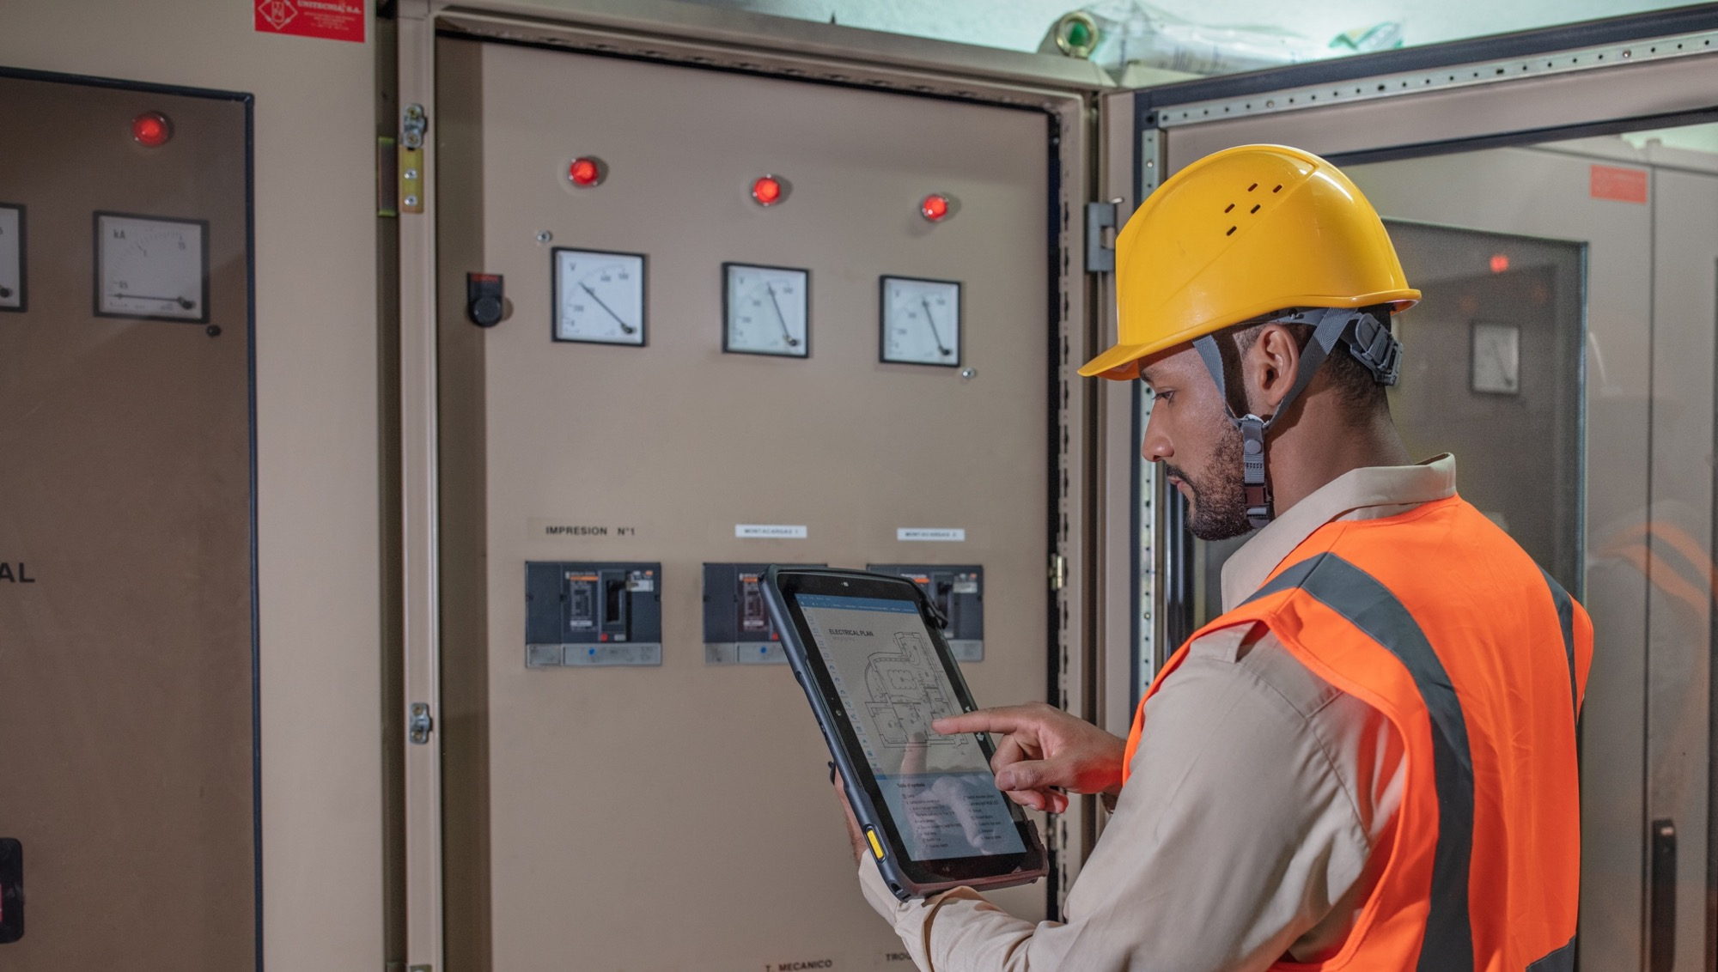

Thank you!
For more information, visit, www.zebra.com/et8x-series
ZEBRA and the stylized Zebra head are trademarks of Zebra Technologies Corp., registered in many jurisdictions worldwide. Android is a trademark of Google LLC. The Bluetooth® word mark and logos are registered trademarks owned by Bluetooth SIG, Inc. and any use of such marks by Zebra is under license. Wi-Fi™ is a trademark of Wi-Fi Alliance®. All other trademarks are the property of their respective owners. ©2023 Zebra Technologies Corp. and/or its affiliates. 08/15/2023

