Slide 1

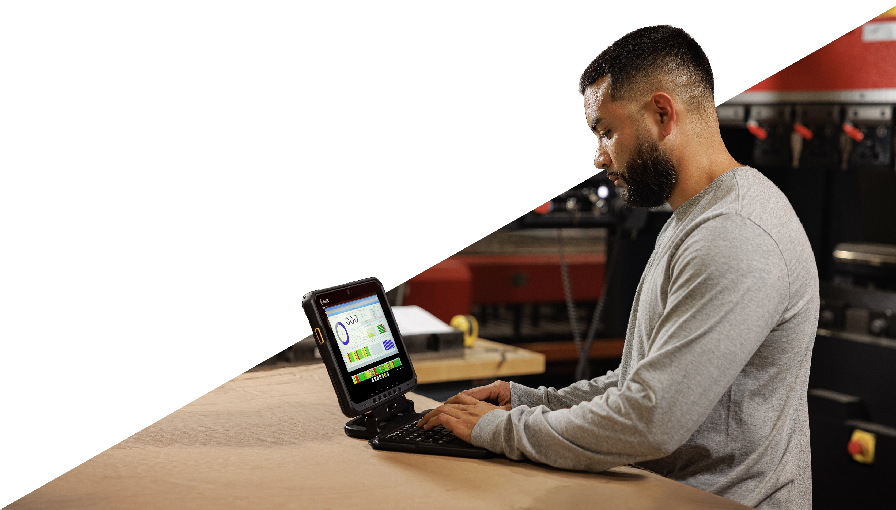
Manufacturing 4.0 and Plant Mobility
Augment Your
Manufacturing Plant Floor
with Rugged Tablets

Slide 2

The Challenge
Increasing Demand in the Global Middle Class
Population forecast
Annual spending forecast on manufactured goods
1.7 billion
(2020)
5.3 billion
(2030)
$35
trillion
$64 trillion
by 2030¹
Labour Shortages and High Labour Turnover
v
To navigate the key pressures, many job aspects need
automation
to improve productivity
and enhance training for
full-utilisation of
available labour
With higher demand for goods, comes the expectation for faster delivery of flawless goods
Global manufacturers are facing historic labour shortages estimated to exceed 8 million by 2030
(loss of as much as $607 billion)²
Rising Costs
Raw material and labour costs continuously on the rise
Need to reduce cost-per-unit (CPU)
1. The next phase of Digital Evolution, Manufacturing in 2030 Project, Manufacturing Leadership Council, September 2022.
2. Why is there a global labor shortage? Randstad; February 2024. https://www.randstad.com/workforce-insights/talent-acquisition/why-there-a-global-labor-shortage/

Slide 3
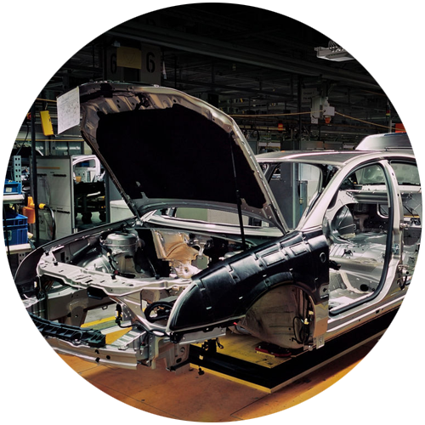
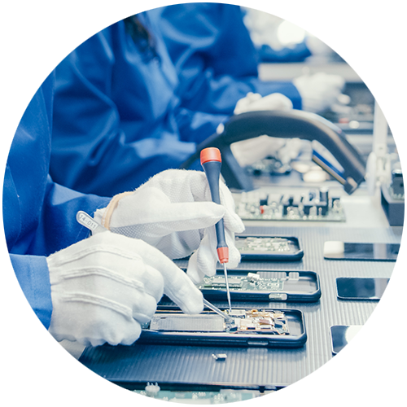
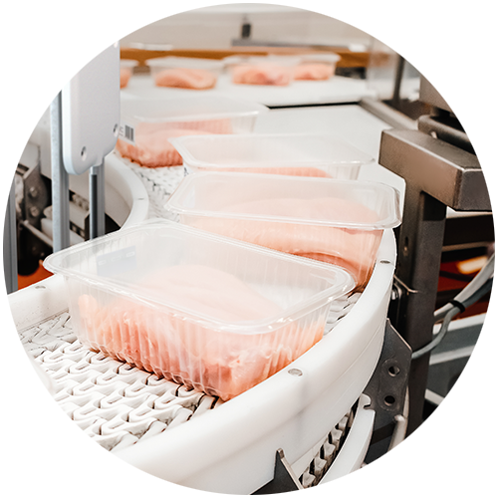

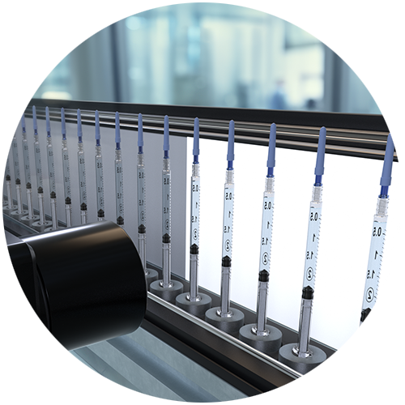
The Solution
Enable plant mobility and flexibility with the right enterprise features in
RUGGED TABLETS
Workers are no longer tied to a fixed workstation and can access the
information required wherever, whenever, for better and faster decisions.
Experience durability indoors on plant
floor and outdoors on the receiving dock or in the yard:
Automotive
Manufacturing
Electronics
F&B
Heavy industrial
machinery
Pharmaceuticals

Slide 4
Rugged tablets
Integrated with latest Wi-Fi 6/6E &
Cellular Connectivity (5G/Private 5G):
Maximise task efficiency and accuracy
Speedy and accurate data entry with automated data capture tools (barcode scanning, image capture)
Video calls for remote task-specific expert support
On-demand training with required completion, to enrich labour pool investments
Incorporate multiple device capabilities that enables instant connection to various devices via a workstation cradle, reducing technology investments and IT support needs with separate computer workstations, while simplifying employee tasks
Replace two-way radios and PBX handsets, reducing device purchases and management
Enable multi-modal advanced collaboration for seamless workflow and improved efficiency of enterprise operations

Slide 5
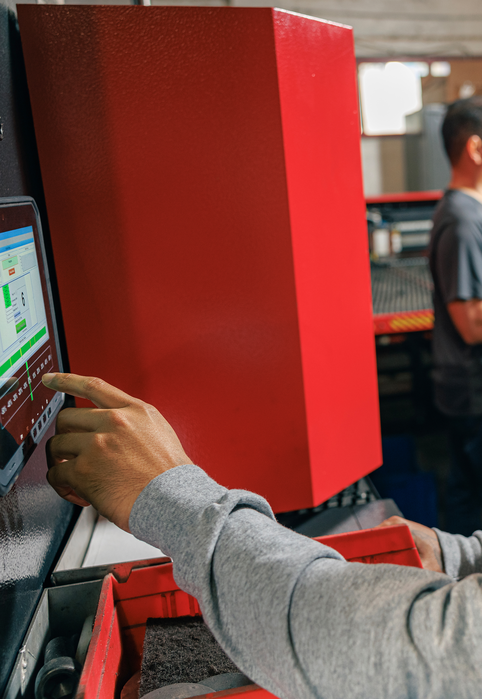
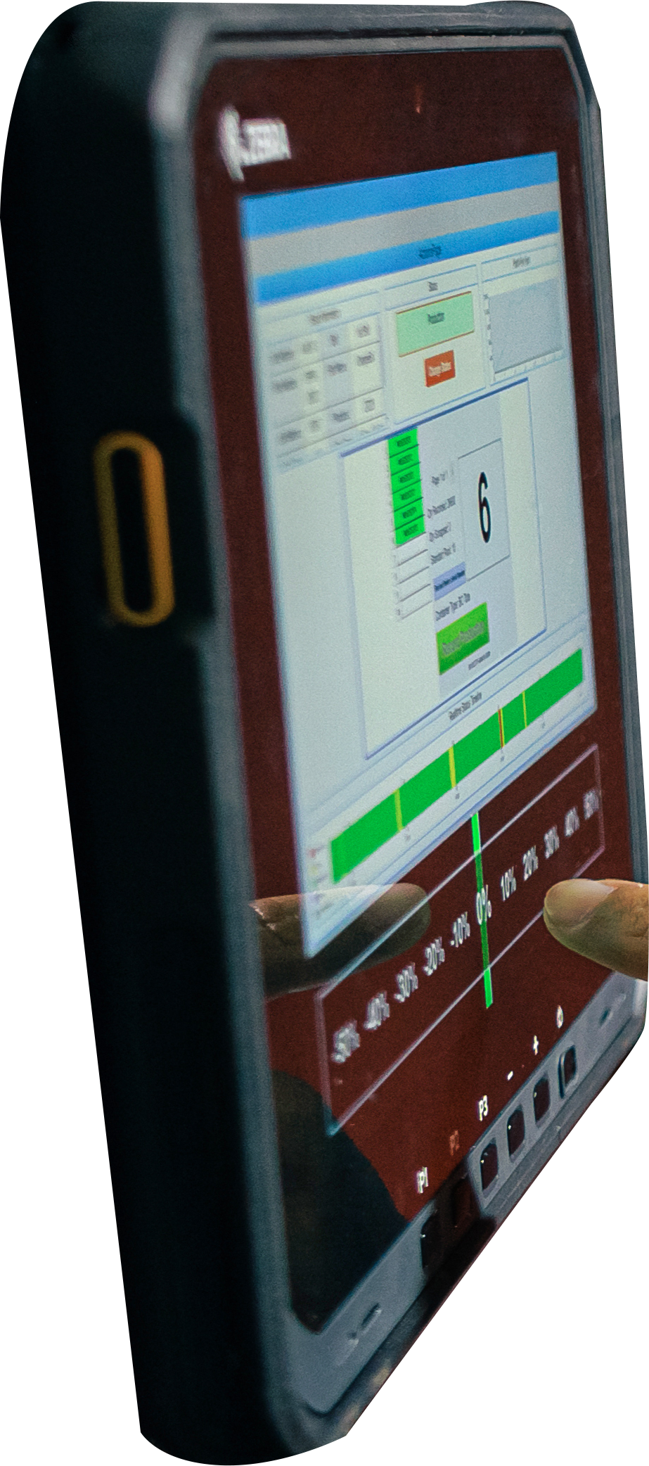
Why
RUGGED ENTERPRISE
TABLETS?

Slide 6
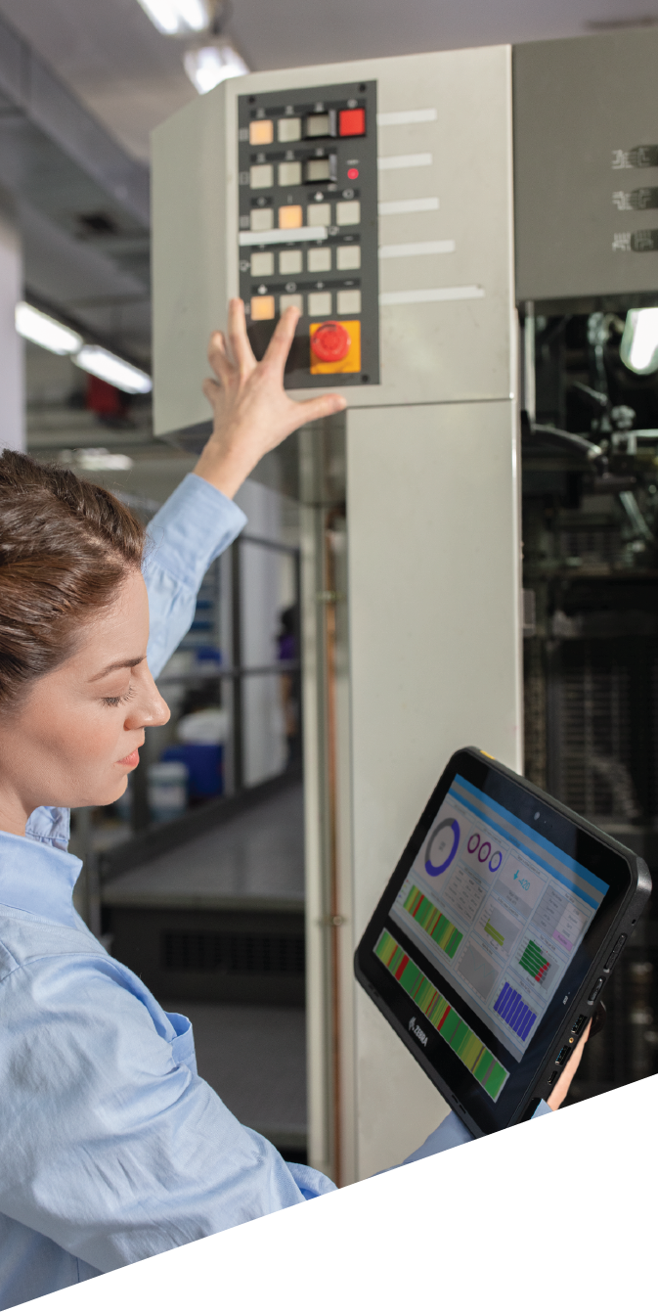
Benefits of rugged enterprise tablets
• Accelerate decision-making and task completion on the manufacturing plant floor, saving time and money
• Enhance productivity with mobile data access, reducing labour costs and increasing production quality
• Improve user experience with a large display that minimises scrolling and boosts information accessibility
- Enable engineers to access detailed equipment schematics, conduct video calls with remote experts,
and view PLC data
Applications best suited for rugged enterprise tablets
Mobile Human to
Machine Interface (HMI)
Quality
Assurance
Manufacturing Execution
System (MES) Integration
Training
Plant Management
Warehouse Management
System (WMS)

Slide 7
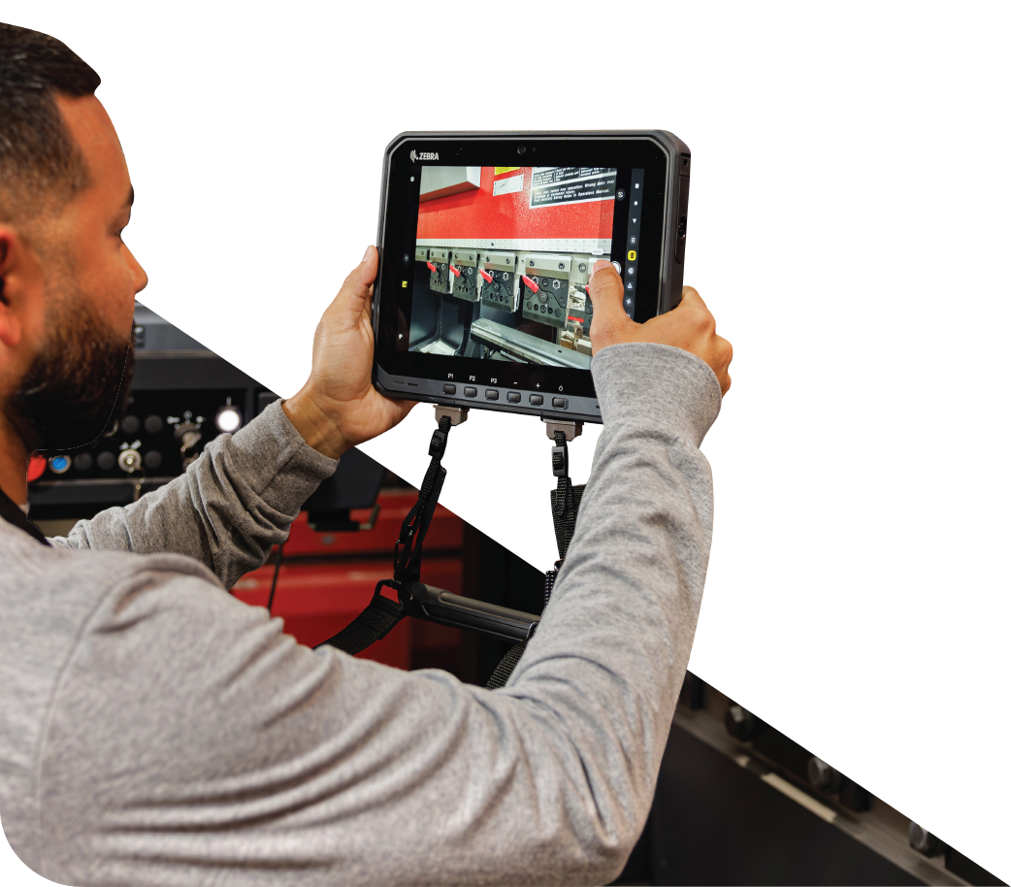
Mobile Human to Machine Interface (HMI)
Enhance plant floor machine maintenance
In-house technicians and engineers can use tablets to proactively service plant equipment, preventing unplanned downtime and faulty products. Engineers can also remotely control machines using tablets as mobile HMIs for the PLC.
New processes & benefits
• Improve productivity
- Eliminate paper-based tasks, increasing daily work order completion
- For example, engineers can service more machines per day using
rugged tablets as mobile workstations
• Improve safety
- Monitor workers’ activity in real-time via integrated locationing
technologies, to ensure safety during evacuations
• Better workforce management
- Track work order completion times to identify workers that need
training and potential mentors
• Boost collaboration for faster, more accurate maintenance
- Facilitate instant communication with engineers via video call or
push-to-talk
• Augmented reality and digitised work instructions
- Visually guide employees through steps for maintenance
• Enable new and less experienced workers to accurately
complete maintenance during training
• Enhance efficiency through
streamlined workflows
- Eliminates the need for control room
calls and manual searches for
equipment readings and schematics
• Digitalised maintenance records
- Replace paper checklists with
electronic forms for automated,
error-proof data capture
- Digital data predicts downtime and
identifies bottlenecks by comparing
maintenance records across similar
machines

Slide 8
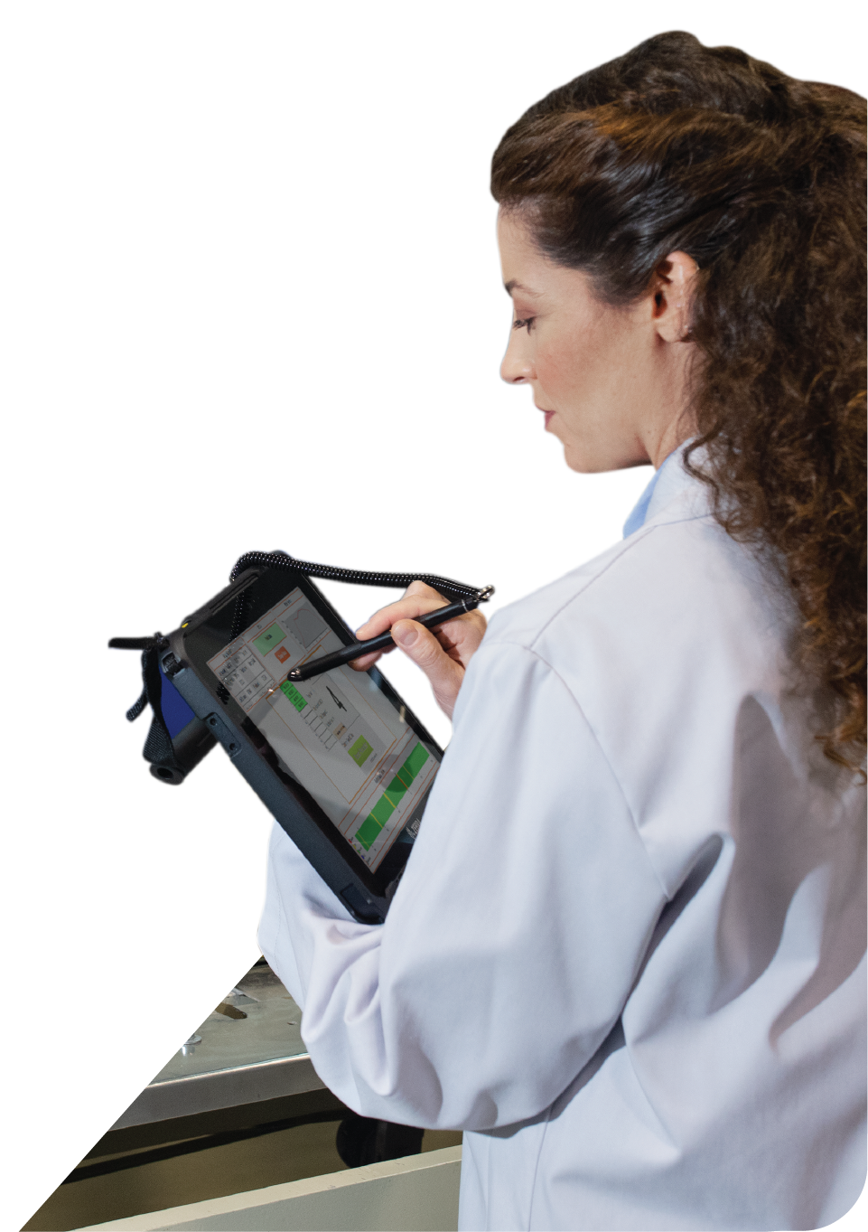
Quality Assurance
Quality checks anytime, anywhere
Conduct on-site quality checks by scanning barcodes and snapping photos to document raw materials and
finished products, eliminating the need for transportation to a QC station.
New processes & benefits
• Improve productivity
- Conduct more spot checks daily, increasing workforce efficiency
• Enhance efficiency through streamlined workflows and
data digitisation
- Capture data faster and accurately with electronic checklists
- Gain visibility into operations and detect errors using data insights
- Resolve quality issues swiftly through video calls and push-to-talk,
minimising costs related to quality issues
• Digitised work instructions
- Improve data integrity by using electronic manufacturing travelers
and build books
• Capture data faster and more accurately
- Electronic quality checklists replace paper checklists, minimizing
manual labour and errors
- Barcode scanning enables accurate capture of product information
• Better workforce management
- Track work order completion times to identify
workers that need training and potential mentors
• Better management of labour shortages
- Remote expert assistance ensures quality
standards regardless of location
• Enable new and less
experienced workers to
accurately complete
maintenance during training

Slide 9
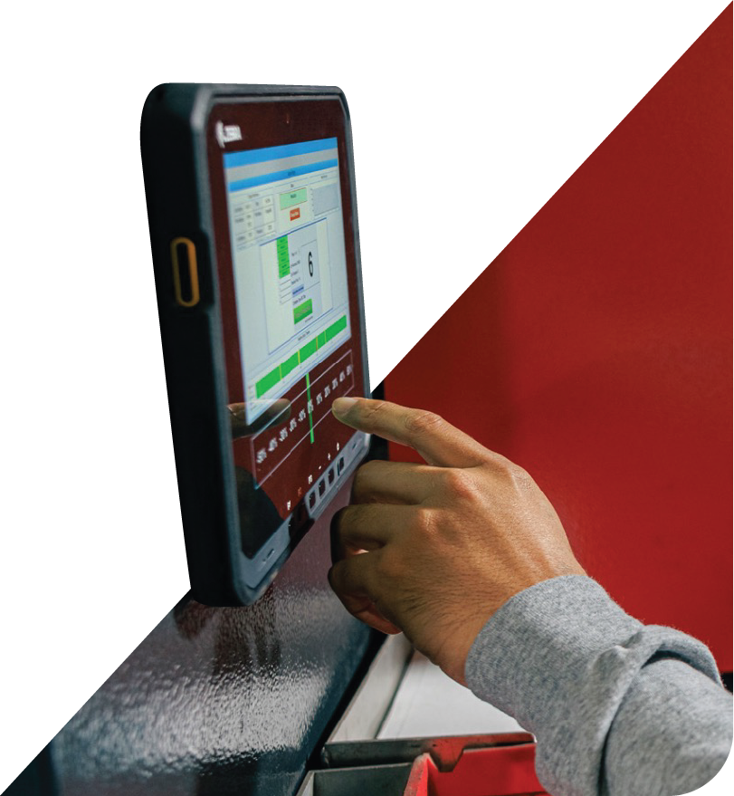
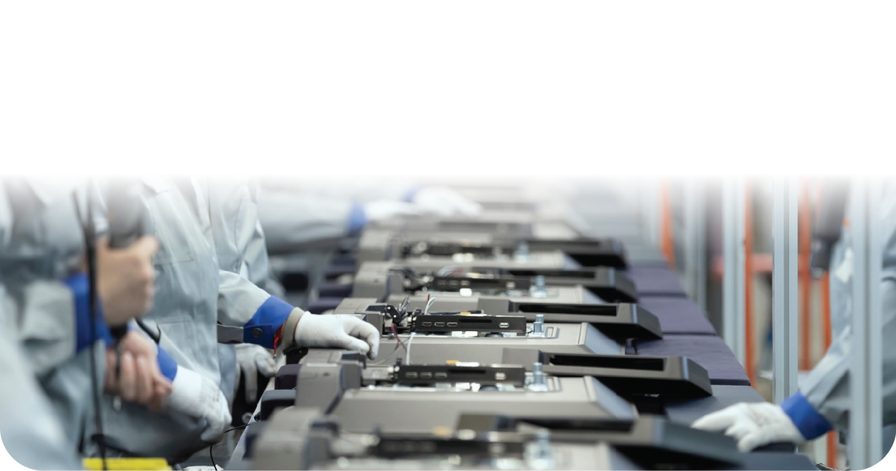
Manufacturing Execution System (MES)
Digital assembly instructions on the production line
MES on tablets provide digital assembly instructions at any station, ensuring accurate assembly across all assembly line types and safeguarding product quality, even with less experienced workers.
Digital job traveller
Digitising all job travellers provides instant visibility and audit trails for orders, enhancing management of work in process, customer expectations, and financial data.
New processes & benefits
New processes & benefits
• Improve documentation
- Scan barcodes on a finished
assembly and capture photos
of work in process
• Increase flexibility in
production
- Use tablets to move between
stations or access fixed tablets
on the assembly line
• Real-time data access
- Instant visibility without lag time between paper-based
data collection and data reflection
• Document management
- Prevent loss or damage of documentation
- Reduce time spent managing paper documents

Slide 10

Manufacturing Execution System (MES)
Efficiently ease more intensive data entry tasks
Expand digitisation to new plant floor areas enhances productivity and real-time traceability. Workstation cradles transform tablets into mobile-driven workstations, simplifying intensive data entry and enabling instant digitisation of data like providing detailed notes and responding to time-sensitive emails.
New processes & benefits
• Improve productivity, throughput, task accuracy and quality
on the production line:
- Streamlines overpacking
- Facilitates intensive data-entry tasks
• Ensure safety
- Monitor workers’ activity in real-time via integrated locationing
technologies, to ensure safety during evacuations
• Better Workforce Management
- Track work order completion times in assembly and overpacking to
identify workers that need training and potential mentors
• Enable new and less experienced workers to accurately
complete tasks during training

Slide 11
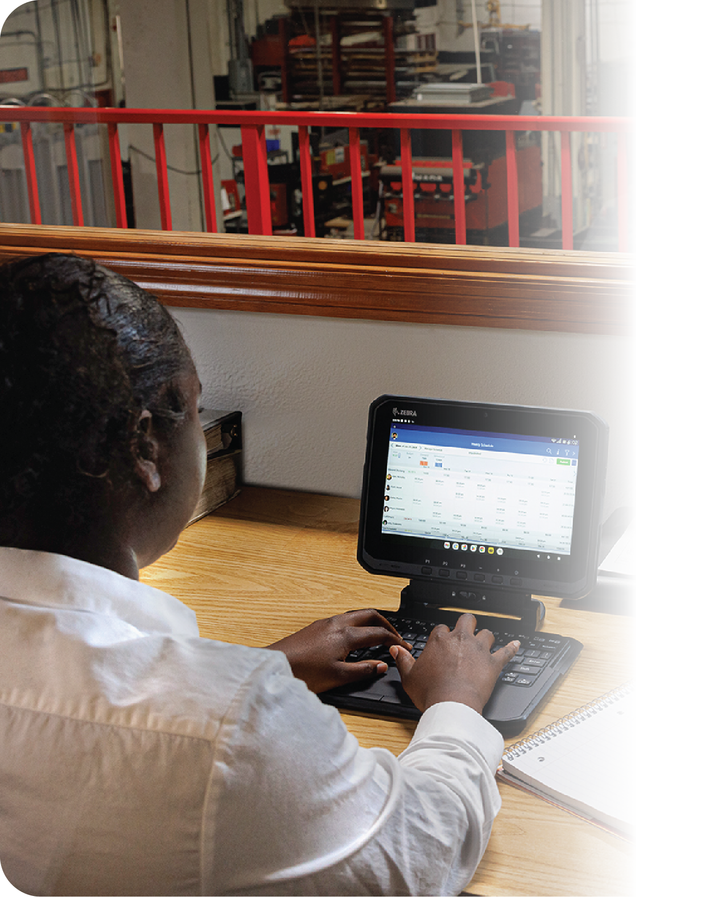
Training
Enable comprehensive on-demand training
and cross-training options
Present on-demand training directly to tablets across the plant floor to reduce learning curves and facilitate efficient cross-training.
The large tablet display supports various virtual training formats, including self-paced courses, on-demand vignettes, and augmented reality training. Workers can use push-to-talk or PBX call capabilities to instantly seek assistance.
New processes & benefits
• Ramp up onboarding for less experienced workers
• Improve task accuracy during training
• Track worker training progress and ensure course compliance
• Analyse course popularity to optimise in-person training sessions
• Minimise risks in hiring and cross-training across
departments or locations

Slide 12

Plant Management
Keep managers on the move yet always connected
Plant managers can oversee operations on the floor and address issues with full visibility on essential business applications.
New processes & benefits
• Continuous communication
- Stay connected to email and messaging systems, ensuring timely issue
resolution across the plant
• Efficient data input
- Input heavy data on-the-go using the keyboard on a 2-in-1 rugged tablet
• Instant access to information
- Use push-to-talk and PBX calling for immediate answers, without
needing to return to the office for a deskphone

Slide 13
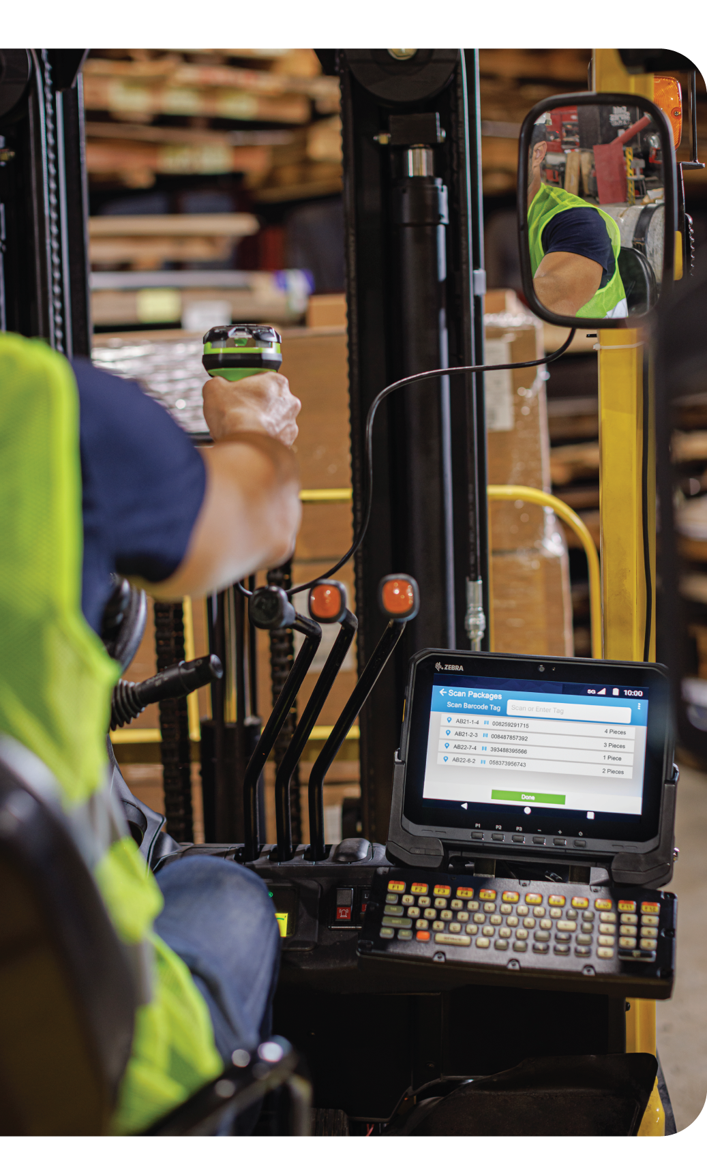
Warehouse Management System (WMS)
Integration
Digital production line replenishment/raw materials warehouse management
Rugged tablets in forklifts streamline picking and putaway operations in raw materials warehouses, ensuring timely replenishment of product line materials and preventing shutdowns and downtime that can cost millions or billions a minute depending on the size of the manufacturer.³
New processes & benefits
• Enable real-time operations
- Operators receive timely picking and putaway orders to maintain continuous availability
of lineside materials, preventing costly downtime
- Instant inventory updates from material scanning allows for timely re-orders and
efficient stock management
- Prompt receival and processing of putaway orders ensures accurate inventory storage,
minimising false out-of-stocks and enhancing replenishment availability
- Use push-to-talk for immediate communication to resolve urgent issues, preventing line
shutdowns or unfulfilled orders
3. Aberdeen Report: Maintaining Virtual System Uptime in Today’s Transforming IT Infrastructure as published in
a blog on Aberdeen’s website; Stat of the Week: The Rising Cost of Downtime; Aberdeen Strategy and Research; Ryan Arsenault; April 21st 2016; https://www.aberdeen.com/blogposts/stat-of-the-week-the-rising-cost-of-downtime/#iLightbox[gallery31532]/0; Referenced in The Actual Cost of Downtime in the Manufacturing Industry; IIoT World; November 14, 2018; https://www.iiot-world.com/predictive-analytics/predictive-maintenance/the-actual-cost-of-downtime-in-the-manufacturing-industry/

Slide 14
Choosing a tablet:
Enterprise-class or Consumer?
ENTERPRISE TABLET
CONSUMER TABLET
Cost-effective in the long run,
eliminating the need for high repair costs
Overall Total Cost
of Ownership (TCO)
Cost nearly 60% more over 5 years due to additional device failure and replacement costs
Cost nearly 60% more over 5 years due to additional device failure and replacement costs
Equipped with the rugged ability to tackle the demands of challenging enterprise environments and the robustness to withstand drops on concrete, water, dust and extreme temperature. Certain models are certified C1D2 for safe usage in areas with hazardous materials.
Ruggedness
Lack of rugged design and safety certification impacts productivity and TCO, costing an average of 74 minutes of lost productivity per device failure
Significantly less hassle and costs incurred in
maintenance and repairs
Productivity
Generates 20% more trouble tickets⁵, taking averagely 70 minutes for an IT support technician to resolve or initiate a return⁴, leading to nearly 2x the loss in productivity costs
User-replaceable or swappable batteries eliminates the need to remove devices from daily operations for charging,
minimising downtime and increasing ROI
True hot swap – all device functions still remain available during a battery swap
Warm swap – devices are not functional but workers can continue right where they left off post-swap
Battery Power
A dead battery causes productivity loss of 54 minutes
per incident on average, while users hunt for a
fully-charged device
4. Enterprise Mobility Total Cost of Ownership; Emily Gove and David Krebs; VDC Research, 2022
5. Enterprise Mobility Total Cost of Ownership; From the Expected to the Unexpected: Uncovering the True Costs of Mobile Solutions for Frontline Mobile Workers; VDC Research, 2021

Slide 15
Choosing a tablet:
Enterprise-class or Consumer?
ENTERPRISE TABLET
CONSUMER TABLET
• Maximum connection reliability and efficiency with the fastest network protocols while increasing screen refresh time with application interactions
• Wireless radios can utilise external vehicle antennas for stable connectivity
• Provide near-instant application response times, even in large facilities with heavy machinery and metal infrastructure
Wireless connectivity
• Typically based on older, slower wireless standards, leading to 28% higher likelihood of wireless connectivity issues⁵, which impacts communication and productivity
• Drop in productivity typically accumulates to 24 minutes each time, impacting plant throughput and ability to meet delivery date
Cost nearly 60% more over 5 years due to additional device failure and replacement costs
• Omnidirectional point-and-shoot capabilities reduces time and
effort in aligning a barcode to the scanner or camera
• Able to capture damaged, poorly printed and dirty barcodes commonly found in industrial manufacturing settings
• OCR camera technology allows specific data capture, such as vehicle identification numbers (VINs) and tire identification numbers (TINs) required in the automotive industry. It sends formatted data directly to the right applications, eliminating manual entry and preventing potential errors.
Integrated data capture functionalities
• Typically requires additional specialised software purchase and management for productive data capture
• Lacks scanning algorithms enabling accurate and fast scanning in demanding environments, which erodes productivity
5. Enterprise Mobility Total Cost of Ownership; From the Expected to the Unexpected: Uncovering the True Costs of Mobile Solutions for Frontline Mobile Workers; VDC Research, 2021

Slide 16
Choosing a tablet:
Enterprise-class or Consumer?
ENTERPRISE TABLET
CONSUMER TABLET
Fully-developed ready-to-use solutions that minimises device volume, streamlining manufacturing processes while reducing carbon footprint:
• Two-way radio capabilities for push-to-talk (PTT) over Wi-Fi and cellular networks
• PBX handset functionality to take calls as needed from partners, customers and co-workers
• Secure text messaging for easy communication in noisy plant areas and serves as a written audit trail
• Docks transform tablets into full workstations with a monitor, keyboard, mouse, network connectivity, and allow quick transition back to mobile devices
Availability of additional solutions for an ‘all-in-one’ device
Lack the ability to integrate enterprise capabilities and requires extensive software management to locate, develop and test a capability
Cost nearly 60% more over 5 years due to additional device failure and replacement costs
Lesser chance of malfunction and breakage,
reducing repair and downtime costs
Support costs
Lack in rugged durability can incur nearly 2x more IT support costs compared to rugged counterparts
Software suite of ready-to-use proven applications and
device security solutions to make devices easier for IT to manage
and secure, while enhancing worker usability
Software ecosystem
Separate applications and external software, adds complexity and hassle in usability and maintenance

Slide 17
Choosing a tablet:
Enterprise-class or Consumer?
ENTERPRISE TABLET
CONSUMER TABLET
Tailored accessories that enhance functionality and efficiency across specific-use cases:
• 2-in-1 keyboards for easy data entry
• Vehicle docks and mounts to enable tablet usage in forklifts and other material handling vehicles
• Desk and multi-slot chargers to simplify and reduce backroom management costs
• Workstation cradles to convert tablets into full workstations, potentially replacing desktop computers on production lines
• Specialised cabinets for secure storage, charging, and device management at shift changes
Also, seek manufacturers with “evergreen” accessory strategy which ensures compatibility of accessories with future tablet generations, reducing migration costs to newer technology
Expansion Accessories
• Lacks compatibility with newer models and latest technology
• Lacks versatility in accessory customisation for alternative setups
• Requires additional purchase of accessories from external parties which typically cost about a third of the tablet’s price⁴
Cost nearly 60% more over 5 years due to additional device failure and replacement costs
• Longer lifecycle of over 3+ years
• Specific models may be available for sale for 3+ years from release date, simplifying mixed model deployments
• Additional service and support is often available for another 3+ years after the model’s end of sale
Lifecycle
Lower price tag but has a short lifecycle designed to only last 1-2 years, losing consistent reliability after its 1st year and shown to fail 3x more frequently, significantly increasing TCO⁴
4. Enterprise Mobility Total Cost of Ownership; Emily Gove and David Krebs; VDC Research, 2022

Slide 18
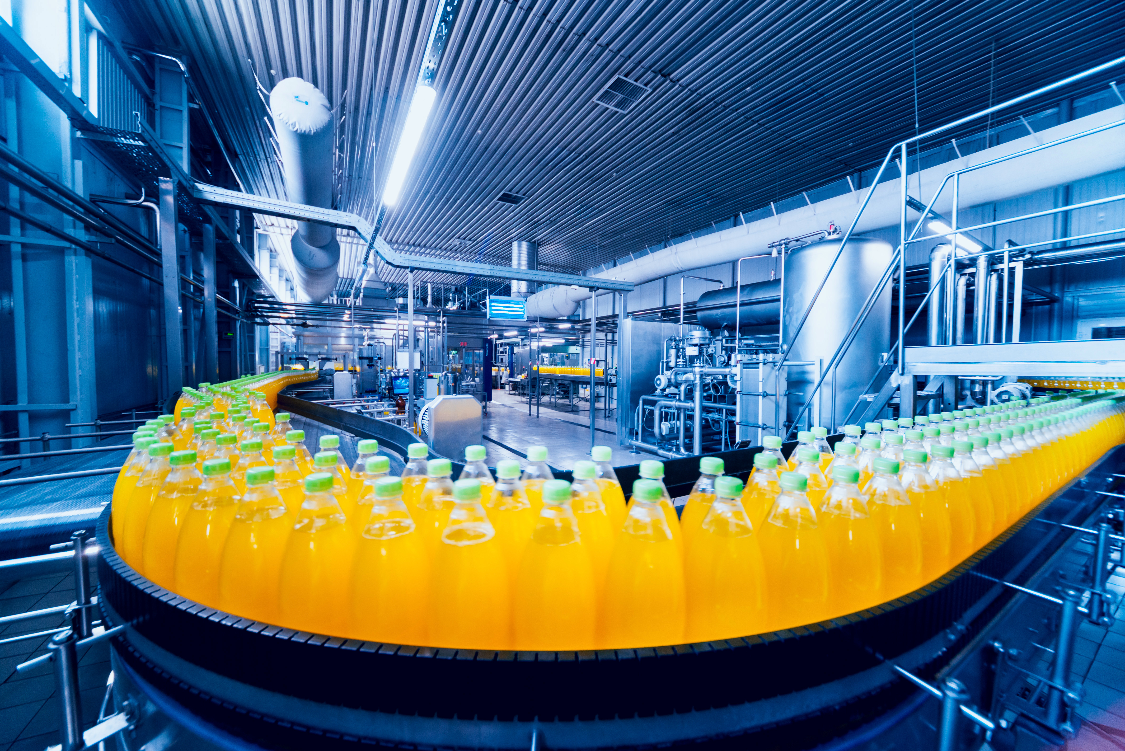
Increase throughput, product quality and workforce productivity on your manufacturing plant floor with rugged enterprise tablets.
For more information on Zebra’s manufacturing solutions, please visit
www.zebra.com/manufacturing
For more information on Zebra rugged tablets, please visit
www.zebra.com/tablets
NA and Corporate Headquarters
+1 800 423 0442
inquiry4@zebra.com
Asia-Pacific Headquarters
+65 6858 0722
contact.apac@zebra.com
EMEA Headquarters
zebra.com/locations
contact.emea@zebra.com
Latin America Headquarters
zebra.com/locations
la.contactme@zebra.com
ZEBRA and the stylized Zebra head are trademarks of Zebra Technologies Corp., registered in many jurisdictions worldwide.
All other trademarks are the property of their respective owners. ©2024 Zebra Technologies Corp. and/or its affiliates. 08/12/2024.

