Slide 1
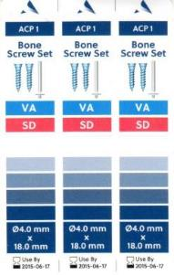
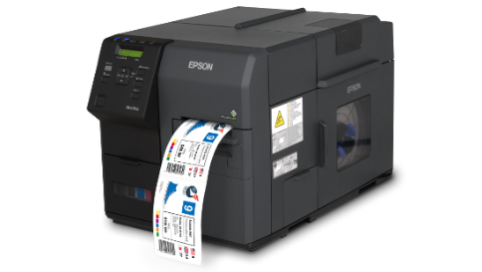
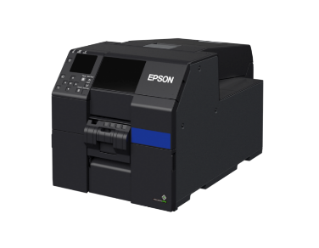
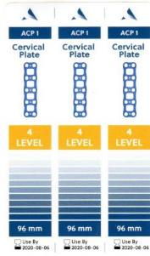
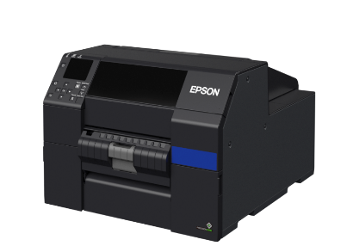
ColorWorks Product Offering for the Medical Device Industry
MAR
2020

Slide 2
Agenda
Market Requirements
Color Labels’ Impact on Customer Experience
Value Proposition
Product Lineup & Features
Advantage over Competition
Additional Resources

Slide 3
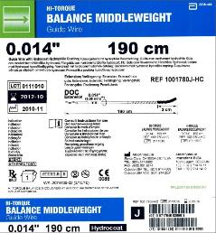
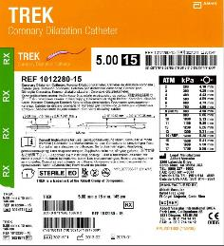
Medical Device Industry
Requirements
Lots of small text must be readable
Customer Pain Point
Patient safety requires color codes and pictures
  Helps identify item contents, size, and style
Highly variable color content can’t be printed dynamically
Pictures of item required
Accurate, readable barcodes required
Required color coding

Slide 4

Color Labels Create a
Better Customer Experience

Slide 5
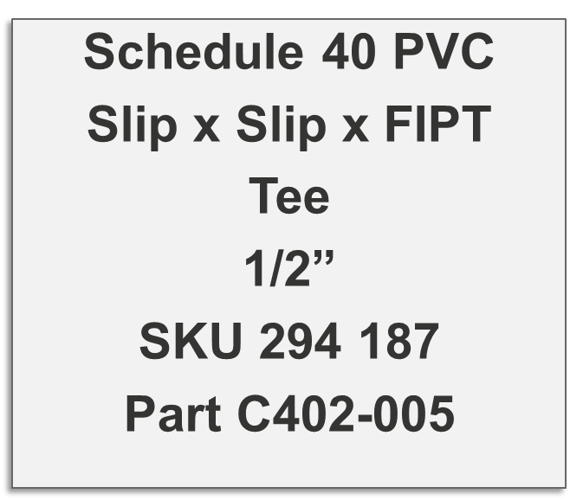
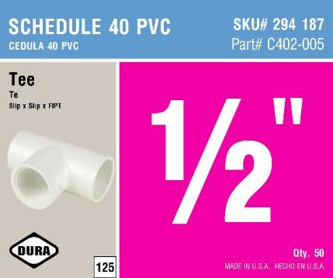
A Picture is Worth a Thousand Words
OLD THERMAL TRANSFER
NEW COLOR INKJET

Slide 6
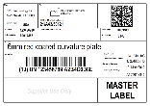
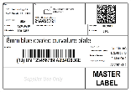
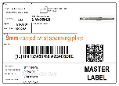
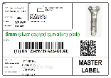
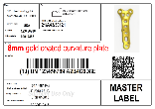
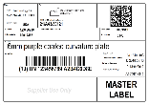
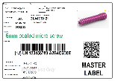
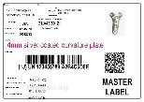
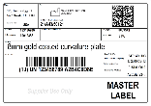
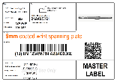
Color Images Help Customers Identify
Right Product
How easy can you find a 8mm gold coated curvature plate on right? Left?

Slide 7
The Solution

Slide 8

ColorWorks Value Proposition
Epson ColorWorks printers:
Effortlessly handle variable color content, custom label designs, diverse sizes, and evolving requirements
High resolution images, barcodes, and text
Eliminate pre-printed labels
BS5609 certified labels last under extreme conditions
Connectivity with required enterprise software
Smooth integration into production workflow with its ZPL II, I/O port, and peeler features
Notes:
Customer Insight: [What is the customer dealing with? Painpoints?]
Customer Benefit: [What does the customer want to be able to do?]
Gap in the market: What’s the problem with current solutions? Why does status quo not work? What is the market need?
Epson’s Value Prop: Why does our solution fill the gap in the market?
What makes us special/different?

Slide 9




Product Lineup
Attribute | C6000 | C6500 | C7500G | C7500 | C3500
MSRP | $2,580-3,050 | $3,500-3,980 | $8,819 | $8,819 | $1,919
Print speed (inches per second) | 4.7 | 3.4 | 11.8 | 11.8 | 3.3
Print width maximum | 4.25” | 8.34” | 4.25” | 4.25” | 4.1”
Resolution | 1200 x 1200 | 1200 x 1200 | 1200 x 600 | 1200 x 600 | 720 x 360
BS5609 | Yes | Yes | Yes | Yes | Yes
Internal media support | 8” roll | 6” roll | 8” roll | 8” roll | 4” roll
Rear media feed support | Ext. Roll & fanfold | Ext. Roll & fanfold | Ext. Roll & fanfold | Ext. Roll & fanfold | Ext. Roll & fanfold
Time to first print | Near instant | Near instant | 10-15 seconds | 10-15 seconds | Near instant
High gloss media | Yes | Yes | Yes | No | Yes
Semi gloss media | Yes | Yes | Yes | No | Yes
Matte media | Yes | Yes | Yes | Yes | Yes
Peeler | Yes | Yes | No | No | No
MSRP prices effective 10/20/2019

Slide 10
Focus on C6000 Series

Slide 11




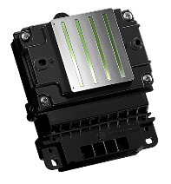
Product Feature: PrecisionCore™ technology
Perfectly round nozzles
High nozzle density
Precise dots
Variable droplet size
The precise dots created by the PrecisionCore™ TFP printhead's perfectly round nozzles ensure consistently superior image quality.
11

Slide 12




Product Feature: PrecisionCore™ technology
High gloss and high quality images create beautiful labels.
High resolution printing with PrecisionCore™ head （Max.1200 x 1200dpi) → Razor sharp barcodes, text, lines, and graphics
Automatic nozzle checking and correction
High resolution
High saturation
12

Slide 13
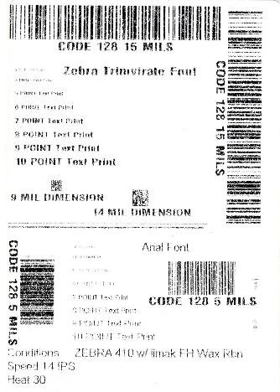
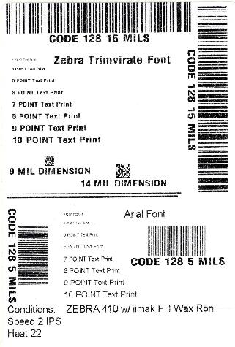
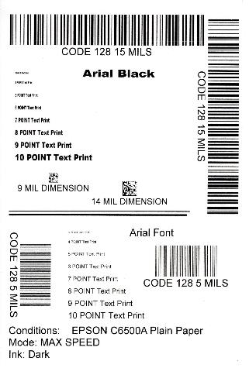
C6000 Print Quality Comparison
Zebra ZT410 at 14 ips
Zebra ZT410 at 2 ips
EPSON C6500A

Slide 14
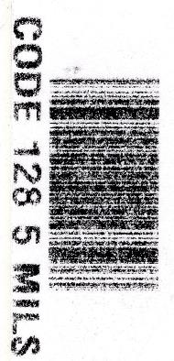

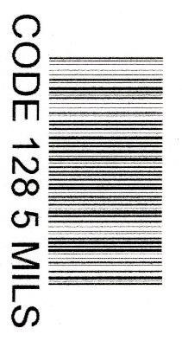
C6000 Barcode Quality Comparison
High quality barcodes for mission critical jobs
Zebra ZT410
14 IPS
Zebra ZT410
2 IPS
EPSON C6500A
4.7 IPS
Printed on matte thermal transfer media at best settings using iimak FH wax ribbon
Printed on plain non-inkjet paper in lowest quality mode

Slide 15

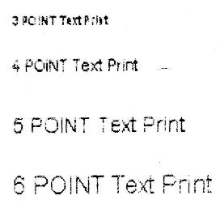
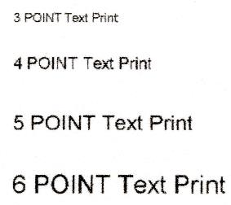
C6000 Text Quality Comparison
Huge improvement in readability for small text and details
Zebra ZT410
14 IPS
Zebra ZT410
2 IPS
EPSON C6500A
4.7 IPS
Printed on matte thermal transfer media at best settings using iimak FH wax ribbon
Printed on plain non-inkjet paper in lowest quality mode

Slide 16

Features for Industrial Use
Epson printers can be smoothly integrated into a production workflow with its features designed for industrial use:
Peeler
I/O port
ZPL II compatibility
Enables integration with downstream barcode verifier

Slide 17
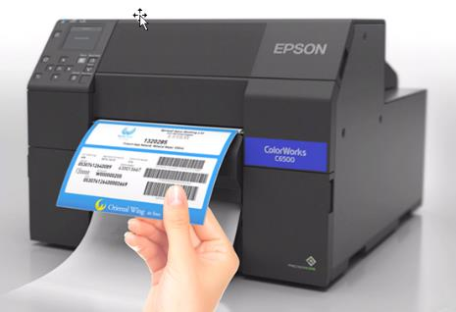
Product Feature: Peeler
The first color inkjet label printer to offer a peel-and-present option
Enables quick application
Faster production flow
Can apply labels with gloves on
17

Slide 18
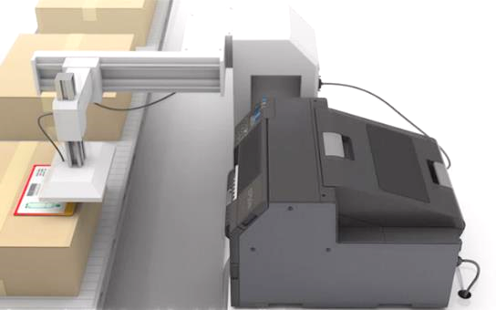
Print & Apply Capability
1st label printers with peel-and-present coupled with remote I/O control
Enables first print one apply one automated color label applicator
Compatible applicators are on the market; contact info available
18

Slide 19

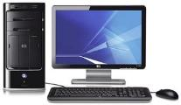
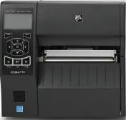
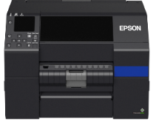


Ready to Drop Straight Into Action
Add a few data mods to colorize
Plug-n-Play direct ZPL II printing
ZPL II capability standard
Customer can start monochrome and migrate to color as needed
Makes customer trials easy; they don’t have to modify programming to test

Slide 20











C6000/ C6500 Connectivity
Native driver
Generally supported driver

Slide 21
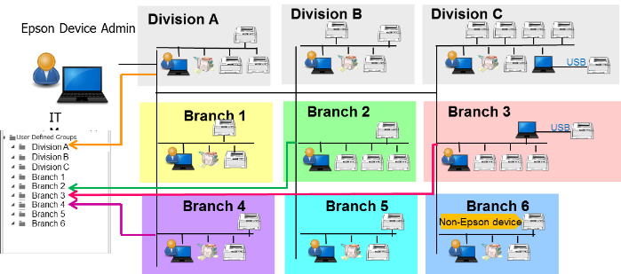
Remote Management Capability
Epson Device Admin
Some installations will have hundreds or thousands of units.
Units will be spread over multiple buildings, states, or countries.
Need consistent configuration – impractical to manage one-by-one.
IT managers will be able to diagnose and correct from afar.

Slide 22
Color Labels Improve the Bottom Line

Slide 23
Epson Advantage over Thermal Printing
Thermal printing fundamentally can’t do color
To add color, must purchase pre-printed labels → adds lead time and cost
Must scrap pre-printed labels when label designs change
Inkjet print quality far superior to thermal transfer

Slide 24
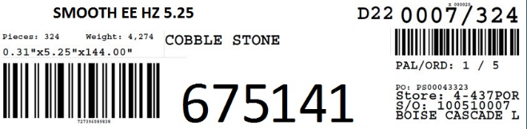
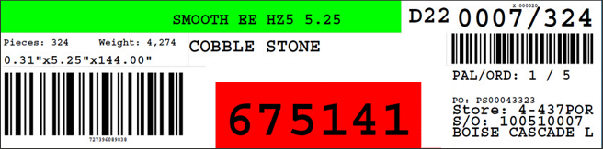
Color Coding Boosts Logistical Efficiency and Accuracy
Improves picking and placing accuracy
Reduced errors and rework
24

Slide 25
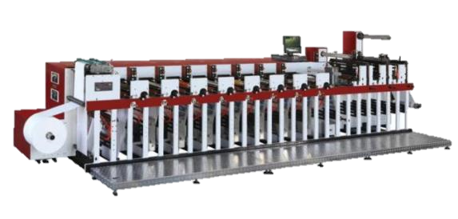
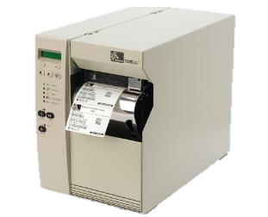
Typical “color printer” is not flexible
+
Static color laid down by flexo press in large run
Thermal printer adds variable data in black

Slide 26
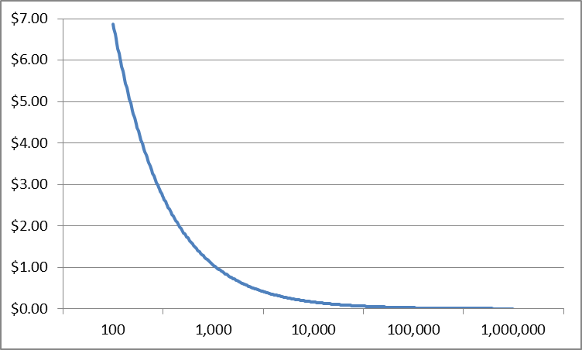
Flexo cost varies wildly by volume
PRINTING COST PER LABEL BY VOLUME
Almost all cost is setup
Creation of plates, alignment, testing, mixing ink
Ranges from $500 - $1,500/ run
Large runs needed to amortize setup cost
20,000 – 100,000 Optimal Order Quantity Per Run

Slide 27
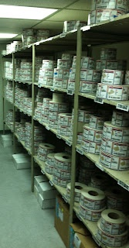
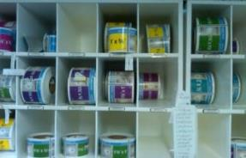
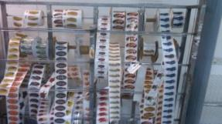
Pre-printed labels: Huge inventory, expense and waste
Every variation of image, color code, logos, etc. requires unique pre-print
Requires someone to order/ manage
Any changes → scrap inventory
Huge Opportunity to reduce lead time, labor and cost

Slide 28
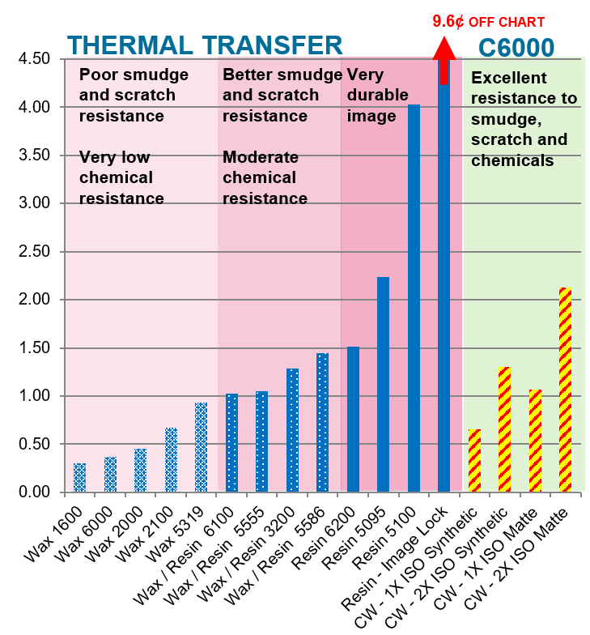
Competitive operating costs
(Printing Only)
Ink cost is comparable to thermal transfer.
For similar durability, ColorWorks costs less.
Only bottom end of durability costs less for thermal.
Label Cost (Cents Ea)
Thermal transfer ribbon prices based on published prices in Zebra ZipShip Ribbons price list May 1, 2019
ColorWorks pricing based on printing the ISO standard color test suite in Plain and Matte modes. 2X ISO is cost to double the density of the ISO patterns. 2X ISO equals to a typical GHS label

Slide 29
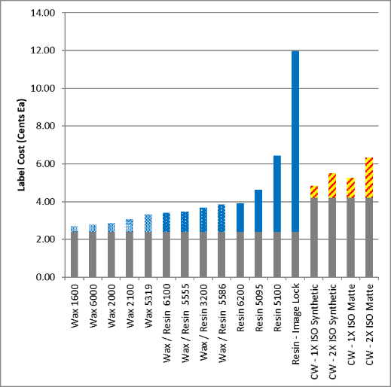
Competitive operating costs
(Print + Media)
Printed inkjet label costs are 1.29 cents higher than thermal transfer labels of moderate-high durability, but offer:
Improved resistance to smudging, scratches, chemicals, etc.
Ability to add color without purchasing pre-printed labels
Label Cost (Cents Ea)
Thermal transfer ribbon prices based on published prices in Zebra ZipShip Ribbons price list May 1, 2019
ColorWorks pricing based on printing the ISO standard color test suite in Plain and Matte modes. 2X ISO is cost to double the density of the ISO patterns. 2X ISO equals to a typical GHS label

Slide 30
Detailed Cost Analysis
See spreadsheet

Slide 31
Epson Advantage over Color Label Competitors
Connectivity with required enterprise software
Smooth integration into production workflow with its ZPL II, I/O port, and peeler features → enables print & apply
Service locations all over North America & worldwide

Slide 32
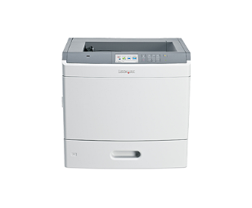
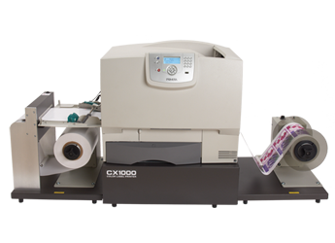
Color Laser Pros & Cons
Good image quality ⬆
High speed ⬆
Best suited for batch print runs⬇
Long warm up time to first label⬇
Poor form factor for industrial applications ⬇
Label waste ⬇
    Typically fed in large multi-up sheets. If only one label is needed many can be waste
High equipment cost ⬇

Slide 33
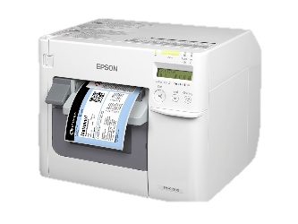
Epson Color Inkjet Pros & Cons
Quick time to first label ⬆
Small footprint typical industrial form factor ⬆
Good image quality ⬆
Low equipment cost ⬆
Suited for batch or on demand print runs ⬆
Very simple to operate ⬆
Very low maintenance ⬆
Medium speed ⬄

Slide 34
Service and Warranty Options

Slide 35
Service, Warranty, and Support
Factory Warranty
One Year Return to Depot
  Printer is shipped to Epson at end user’s expense
  Unit is repaired and returned with Epson paid shipping
Service Options (vary by model)
  SITA
    Customer calls and replacement printer shipped overnight
    Customer packs broken printer and returns pre-paid to Epson
  Extended Depot Warranty
    Printer is shipped to Epson at end user’s expense
    Unit is repaired and returned with Epson paid shipping
  On-Site Service
    Service technician travels next day to end user site to fix printer
    Service locations all over North America & worldwide

Slide 36
Summary
Improve your business with color:
Eliminate waste of pre-printed labels
Color code to reduce errors, improve processing
Add pictures to help ID products
Improved branding to grow sales
Enable private brands and customization
Eliminate hassles of ribbons and thermal transfer

Slide 37
Additional Resources
Case Studies/ Success Stories
Immunalysis Corp
VWR International
Videos
Epson C6000 Series “Tough Guys”
Millstone Medical
Epson C6000 Series – Take the Tour
Epson C7500 Series – Take the Tour
Epson C3500 – Take the Tour

Slide 38
Thank you
epson.com

