Slide 1
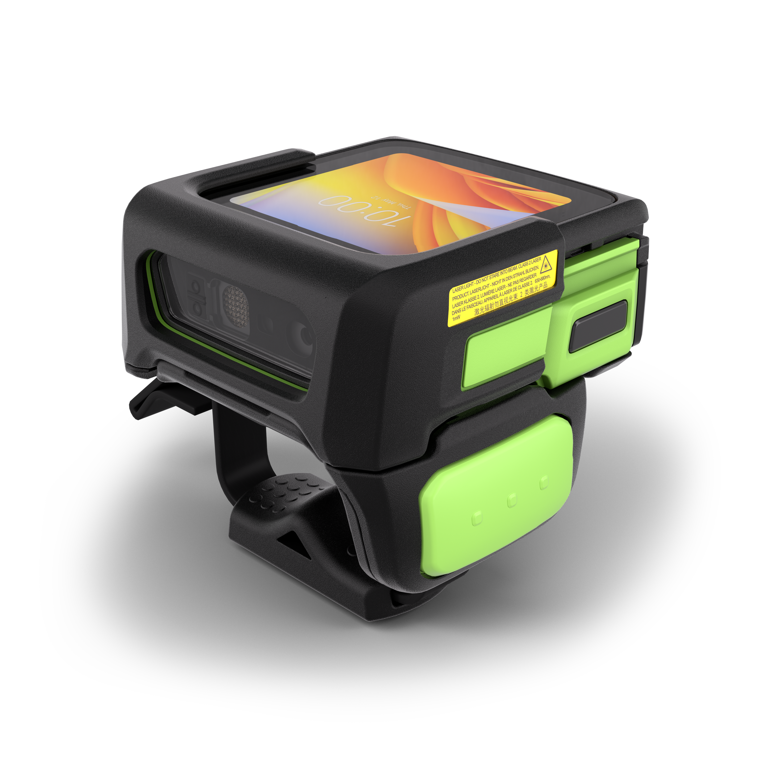

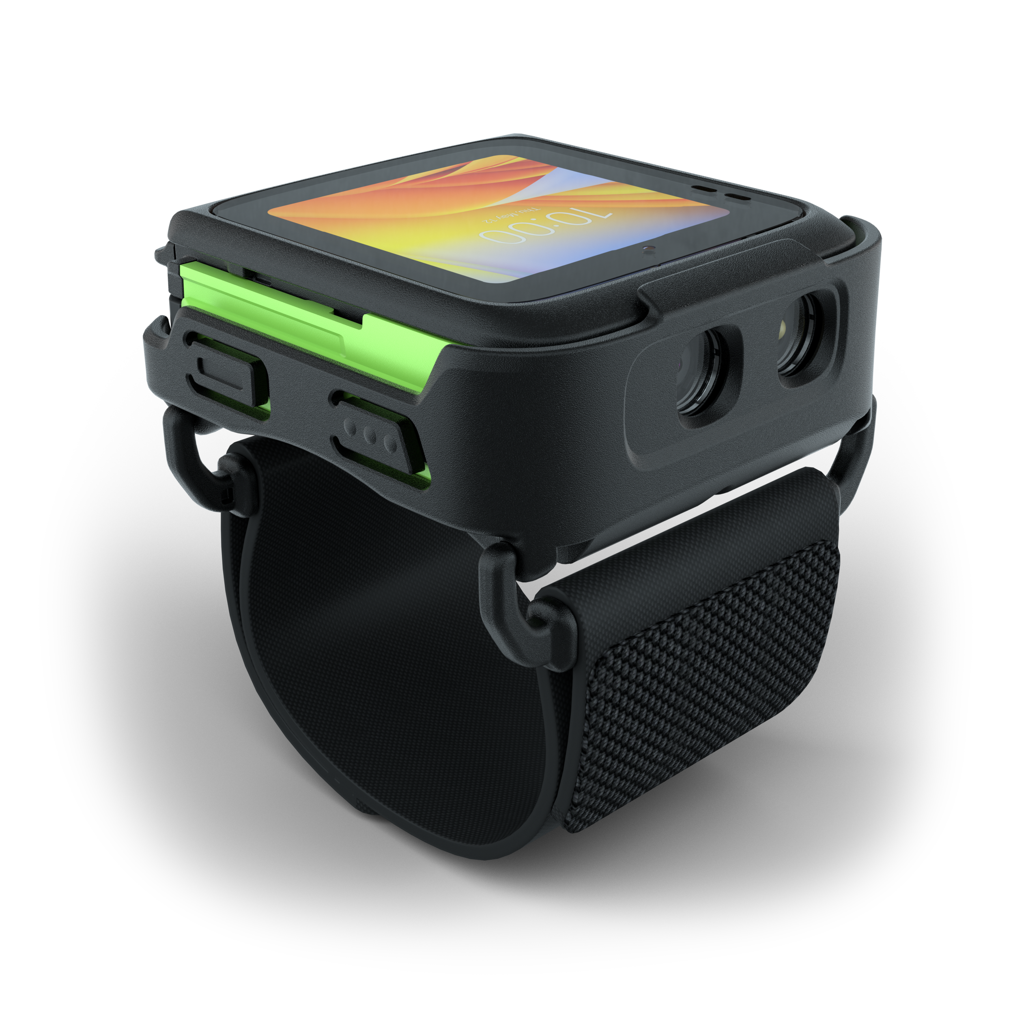
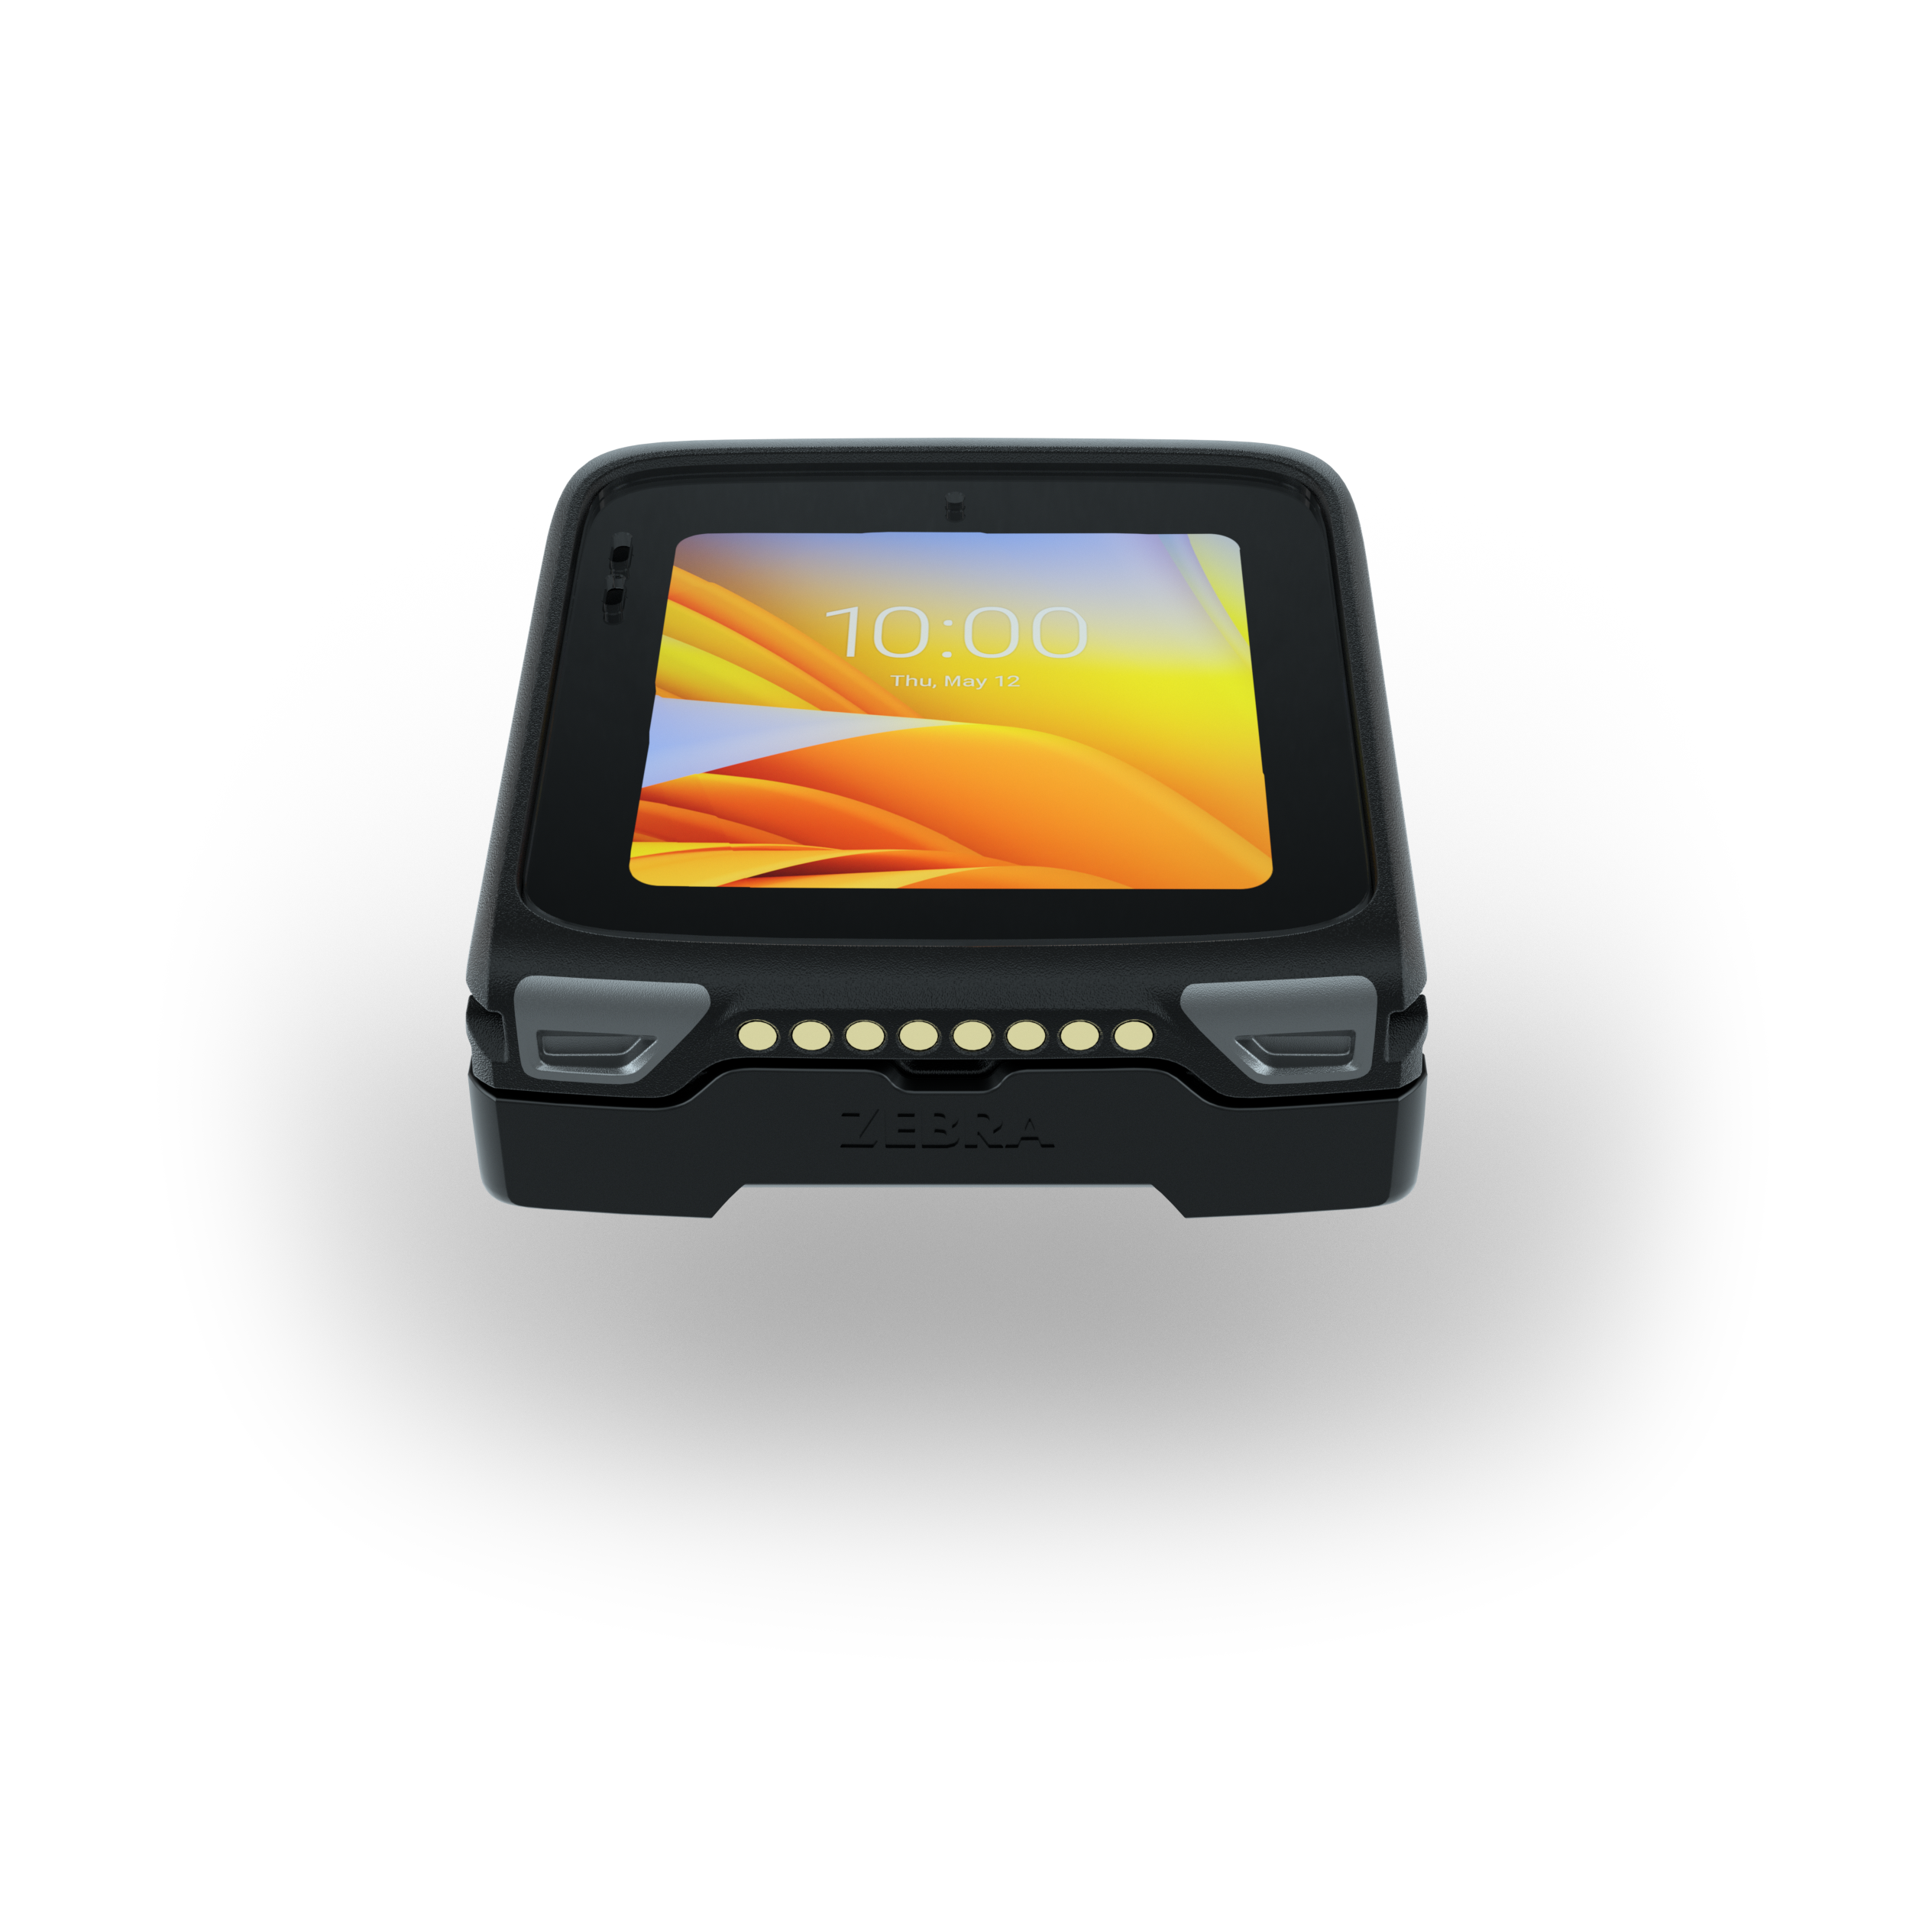
WS50 Android Wearable Computer
The world’s smallest all-in-one Android enterprise-class wearable mobile computer
February 22, 2022

Slide 2
Agenda
Why Zebra?
Challenge and Solution
Vertical Markets and Applications
Unique Benefits
Product Tour
Zebra Mobility DNA
Zebra Services

Slide 3

Why Zebra?

Slide 4

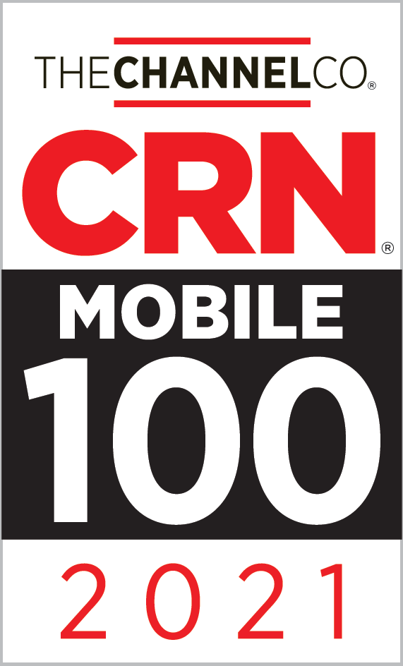



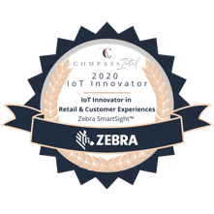
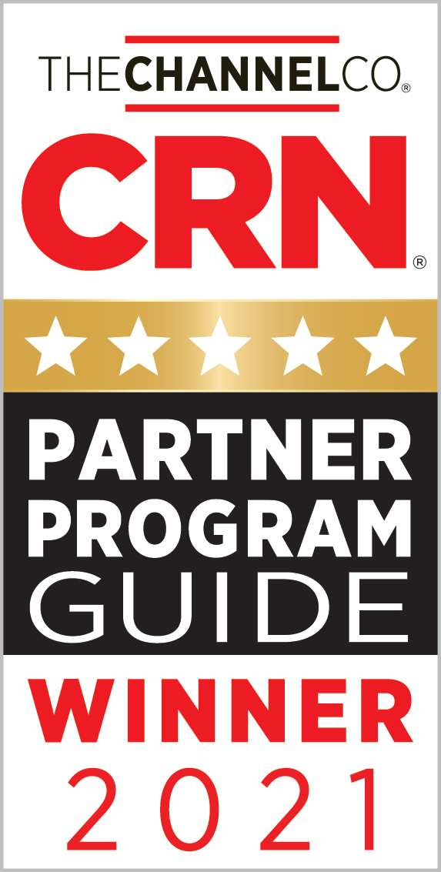

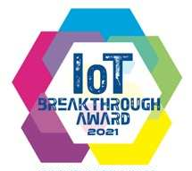


Why Zebra
Extensive Reach
Scalable to meet any
enterprise demands
Leader Status
Gartner Magic Quadrant for Indoor Location Services — Worldwide
Our People
Make the Difference
Channel
Accolades
$4.5B
Global Sales
#1
128+ Offices
in 42 Countries
Rugged
Mobile Computing
5,300+ US and ITL
Patents Issued and Pending
Data Capture
8,800+
Employees Worldwide
Barcode Printing
10,000+ Channel
Partners in Over 100 Countries
Mobile RFID
$453M+ R&D*
*10% of Sales
Sources: VDC Research and Zebra analysis (f#1 market share), Gartner, Inc., "Magic Quadrant Indoor Location Services, Global," Tim Zimmerman, Annette Zimmermann, 13 January 2020 (Leader Status Status)
4

Slide 5






Only Zebra offers a deep understanding of software and industry needs
We have committed to Android since 2011
We are the undisputed leader in enterprise Android: 57% market share in 2020, with 31 Android-based products
We have invested more than $300 million in Mobility DNA and refined it through multiple OS versions and thousands of deployments
We added important enterprise security, device management, application management and data capture features
No other vendor offers such a comprehensive ecosystem of software
to support rugged Android devices in the enterprise
5

Slide 6

Challenge and Solution

Slide 7








The hidden cost of the disconnected task worker
Disconnected workers are forced to take more steps and need more time to complete a task – eroding operational efficiency and making it harder to compete in today’s on-demand economy
  How do workers know what their next task is?
  How do workers communicate with each other or managers?
  How do managers assign tasks to an employee?
  How does a supervisor manage task status?
MARKETS
Warehousing
Manufacturing
Transportation & Logistics
Retail
Hospitality
7

Slide 8




The typical barriers to connecting task workers
  Large screen mobile computers can be overkill for some task-based workflows
  Typical wearable solutions require a separate ring scanner and mobile computer — doubling the number of devices to purchase
Cost
Management Complexity
  Two-piece wearable solutions increase your device management burden… more devices, more batteries and more service contracts to manage
Worker Training
Task workers don’t need a full-size mobile computer — and a simplified user interface is more suitable
8

Slide 9
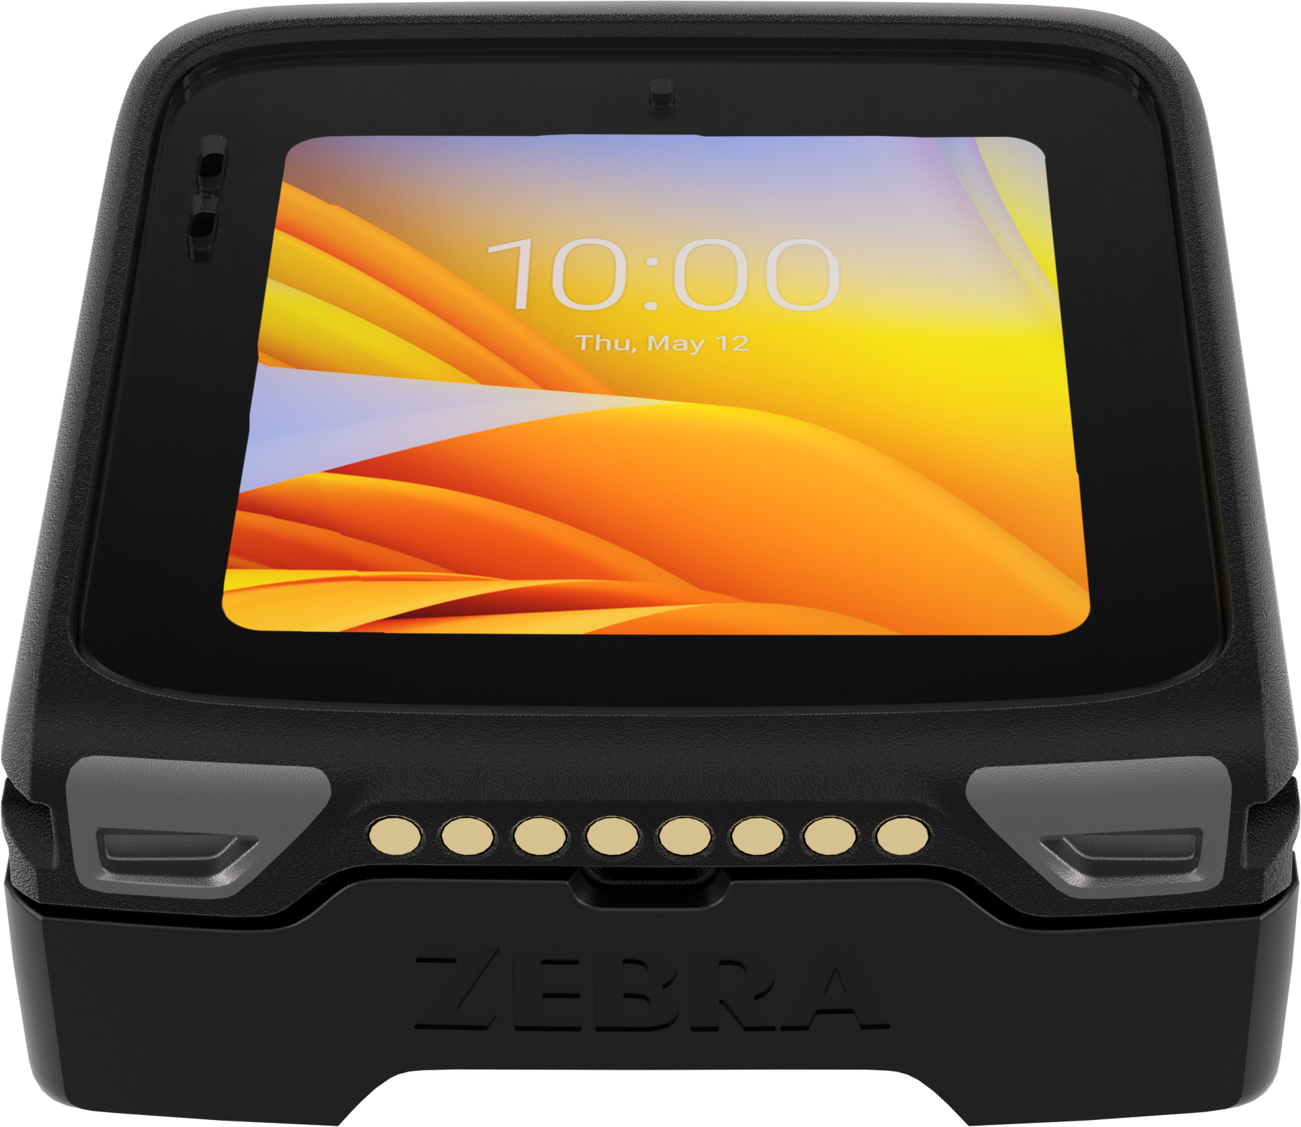
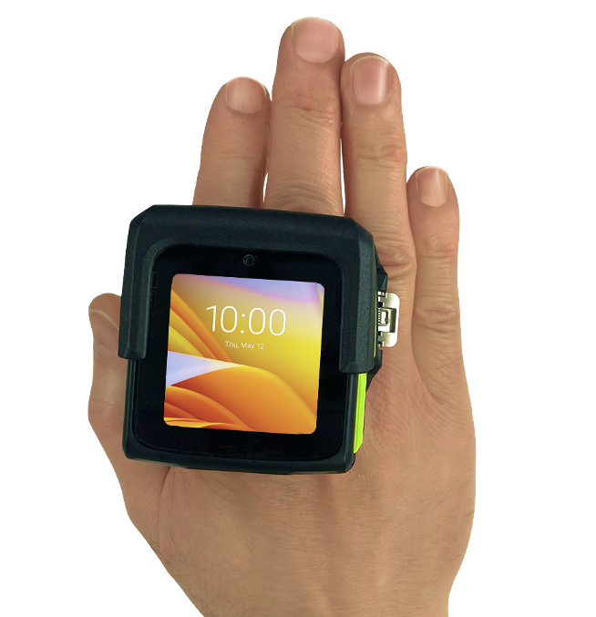
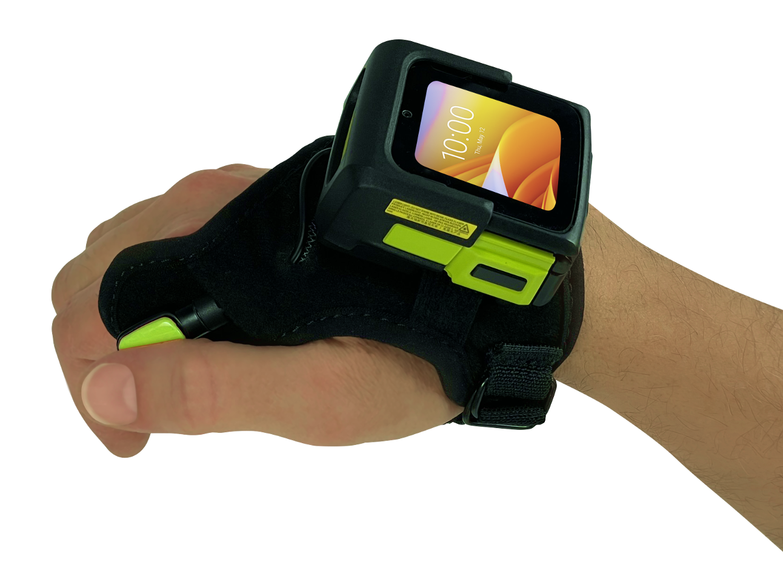
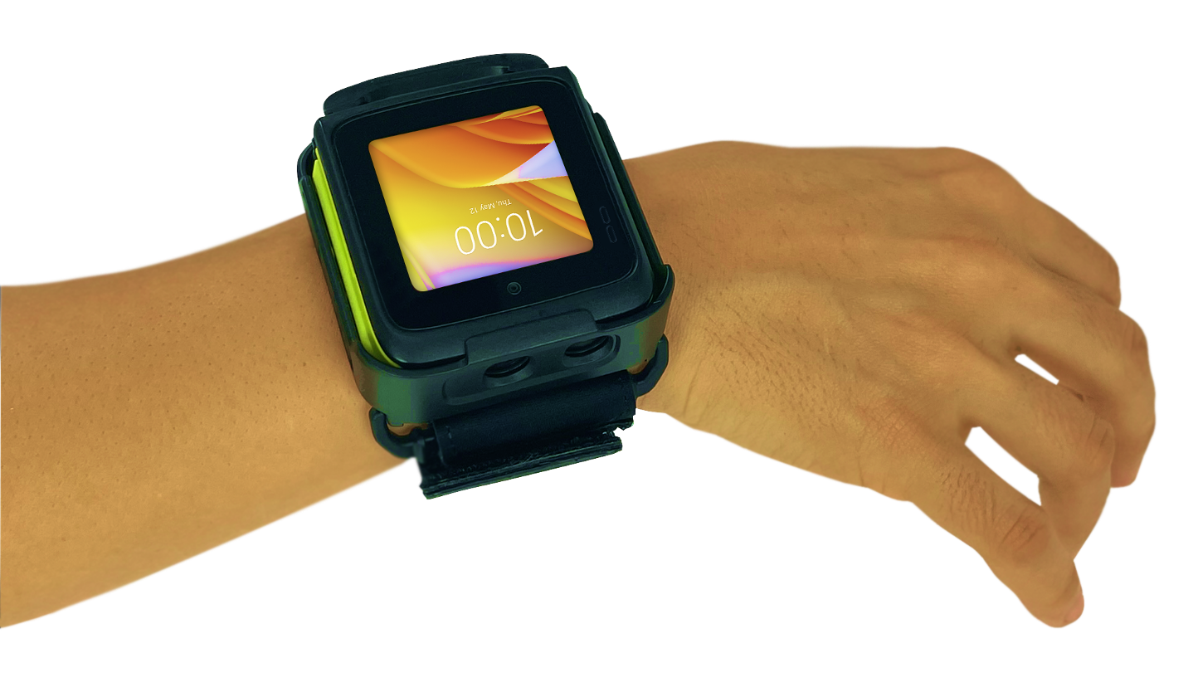
Introducing
The WS50 Android Wearable Computer
The world’s smallest all-in-one Android enterprise-class wearable mobile computer
…the easy way to connect today’s disconnected workers
9

Slide 10
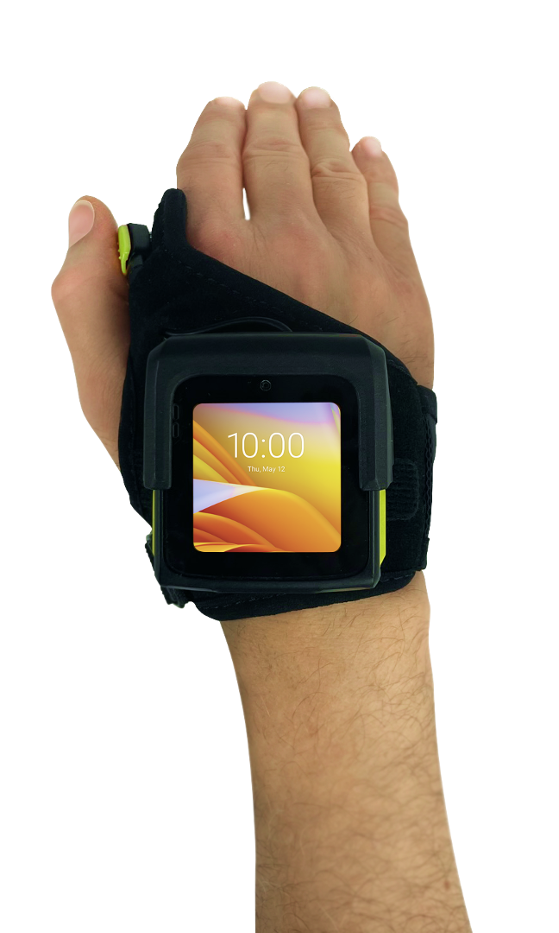

What sets the WS50 apart from the rest?
All-in-one wearable scanner and mobile computer
Maximum flexibility
with three modular mounting options
Smallest Android enterprise-class wearable computer
Industry standard Android OS
Task management, PTT voice and enterprise-class
data capture
Best-in-class 2-inch super bright AMOLED touch display
Easy centralized management with leading EMMs
Powerful Zebra-only Mobility DNA tools
10

Slide 11
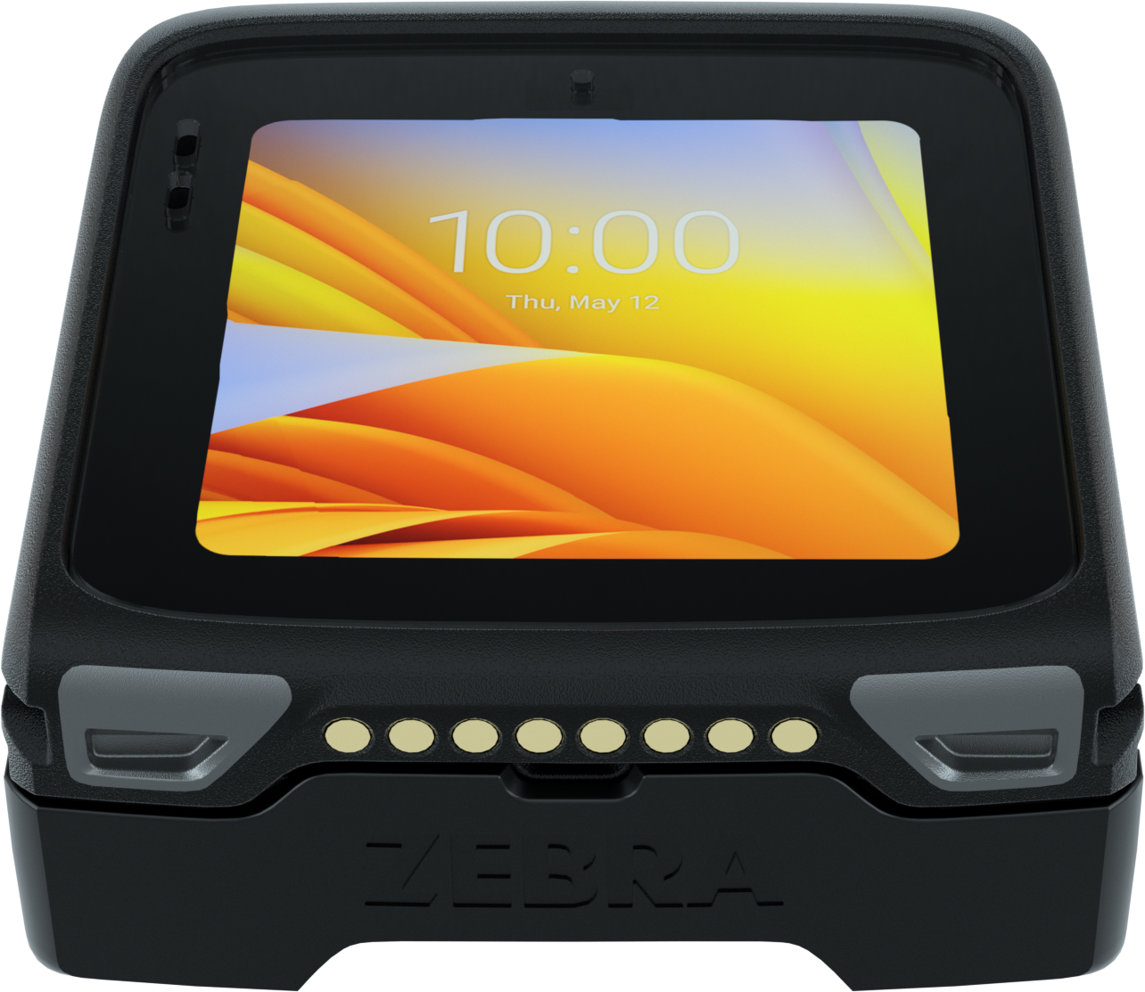
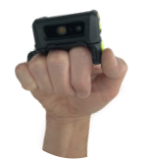
Meets the needs of practically any application with modular mounting options
1
3
Android
computing core
Ways to
wear it
Converged Finger Mount
Scan-intensive workflows
Worn on two fingers
Converged Back of Hand Mount
Scan-intensive workflows
Worn on the back of hand (with or without a glove)
Wrist Mount
Task management
Worn on the wrist

Slide 12

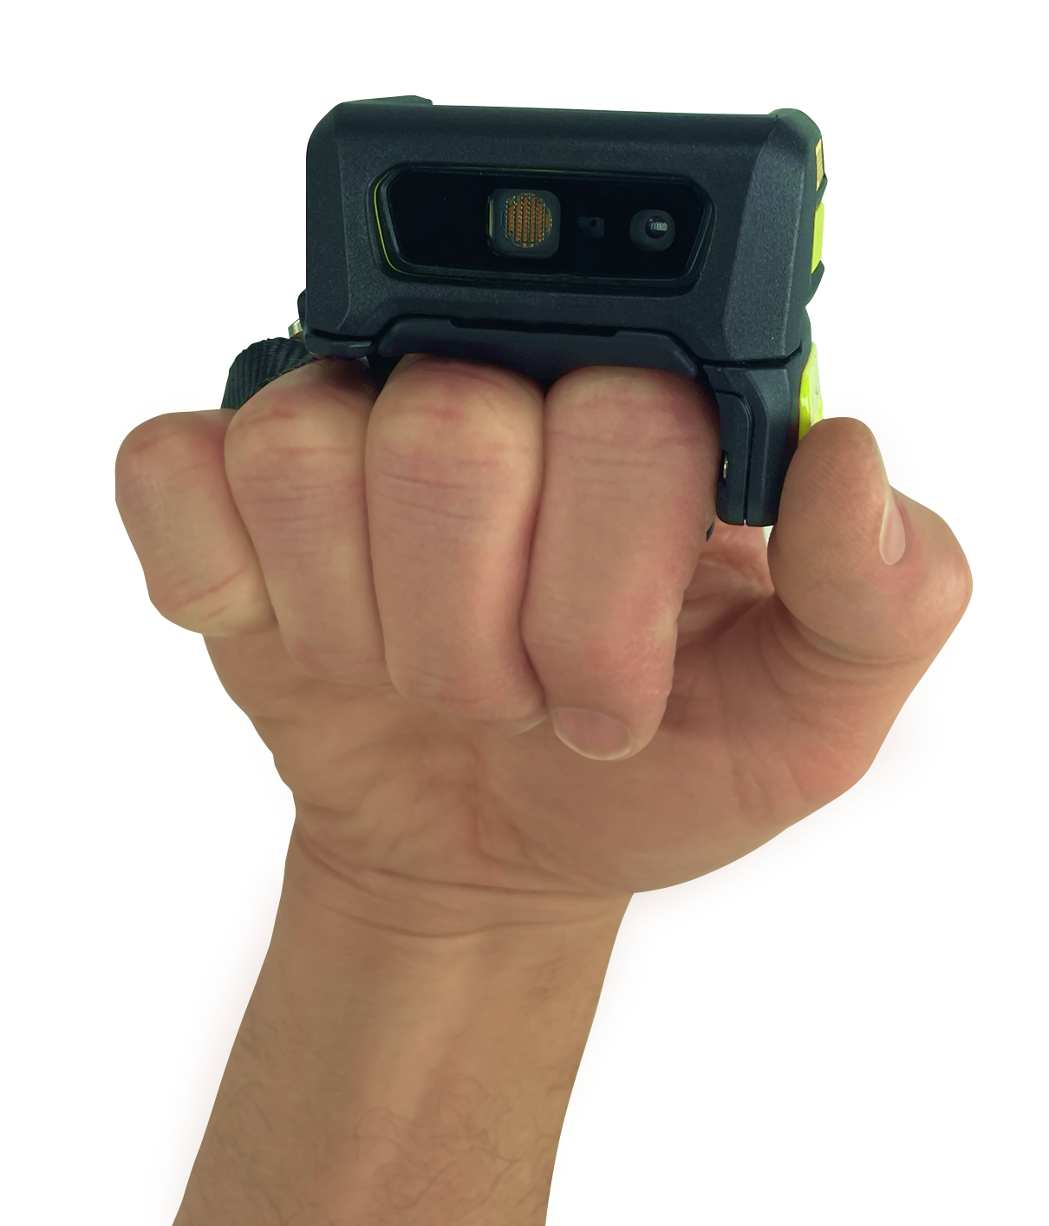
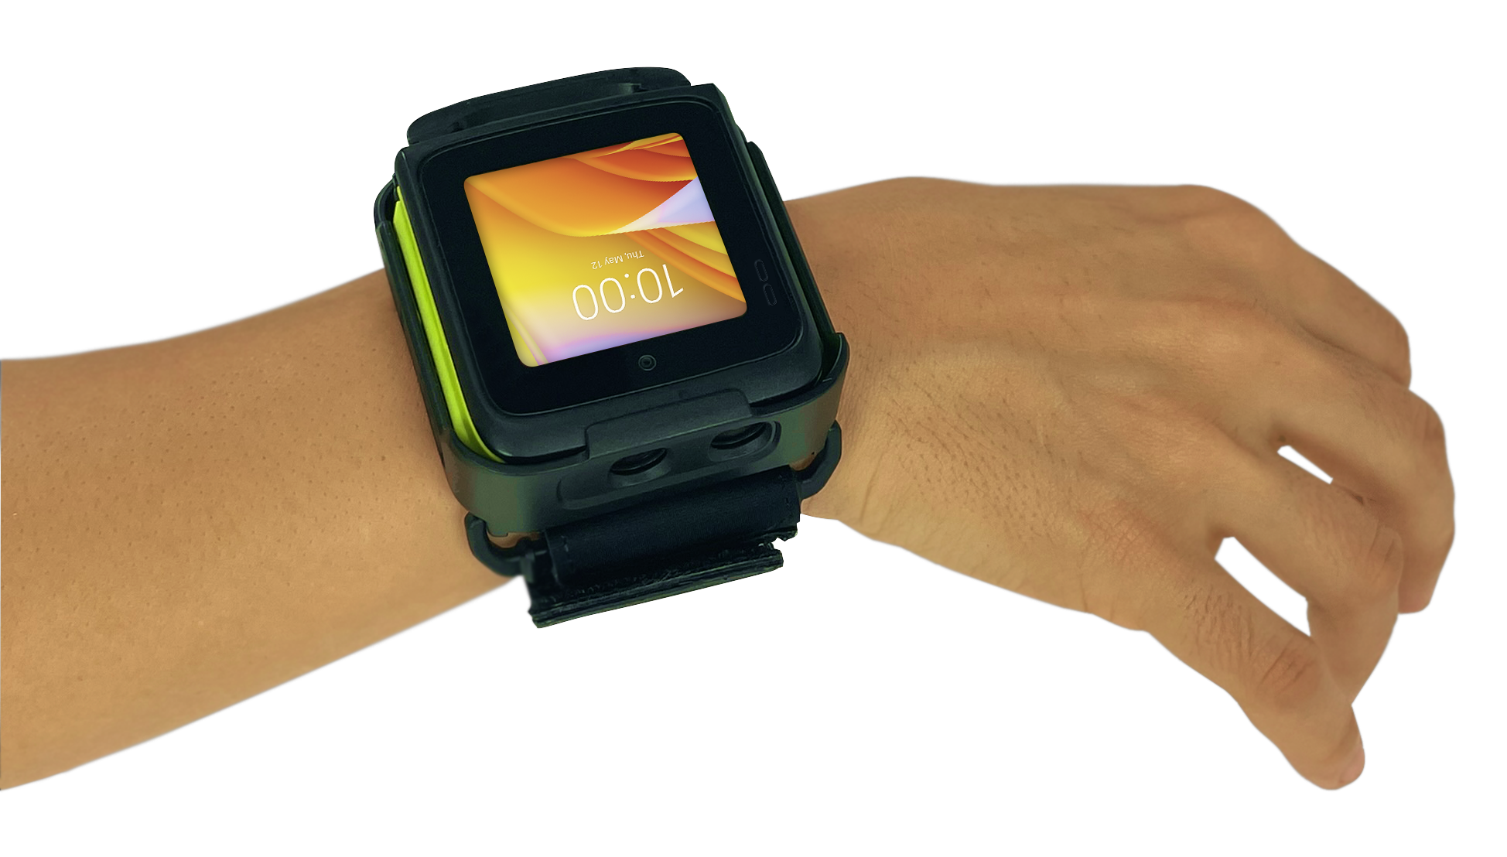
Flexibility
Choose the platform that best meets your needs
Converged Scan
(two finger mount)
Converged Scan (back of hand)
Wrist Mount
WS50 Core
Enterprise-class SE4770 imager for
scan-intensive applications
Task management applications
PTT voice applications via
embedded speaker and microphone
or
Bluetooth headset
1300 mAh battery
6 ft./1.8 m drop specification
Finger trigger with strap
WS50 Core
Enterprise-class SE4770 imager for
scan-intensive applications
Task management applications
PTT voice applications via
embedded speaker and microphone
or Bluetooth headset
1300 mAh battery
6 ft./1.8 m drop specification
Back of hand mount
WS50 Core
13MP camera for photo capture or video and occasional barcode scanning
Task management applications
PTT voice applications via
embedded speaker and microphone
or Bluetooth headset
800 mAh battery
4 ft./1.2 m drop specification
Wrist mount and wrist strap

Slide 13

Vertical Markets
and Applications
Notes:
So why the Zebra L10 A-x? The L10 a-x is ideal for the government sector in public safety, including emergency management, policing, Identity control, outdoor field operations.
Your first responders help make our communities safer and our tablets make their assignments easier and more efficient. With multiple antenna pass through to improve communications throughput, sunlight-readable displays that are easy to read even in a vehicle, and integrated fingerprint readers, smartcard readers, or Windows Hello facial recognition for two-factor authentication, Zebra L10 tablets are the best choice for public agencies.

Slide 14

Verticals
Warehousing
What can your warehousing workforce do with the WS50?
Key applications
Sorting
Put away
Picking
Unloading/loading
Task management
Warehouse managers can push messages and tasks to any worker – without having
to physically track anyone down
Worker moves goods from receiving zone to warehouse shelves
Worker receives urgent task and confirms completion
WS50 models
Converged
(scan-intensive workflows, task management, communications)
Worker gets line of sight instructions for proper bin location for scanned item
Worker gets real-time picking instructions and scans items and shelf tag
14

Slide 15

Verticals
Transportation and Logistics
What can your T&L workforce do with the WS50?
Key applications
Sorting
Unloading/loading
Task management
Worker receives voice-directed instructions to load packages on the proper truck
Managers can push messages and tasks to any worker – without having to physically track anyone down
WS50 models
Converged
(scan-intensive workflows, task management, communications)
Worker receives urgent task and confirms completion
Worker gets line of sight on-screen instructions for proper bin location for scanned item
Worker receives line of sight on-screen instructions to place package on the proper conveyor
15

Slide 16
Verticals
Manufacturing
What can your manufacturing workforce do with the WS50?
Key applications
Equipment maintenance
Line side replenishment
Task management
Floor supervisors can push messages and tasks to any worker – without having to physically track anyone down
Materials manager receives alert of low stock on the assembly line and requests immediate replenishment
WS50 models
Wrist core
(task management, monitoring, communications)
Converged
(scan-intensive workflows, task management, communications)
Maintenance worker receives alerts when machinery needs repair
Worker receives an urgent request for replenishment and confirms completion
Maintenance worker monitors equipment status dashboards on the wrist
16

Slide 17

Verticals
Retail
What can your retail workforce do with the WS50?
Key applications
Pricing/markdowns
Back of store operations
Task management
Worker can move inventory from the loading dock to the backroom or sales floor
Store supervisors can push messages and tasks to any worker – without having to physically track anyone down
WS50 models
Wrist core
(task management, communications)
Converged
(scan-intensive workflows, task management, communications)
Worker can receive an urgent task request and confirm completion
Sales associate can contact the backroom via PTT to request an item
Sales associate can perform price management tasks
17

Slide 18

Verticals
Hospitality
What can your hospitality workforce do with the WS50?
Key applications
Food service: restaurant servers; room service
Housekeeping
Janitorial service
Front desk contacts the bellman for urgent help with guest luggage
Food service worker receives on-screen delivery instructions for room service
WS50 models
Wrist core
(task management, monitoring, communications)
Converged
(scan-intensive workflows, task management, communications)
The front desk can push messages and tasks to any worker throughout the facility
Housekeeping contacts maintenance via PTT for help with a leaky sink
Housekeeping receives an urgent request for guest towels and confirms task completion
18

Slide 19

Unique Benefits

Slide 20
The power of ONE
– no host mobile computer required!
Powerful data capture and a host mobile computer in one
Equip your workforce with the simplicity of an all-in-one solution:
20
One device to wear
One device to procure
and manage
One battery to manage
One service contract
to administer

Slide 21
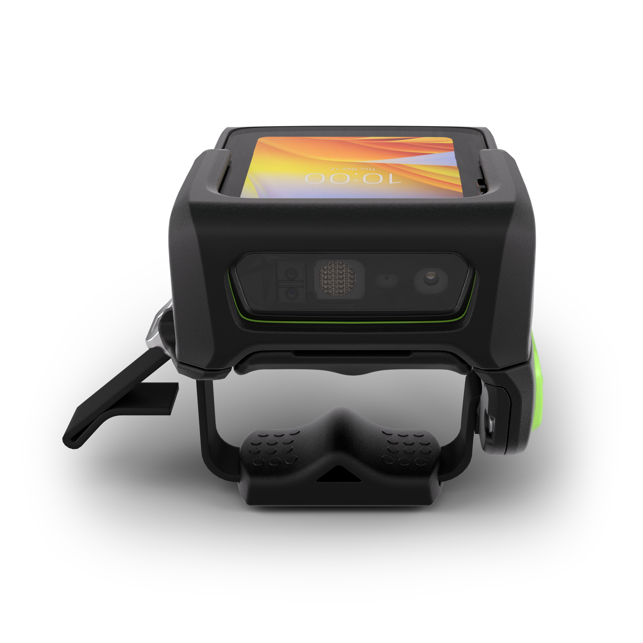
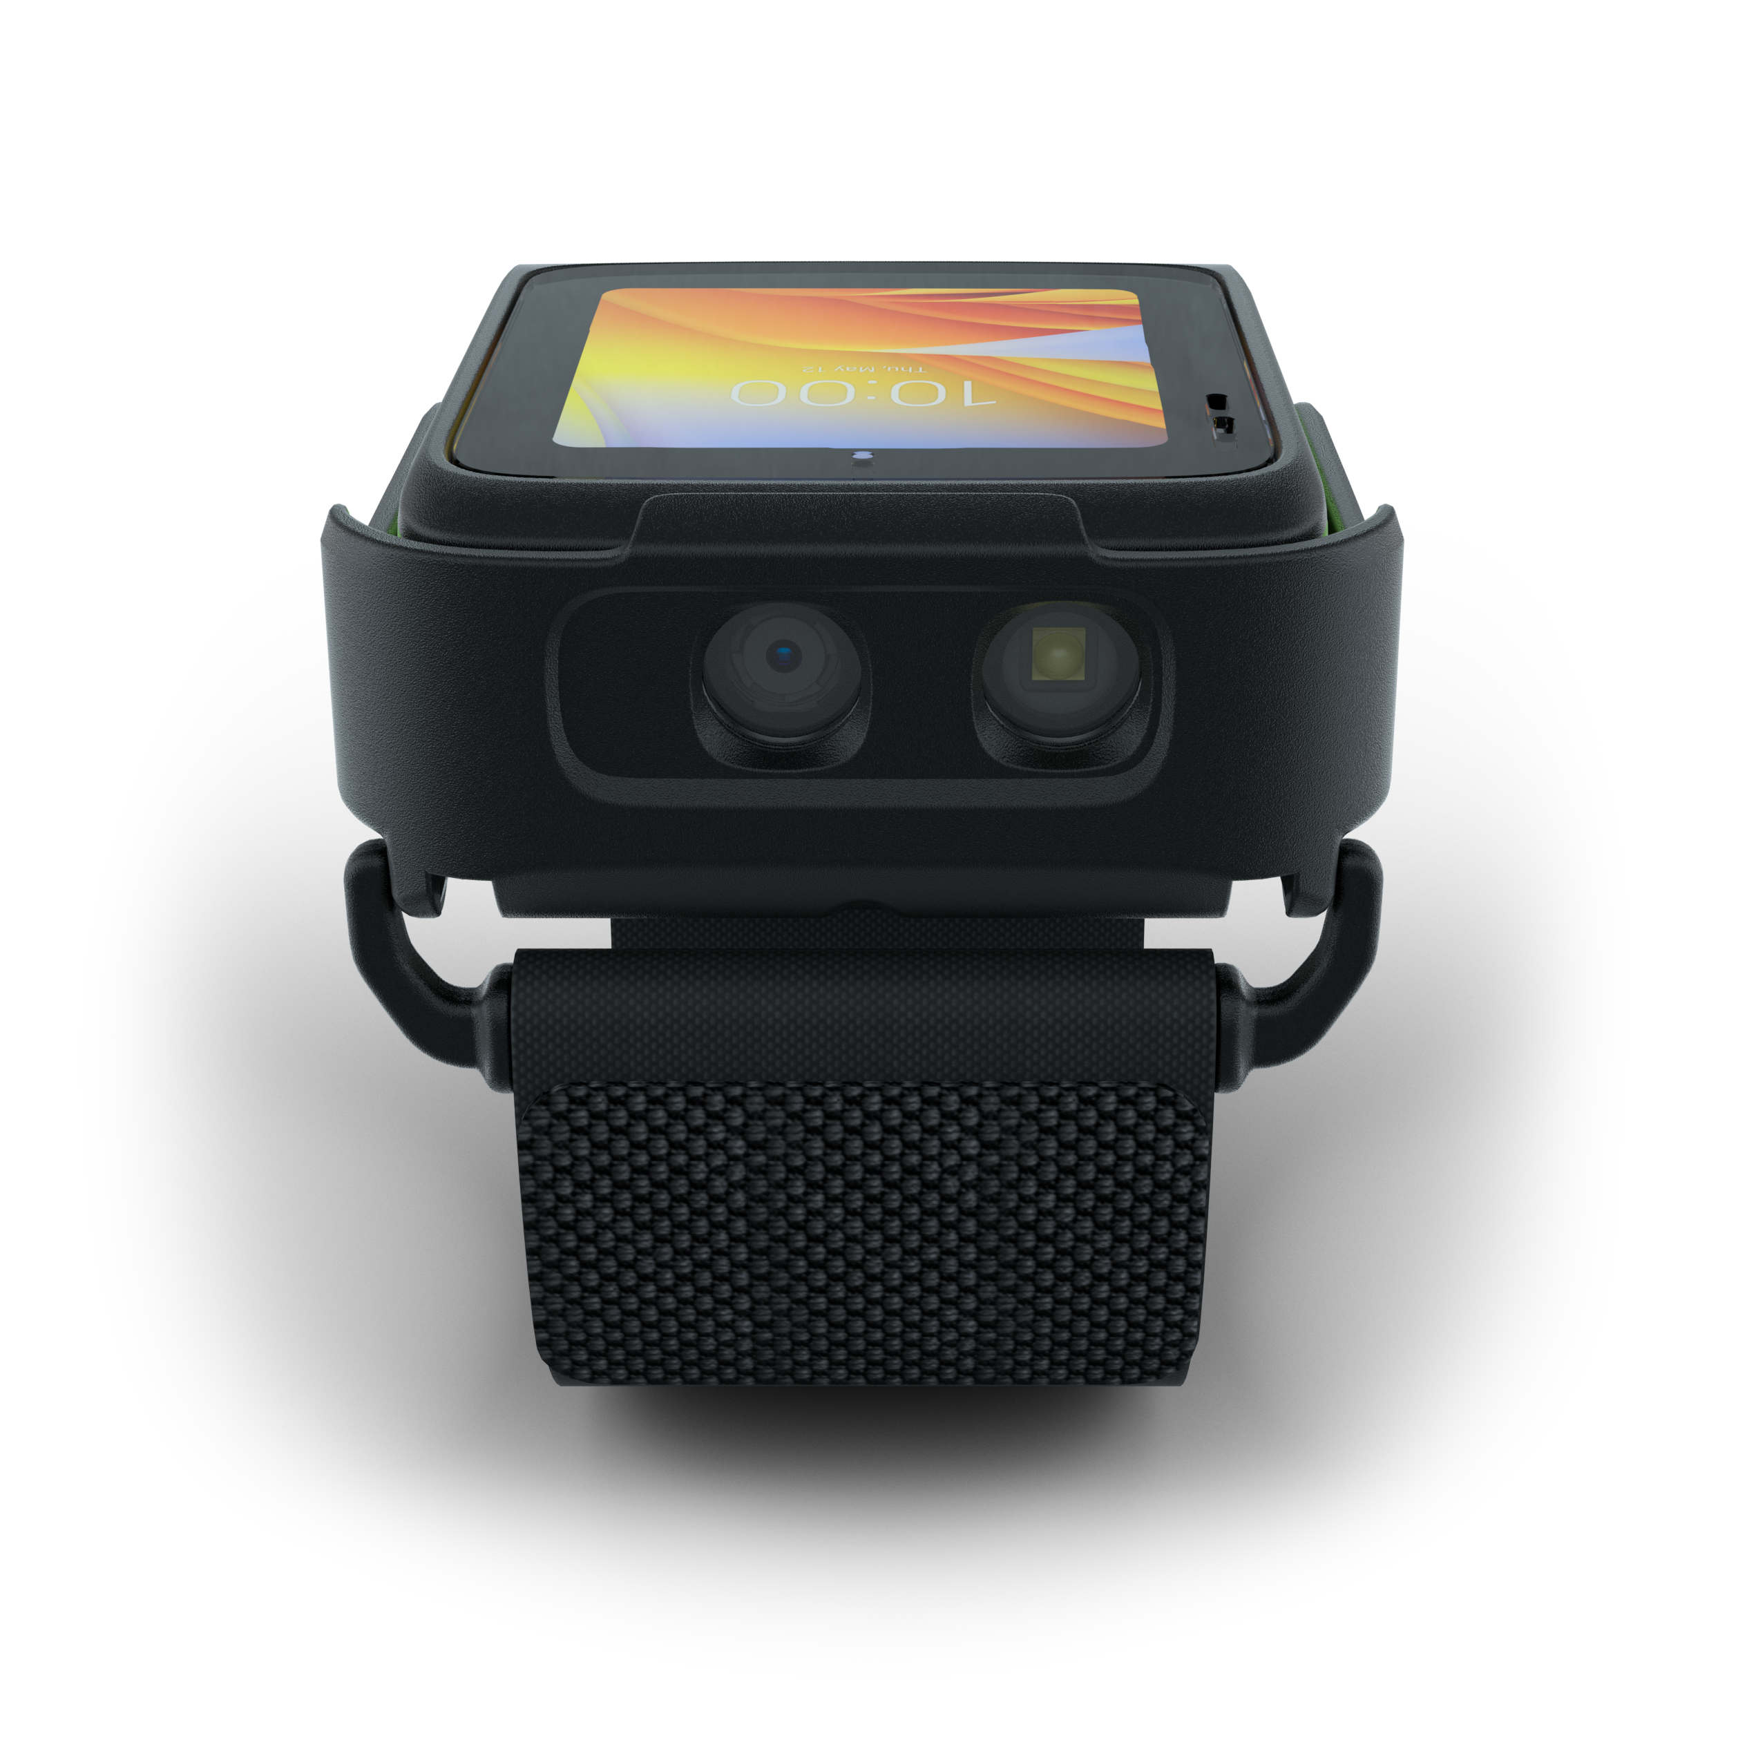
Data Capture
Enterprise-class data capture options
Converged Scan Models
SE4770 scan engine
Wrist Mount Model
13MP camera
Superior data capture for frequent barcode scanning:
Capture barcodes in practically any condition,
even dirty or damaged
Capture barcodes in motion
Scan continuously with optional proximity sensor
Capture large barcodes
Capture multiple barcodes with a single trigger press
Photo capture and occasional barcode scanning:
Capture detailed photos or video to
document proof of condition and more
Occasional barcode scanning

Slide 22
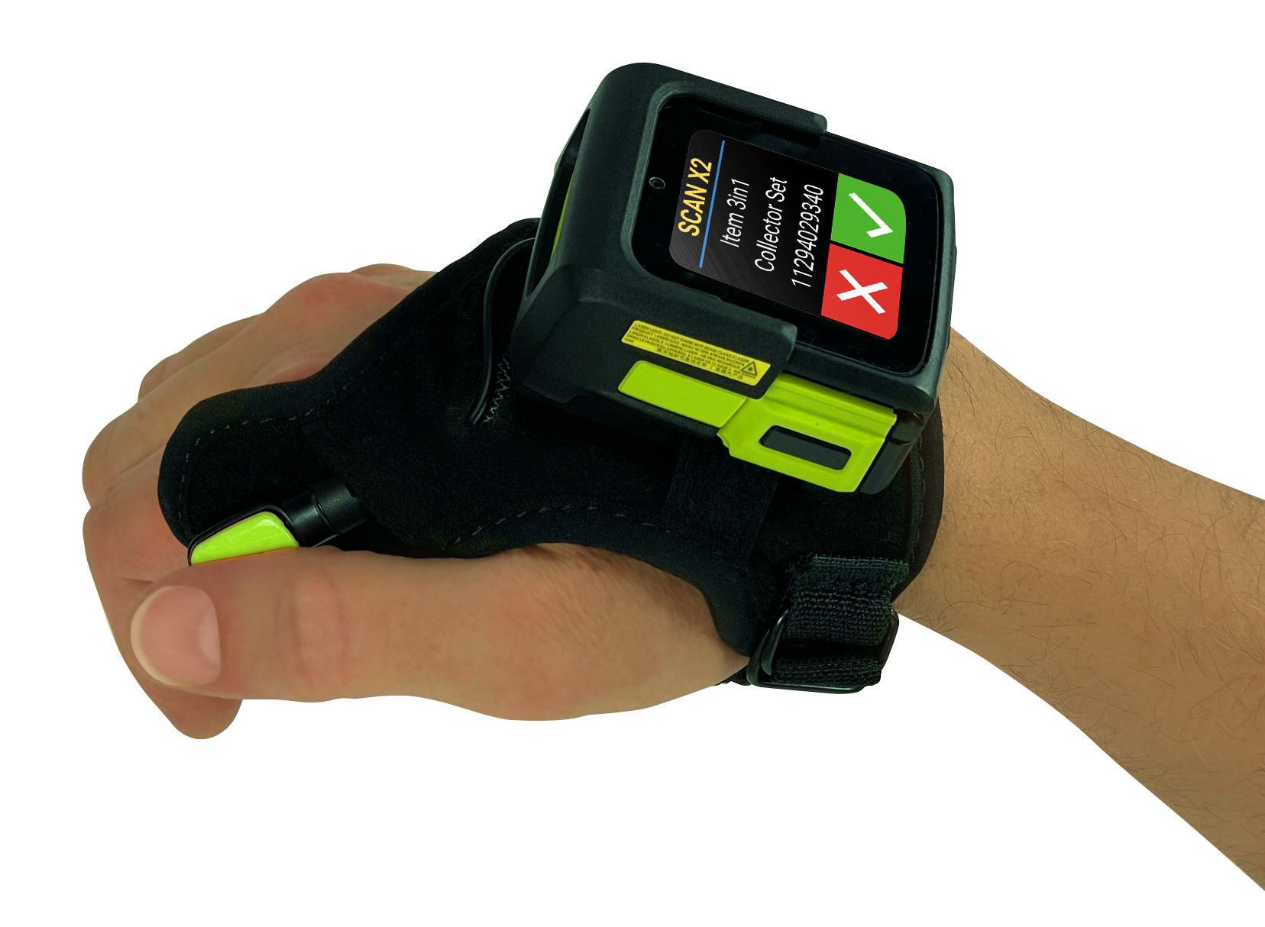
User Interface
Optimized for task-based applications
Superior readability with AMOLED display
Extraordinarily bright for easy viewing in any lighting condition
Better contrast and viewing angles
Right-sized two-inch display
Ideal screen size for simplified task-based applications and communication
Programmable buttons
Instant access to commonly used functions like PTT, camera, barcode scanning and more
22

Slide 23
Small but mighty
All the key features of a full-sized mobile computer
Push-to-talk
(PTT)
Increase workforce collaboration with PTT
Dedicate a button
to PTT for instant access
Embedded speaker and microphone
Bluetooth headset
Full-shift perpetual power
Removable,
hot-swappable batteries; support back-to-back shifts
1300 mAh battery (converged);
800 mAh battery (wrist)
Power of
Android
Industry-standard mobile OS
Future-proof platform to support new technologies and features

Slide 24
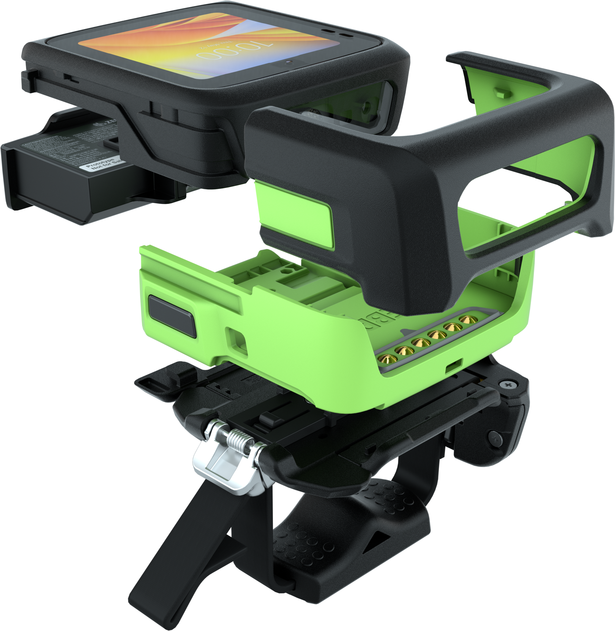
Rugged
Built to handle all-day everyday enterprise use
Handles bumps
and drops
6 ft./1.8 m drops and 2,000 tumbles: converged two-finger and back of hand models
4 ft./1.2 m drops and 1,000 tumbles: wrist mount model
Waterproof
and dust-proof
IP65 sealing
All models are
dust-tight and survive jetting water
Ultra-strong Corning®
Gorilla® Glass
Gorilla Glass fortifies display and imager window
Replaceable protective front shell
Keep your devices looking like new

Slide 25
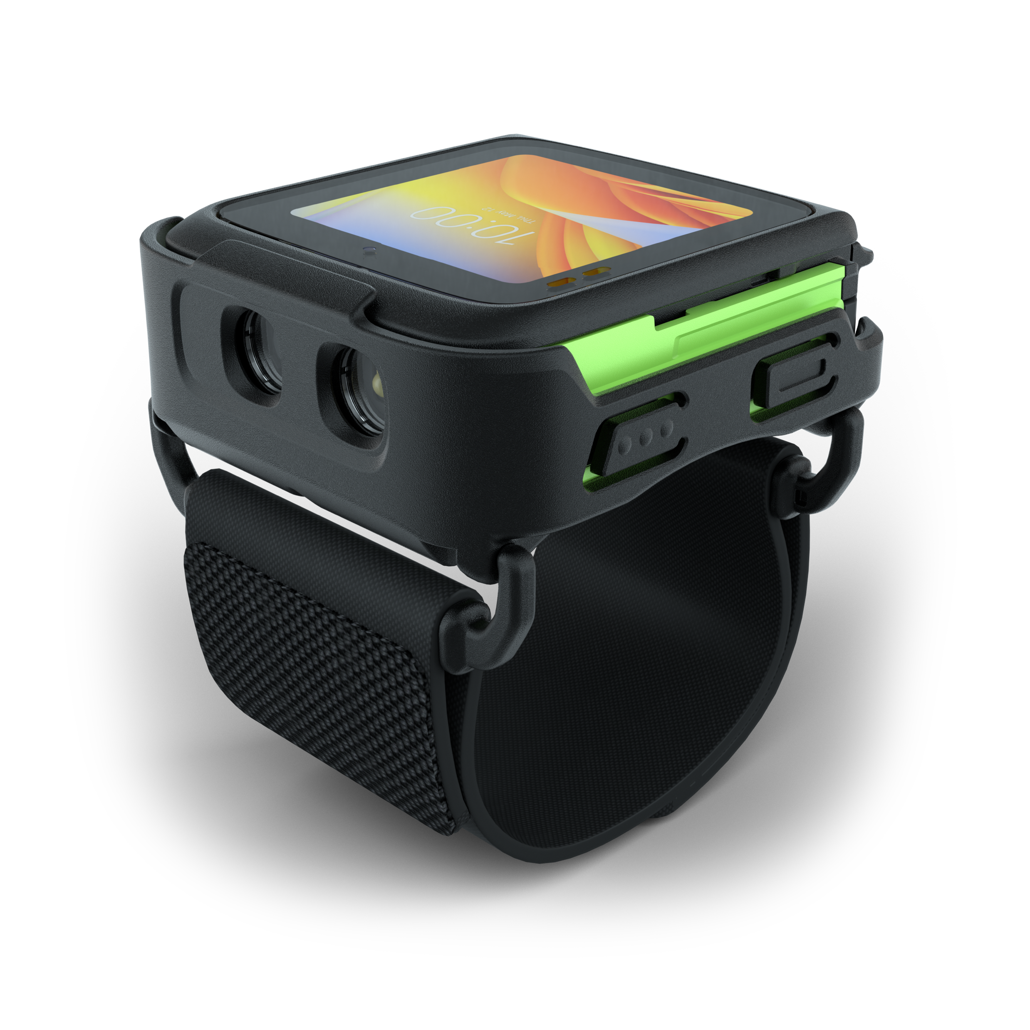
Product Tour

Slide 26
Spec Overview
WS50 Computing Core
ET80 / ET85
Ergonomics and UI
Display
2 in. AMOLED 460 x 460 color display
Optically bonded to touch panel
Touch Panel
Capacitive touch panel; fingertip and glove support; Corning® Gorilla® Glass
Dimensions
Wrist (device):
2.44 in. L x 2.32 in. W x 0.71 in. D
62 mm L x 59 mm W x 18 mm D
Wrist (with mount):
2.9 1in. L x 2.51 in. W x 0.751 in. D
74 mm L x 64 mm W x 19 mm D
Converged:
2.52 in. L x 2.44 in. W x 1.10 in. D
64 mm L x 62 mm W x 28 mm D
Weight
Wrist (device): 2.89 oz./82 g
Wrist (with mount): 3.77 oz./107 g
Converged: 4.48 oz./127 g
Buttons
Wrist: 4 buttons (programmable)
Converged: trigger; 2 buttons (programable)
Notifications
Audible tone; charge LED; OS Notification LED;
multi-color Application LEDs (2); haptic feedback
System
CPU
Qualcomm® Snapdragon Wear W4100+ Platform/SDA429w; quad-core, 2.0 GHz
Memory
1GB RAM / 8GB Flash
Operating System
Android 11 AOSP (non-GMS)
Software Platforming
Mobility DNA (specific tools)
DataWedge
Common SDK and Development Tools
EMMs for Android
Connectivity
Wi-Fi (WLAN)
IEEE 802.11 a/b/g/n/ac/d/h/i/r
Wi-Fi™ certified
IPv4, IPv6
1x1 SISO
Bluetooth (WPAN)
Bluetooth 4.2 with BLE, Class 1
NFC
Tap to Pair, ISO 14443 Type A and B, Felica
and ISO 15693 cards, and Card Emulation via Host (HCE) support
Durability
Drop Specifications
Wrist: 4 ft./1.2 m drop to concrete per MIL-STD 810G across operating temperature
Converged: 6 ft./1.8 m drop to tile over concrete per MIL-STD 810G across operating temperature
Tumble Specifications
Wrist: 1,000 tumbles @ 1.6 ft./0.5 m
Converged: 2,000 tumbles @ 1.6 ft./0.5 m
Meets and exceeds IEC tumble specifications
Sealing
IP65
Operating Temp.
14° F to 122° F/-10° C to +50° C
Data Capture
Scanning
SE4770: 1D/2D standard range omni-directional imager
Camera
13 MP with Flash
Battery
Rechargeable Li-Ion: 800 mAh, 1300mAh
Fast Charging Support (< 3Hrs)
Hot Swap (2min, memory persistent only)
Audio
Speaker (90dBA)
Internal microphone
PTT-ready
Bluetooth headset support
Sensor Technologies
Ambient Light Sensor
Motion Sensor
Proximity Sensor
Notes:
Need spec sheet

Slide 27
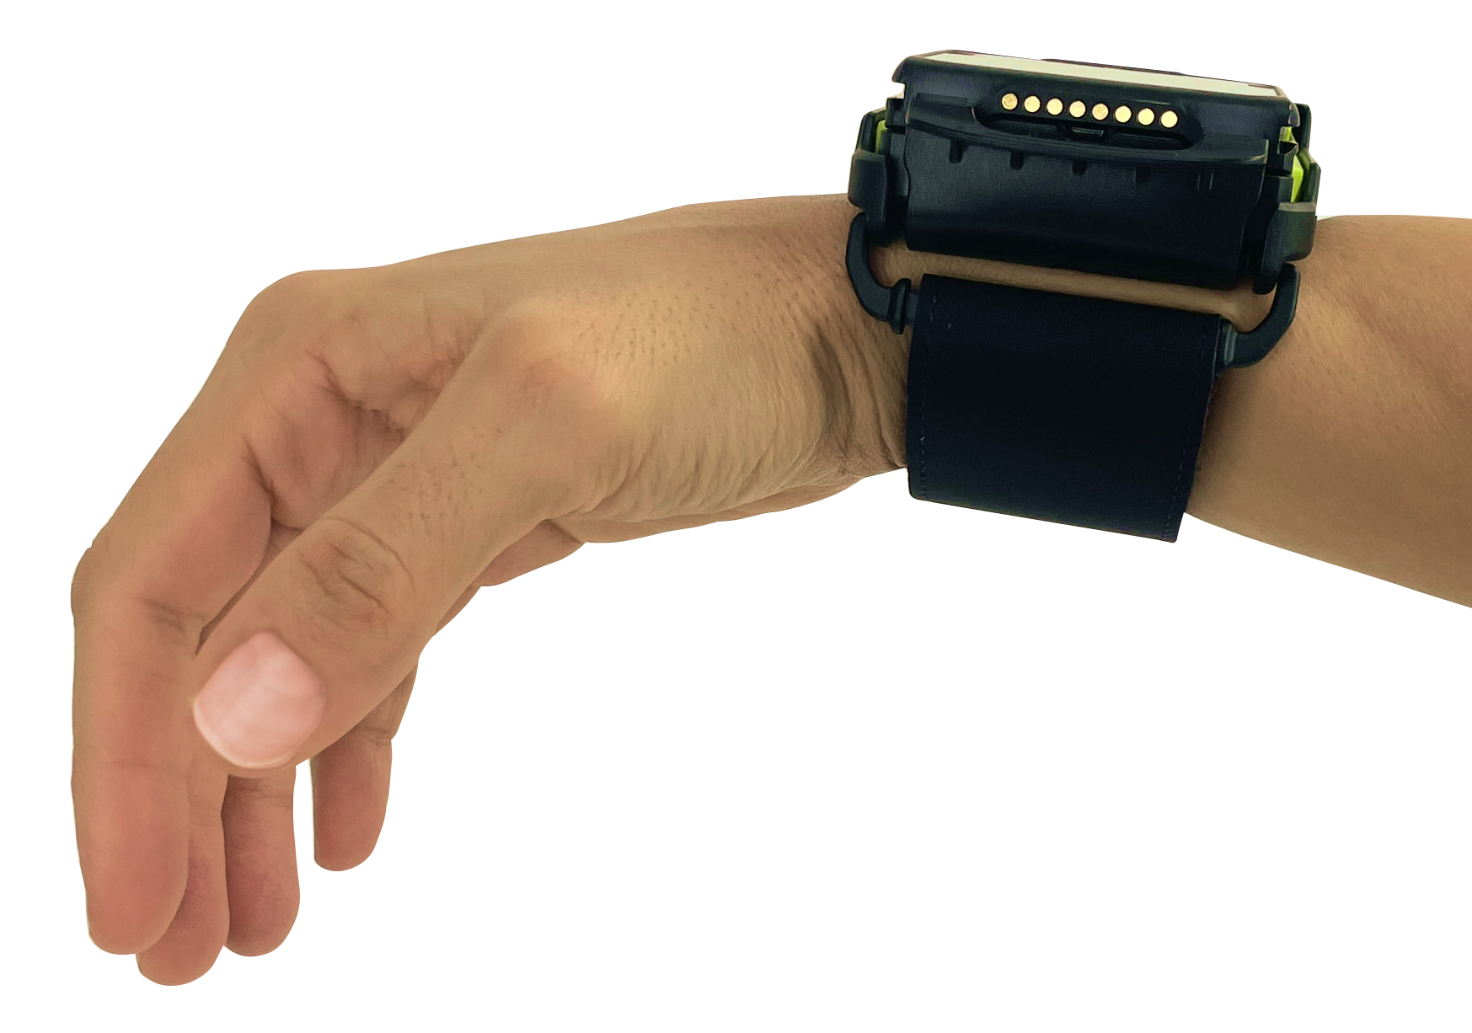
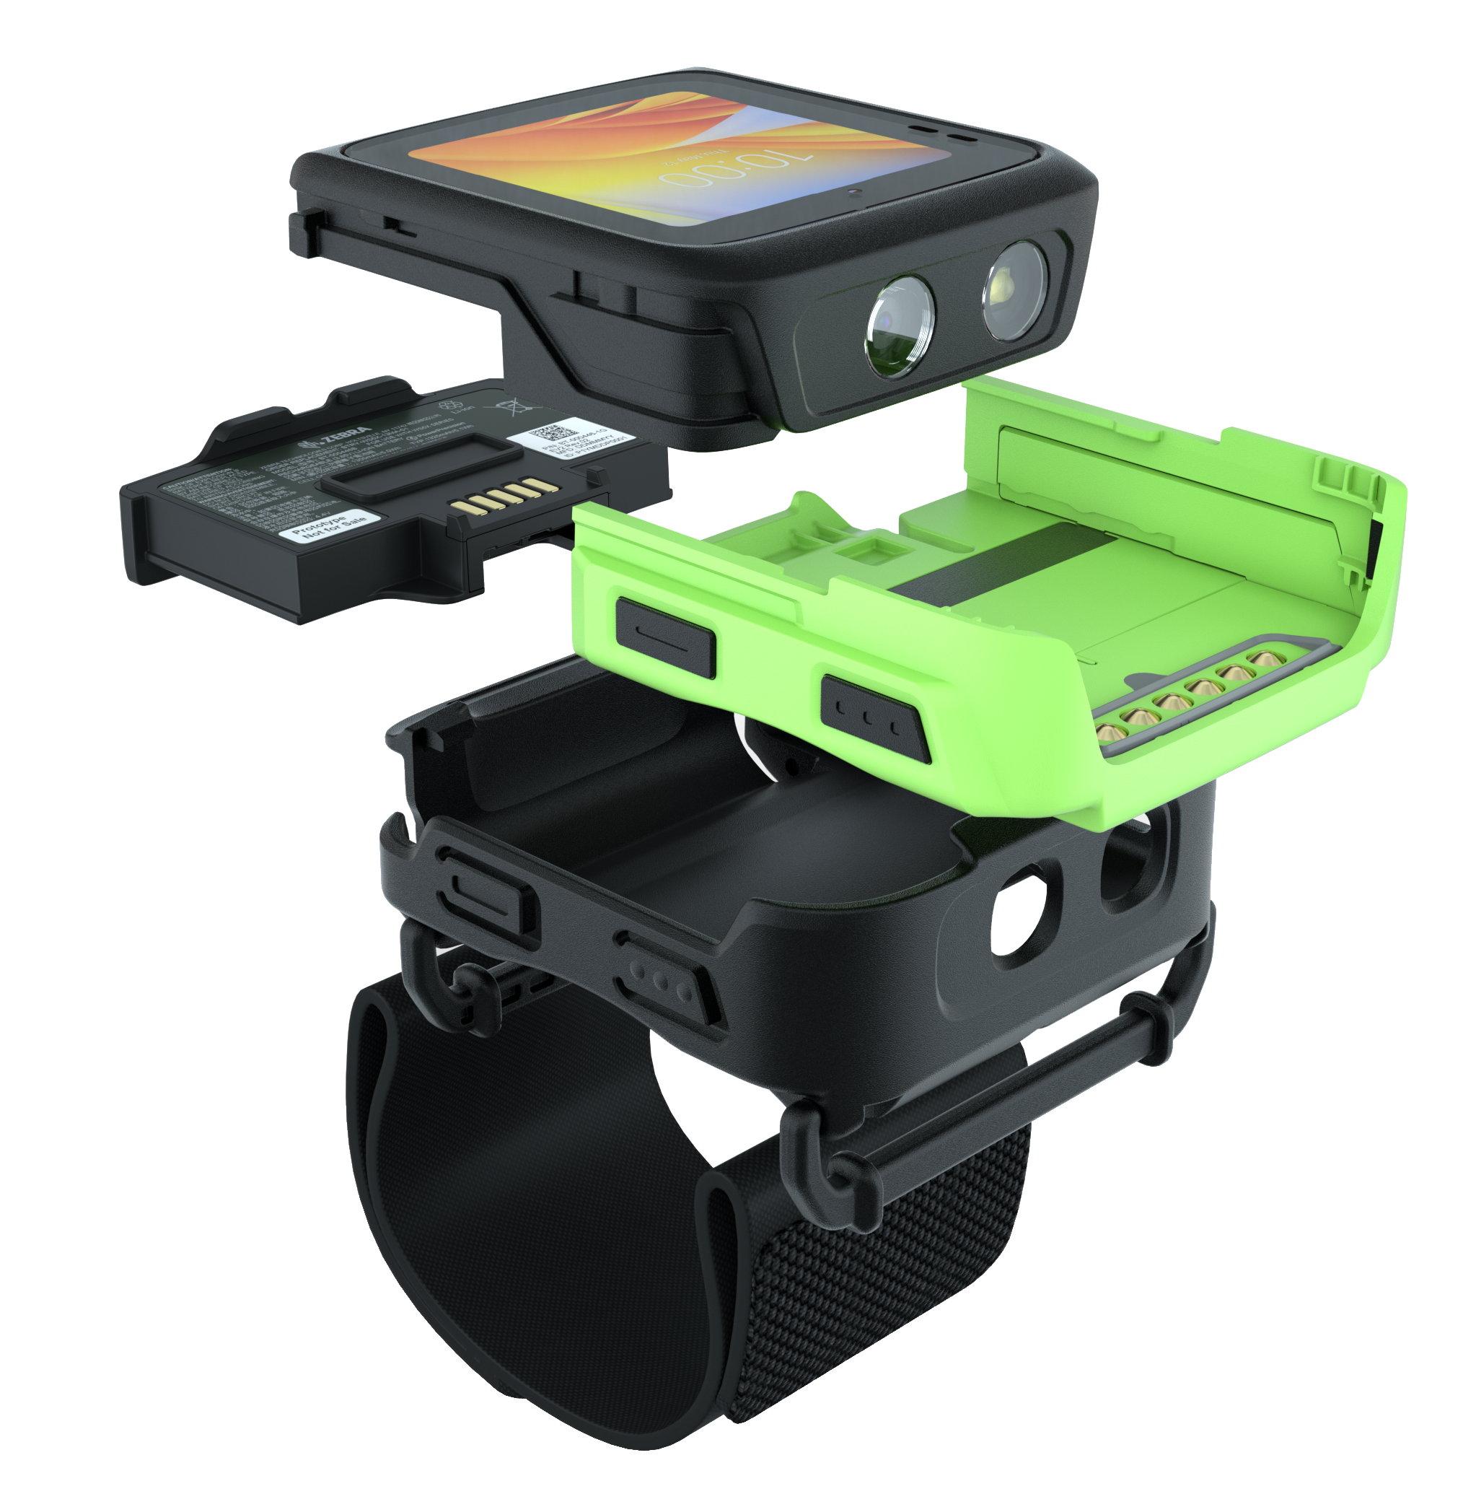
Product Tour
WS50 Wrist Mount
The WS50 Wrist Mount model is ideal for task management and communication in retail, hospitality and manufacturing.
Computing core with two-inch color AMOLED touch display and 13 MP camera
Battery 800mAh
Replaceable Protective Shell with four programable buttons
Wrist Mount
The WS50 Wrist Mount is worn comfortably on the arm
Wrist Strap

Slide 28
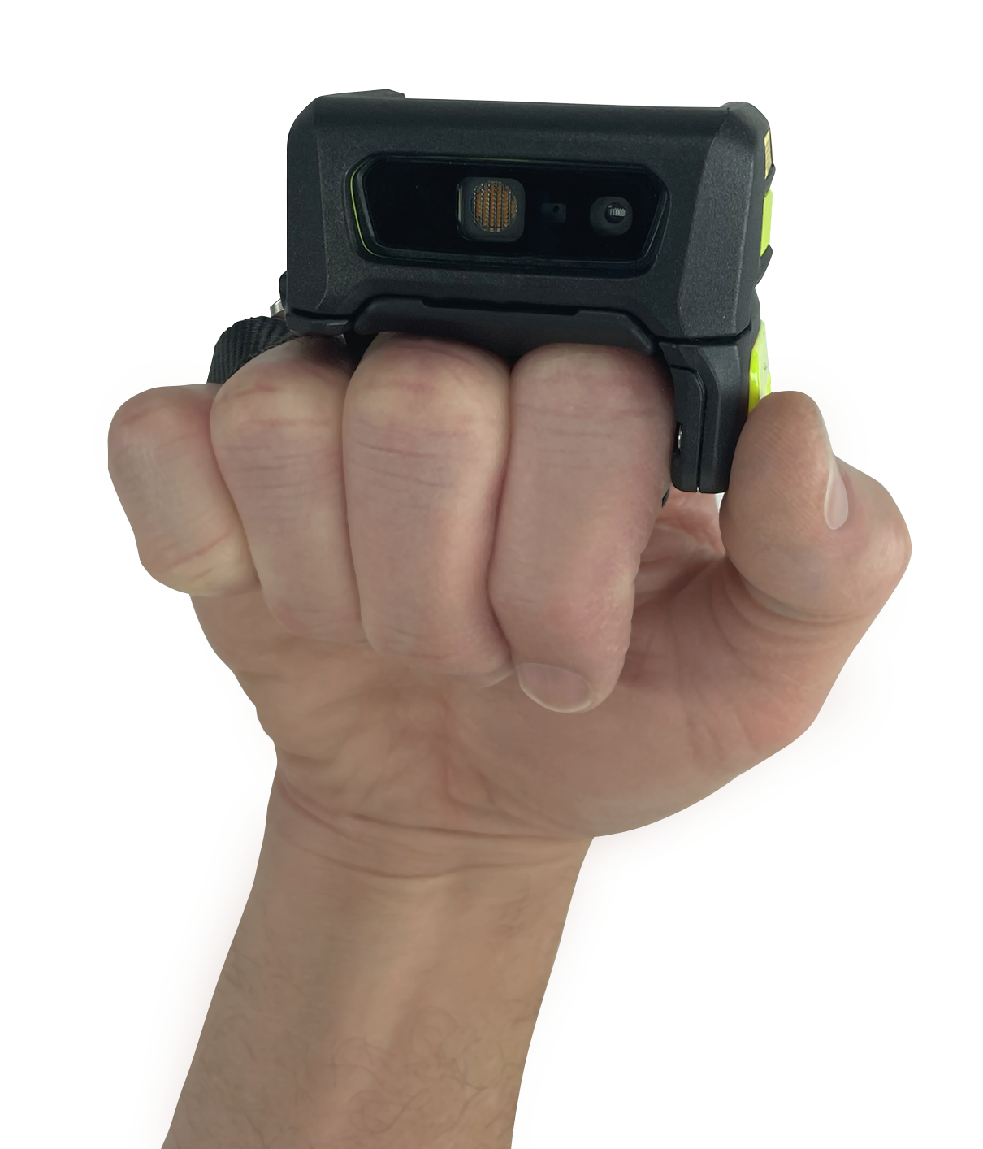
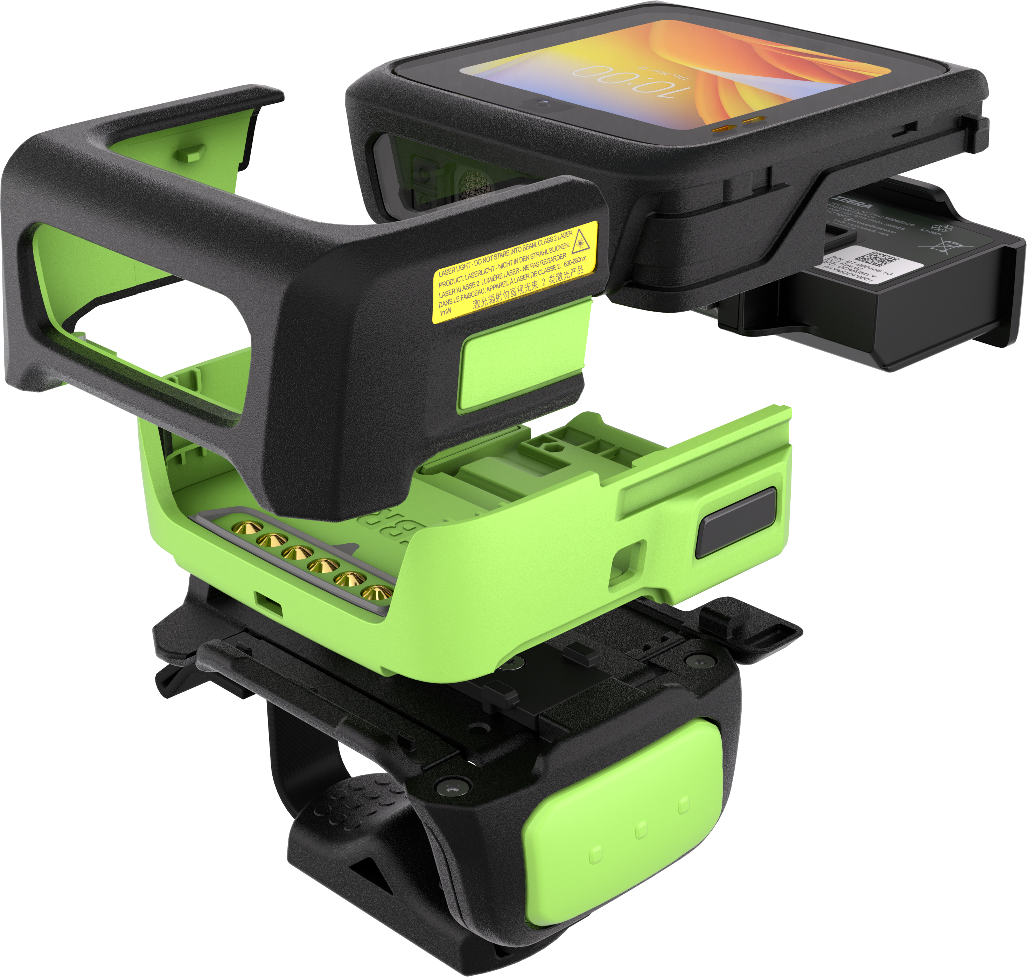

Product Tour
WS50 Converged (Two Finger and Back of Hand Mounts)
The WS50 Converged is ideal for scan-intensive applications
in the warehouse, T&L, manufacturing and retail.
The converged
all-in-one WS50
has a similar size and weight as Zebra’s RS507 ring scanner for
all-day comfort
Core with two-inch color AMOLED touch display and SE4770 scan engine
Deflector for impact protection
Battery 1300mAh
Replaceable Protective Shell with two programable buttons
The back of hand mount offers multiple sizes
to accommodate bare hands
and gloves,
right and left
hand mounting
Comfort Pad, Finger Strap, Finger Pad
Scan Trigger: replaceable,
remove and rotate trigger for left/right hand use
Two-Finger Mount

Slide 29
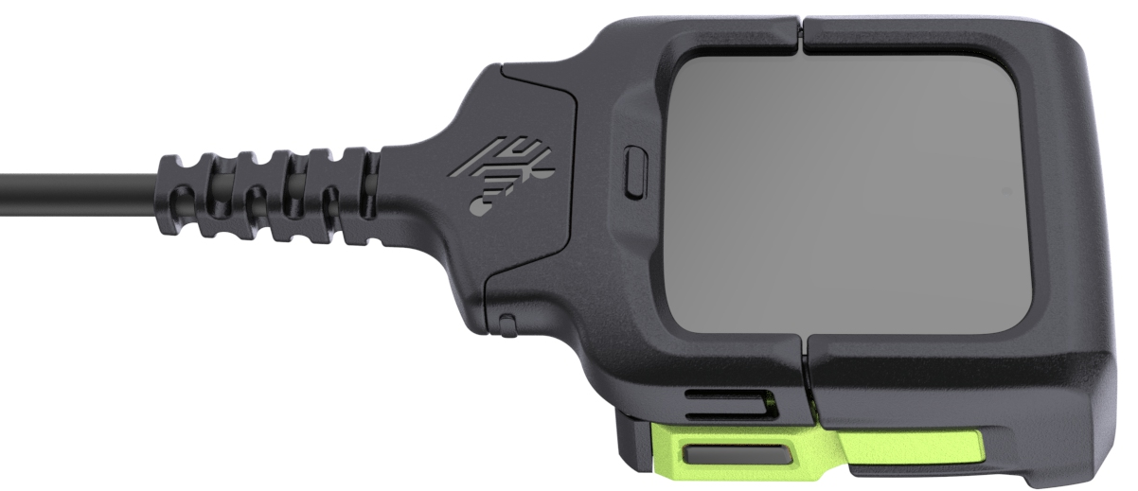
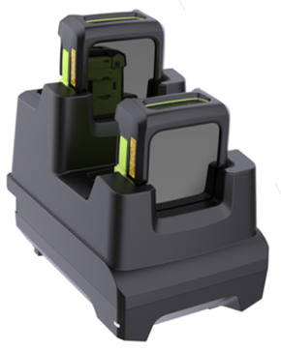
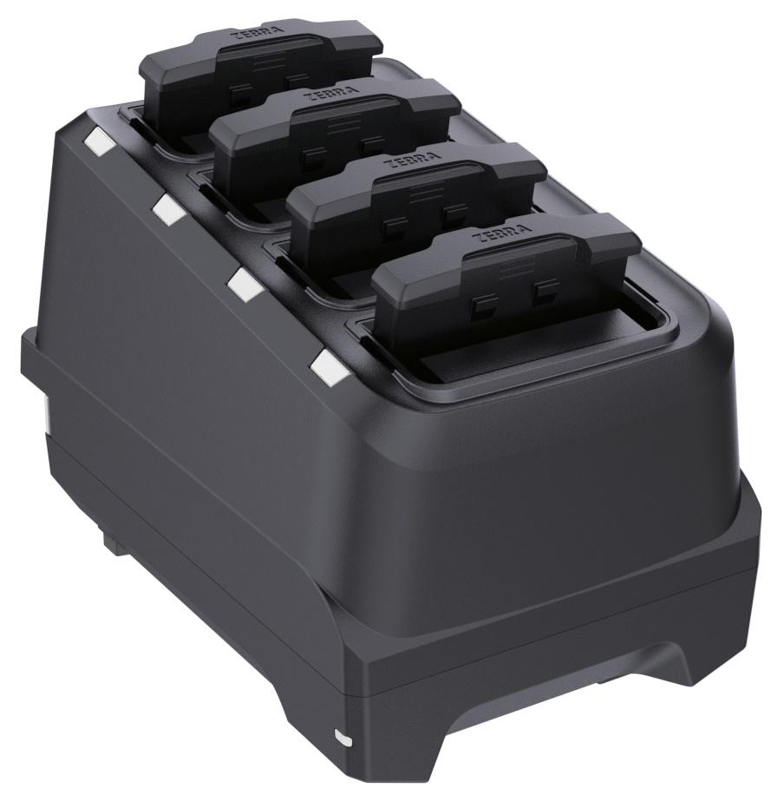
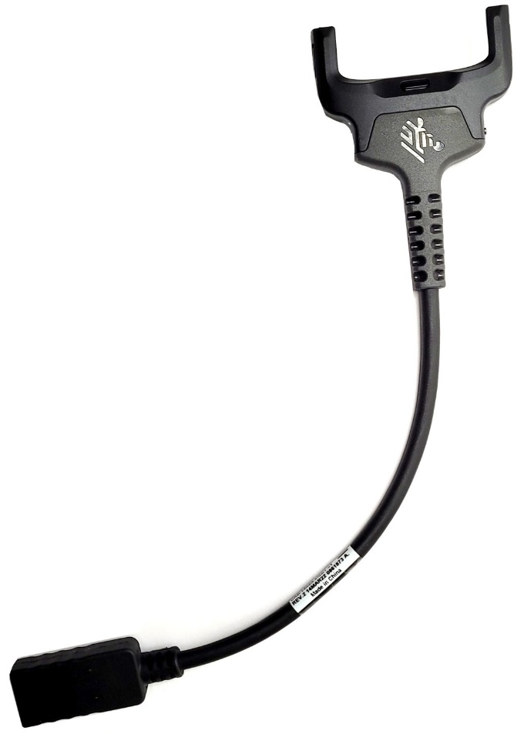
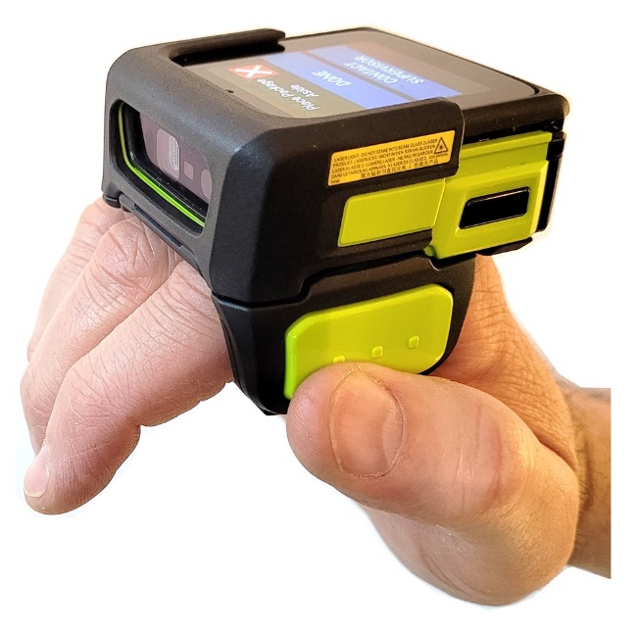
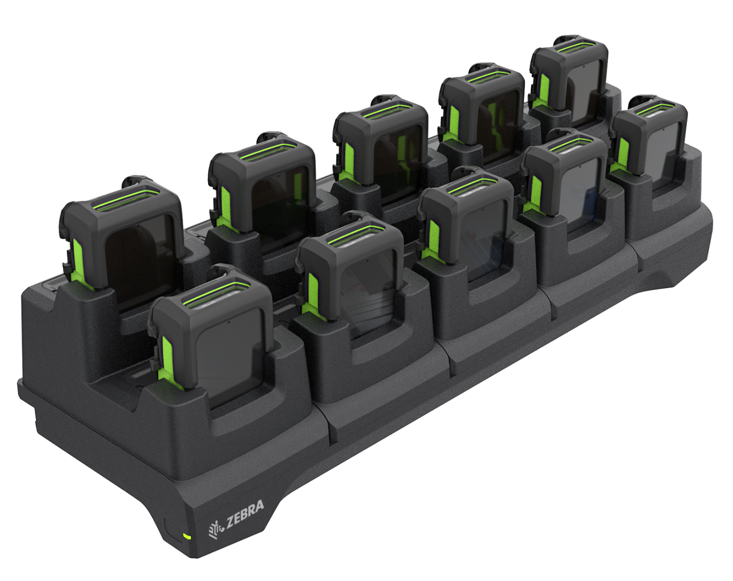
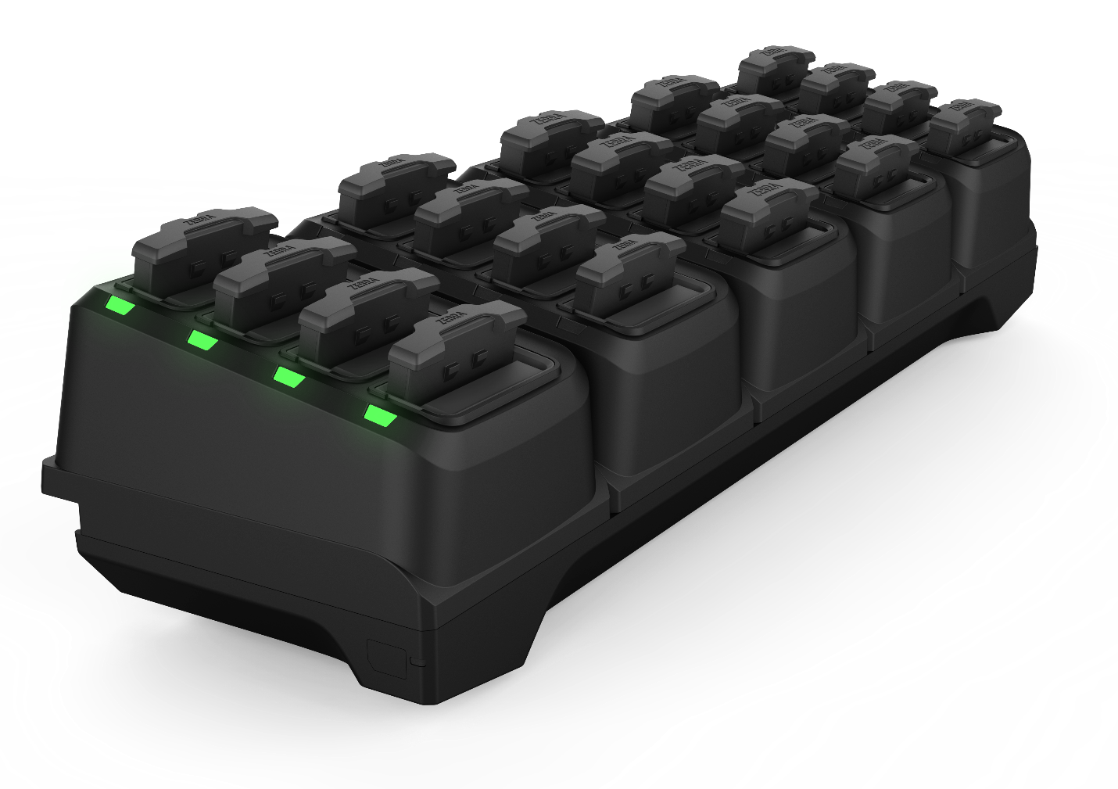
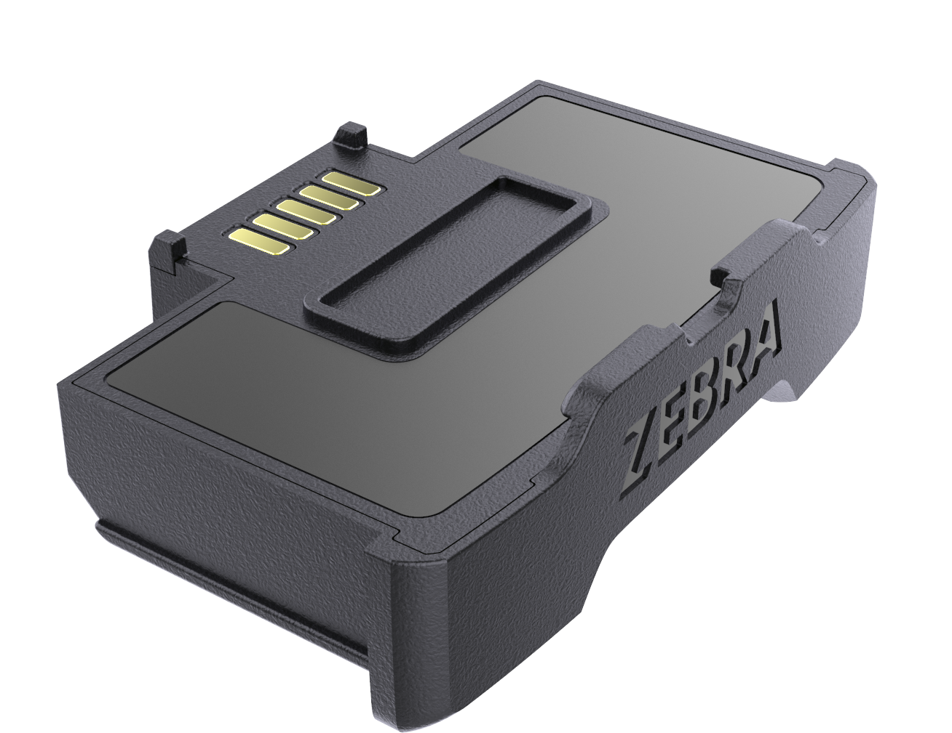
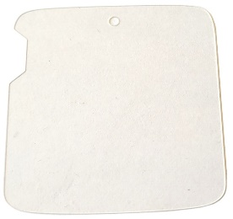
Accessories
WS50 Comprehensive Suite of Accessories
The right accessories make device management easy​
CHARGING/POWER OPTIONS
Mounting Options
Converged Two Finger Mount
Hand Strap
Wrist
Converged, Four Slot Spare Battery Charger
Two Slot Device Cradle
Charge
Cable
PROTECTIVE OPTIONS
10 Slot Device Cradle
20 Slot Spare Battery Charger
Spare 1300mAh Li-ion Battery
Screen Protector

Slide 30
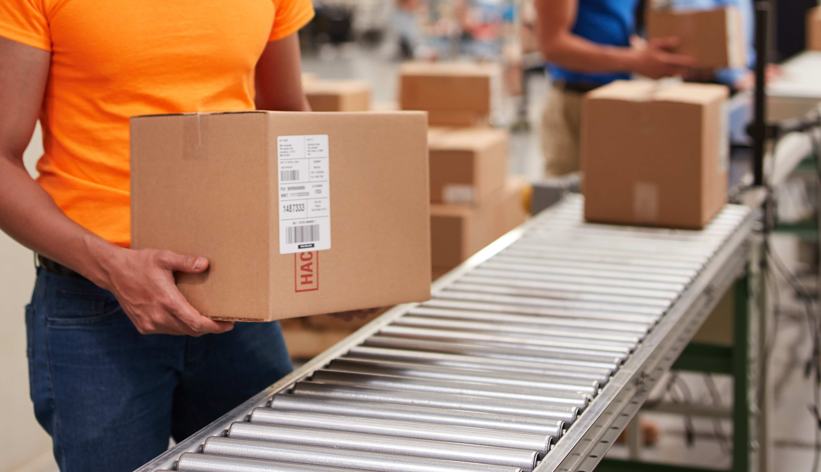
Mobility DNA
Your wearable computer’s built-in advantage

Slide 31

When you invest in a mobile device, you
need more than just great hardware — you need great software. And Zebra’s Mobility DNA delivers.
Mobility DNA offers secure solutions to help deploy, manage and support every stage of your devices’ lifecycle. Simplifying device lifecycle management and the user experience, Mobility DNA helps achieve and accelerate greater business outcomes, lowering total cost of ownership, helping to meet your unique business needs.
Mobility DNA
Your wearable computer’s
built-in advantage
31
31

Slide 32
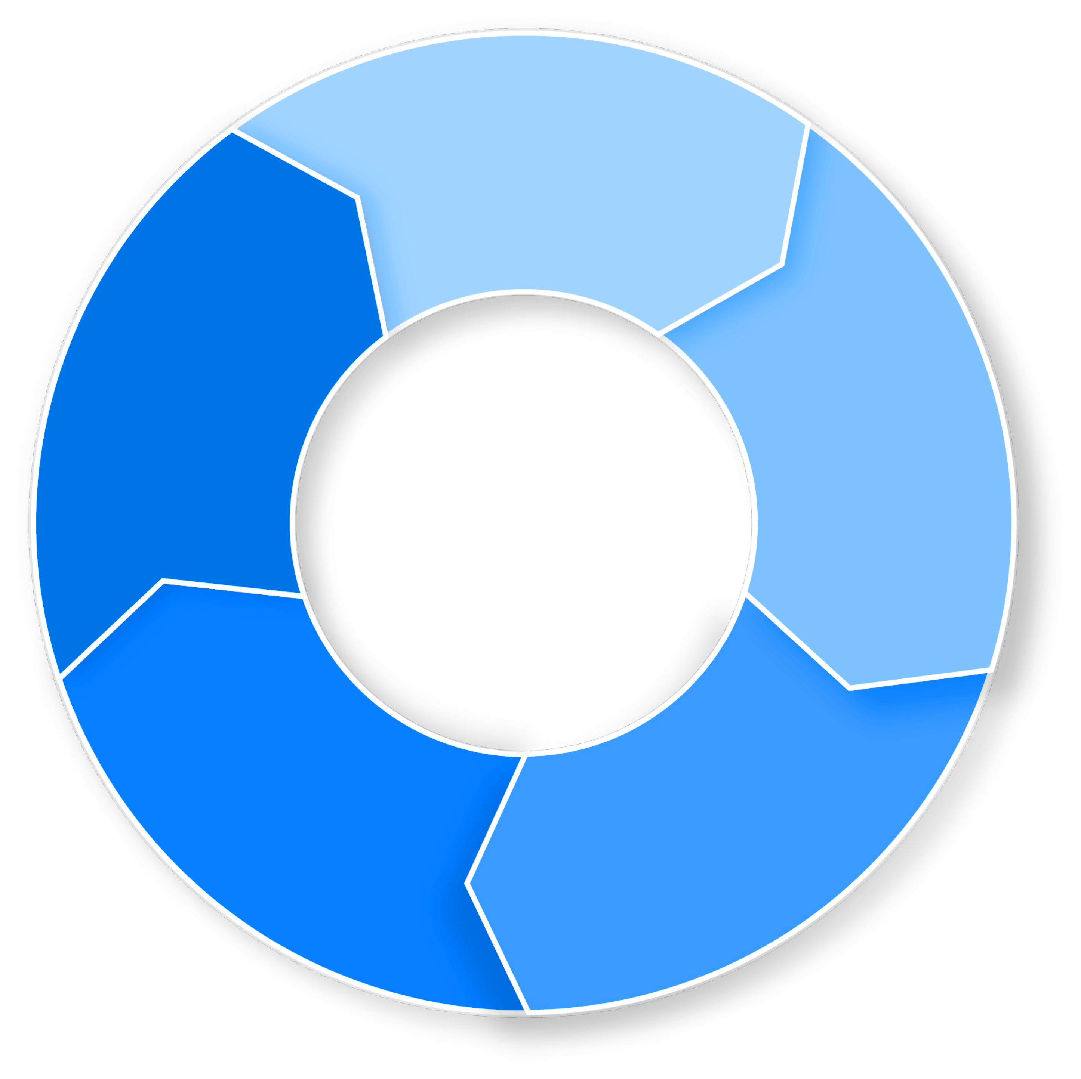





Zebra Mobility DNA
CIO, Developer Manager
(IT, ISV, SW vendor)
Your wearable computer’s built-in advantage
Integrate
Effortlessly integrate line of business applications to enhance the mobile user’s experience
Write it once; run it on multiple platforms
Add advanced enterprise features
Leverage Zebra APIs and sample code
Frontline Workers, Operations Manager, Site Supervisor, Associate Manager
Optimize
Increase the output of your workforce, driving greater job performance
Ensure reliable and consistent connectivity
Reduce disruptions and distractions
Increased end-user productivity
Integrate
Security Manager,
Database Admin
Secure
Greater device protection against a world of security threats, reducing your risk and extending the lifespan of your device
Get up to 10 years of timely, security updates
Control and schedule device updates to meet your business requirements
Prevent operational disruptions and protect workforce productivity by customizing user views/access on device
Optimize
Mobility
DNA
Secure
DevOps, Network Admin,
Support Technician
Manage
Greater visibility and reduced complexity of managing your devices lifecycle, minimizing downtime and lowering your Total Cost of Ownership (TCO)
Centrally manage devices in multiple locations
Features to take advantage of Zebra device capabilities
Resolve software and network issues faster
DevOps, Network Admin
Manage
Deploy
Rapidly stage devices to earn the benefits of your investment sooner
Automate staging and enrollment
Flexible staging options (scan, NFC, USB, etc.)
Provision devices for different network environments
Deploy
32
Notes:
With Zebra Mobility DNA, you’re empowered from the start with built-in applications, utilities and tools that maximize your device performance from integration, security and deployment for easier management and optimization.

Slide 33



Zebra Mobility DNA
Your wearable computer’s built-in advantage
Integrate
  DataWedge
  Easily create custom profiles enabling faster data capture needs across workflows
  Enterprise Mobility Development Tool Kit
  Take full advantage of your device’s capabilities
Deploy
  StageNow
  Stage thousands of devices with a scan of a barcode or a tap of an NFC tag
Manage
  Device Diagnostics
  Test major systems and help eliminate costly, unnecessary repair
  depot trips
  Mobility Extensions (Mx)
  Add extra layers of features and services crucial to protecting business data and network access
  Wireless
  Ensure a dependable and superior Wi-Fi experience
Secure
  LifeGuard™️ for Android™️
  Extend OS security support for up to 10 years
  Enterprise Home Screen
  Specify apps users can access, disable device features and
  automatically launch apps

Slide 34

Zebra Services

Slide 35

Zebra OneCare™ Maintenance Plans
Choose the Plan that Meets Your Business Urgency
You count on your wearable mobile computers in your most demanding environments and applications. Ensure predictable performance, support for critical operations and improved business outcomes while eliminating unbudgeted repair expenses.
Feature | Zebra OneCare Essential Core assurance | Zebra OneCare Select Maximum protection
Live-agent support | Mon–Fri, 8–5 local time | 24/7
Repair turnaround time | 3-day repair turnarounds | ‘Like-new” replacement device ships for next business day delivery
Accidental damage covered
OS software updates
LifeGuard™ for Android™ security updates
Cloud-based visibility into repair, case reports and more with VisibilityIQ OneCare
Spares pool management
Commissioning Service | Option to include Standard or Advanced Commissioning | Standard Commissioning included, option to add Advanced Commissioning
BENEFITS
Enhanced support beyond standard
warranty coverage
Genuine Zebra expertise and parts maximize device uptime – ensure your device is back to Zebra’s manufacturing specifications
Outstanding value – eliminates unexpected repair costs with a planned maintenance plan
Let Zebra handle support,
while you focus on your strategic initiatives
✓
✓
✓
✓
✓
✓
✓
✓
✓

Slide 36

Zebra OneCare™ Enhancements
Flexible enhancements to fit your business needs.
Tailor your plan even further by planning for battery replacements, expediting logistics and shipping
and commissioning devices with the right software and application versions.
  Battery Services
Battery Maintenance - Tests batteries and replaces those that cannot reach a minimum 80% charge during testing
Battery Refresh - Consolidated shipment of replacement batteries at a predetermined time: month 18 for a 3-year plan; months 18 and 36 for a 5-year plan
  Enhanced Shipping Logistics
Expedited Collections Option - pre-paid shipping labels and to schedule carrier pick up using the Zebra RMA portal
Expedited 2-Way Shipping Option - Express shipping of devices into Zebra’s Repair Center and provides Express return shipping of the repaired devices from Zebra’s Service Center back to the Customer
  Commissioning Services
Standard Commissioning Service provides an “out of box, ready to use” experience with the repaired or replaced device pre-loaded with OS version, customer SW, applications and configurations
Advanced Commissioning addresses more complex operational and configuration requirements over and above what is provided with Standard Commissioning
  VisibilityIQ™ Foresight
This business intelligence service transforms device data into actionable insights in a single, cloud- based, color-coded view. Available whether for use with an EMM or without.
Predictive intelligence helps operational staff anticipate recurring events and catch potential problems before they affect the bottom line
Realize increased workforce productivity, operational efficiency and ROI by optimizing device availability and maximizing asset utilization

Slide 37
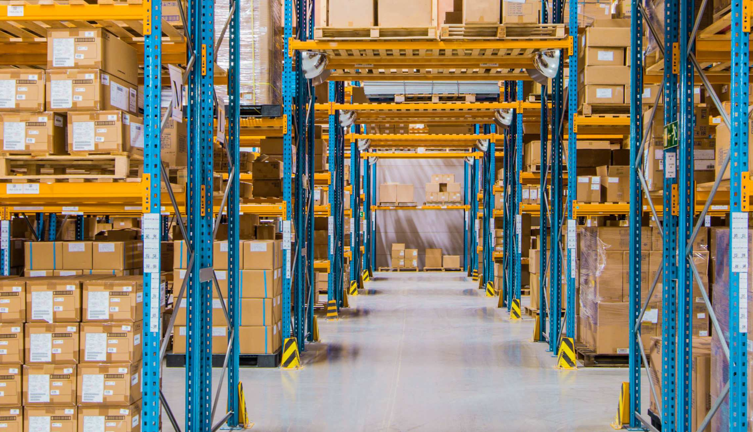

Thank you!
For more information, visit, www.zebra.com/ws50
ZEBRA and the stylized Zebra head are trademarks of Zebra Technologies Corp., registered in many jurisdictions worldwide. All other trademarks are the property of their respective owners. ©2022 Zebra Technologies Corp. and/or its affiliates. All rights reserved.

